Slide 1
Fiscal Year 2019 Proposed Operating and Capital Budget
POLICE DEPARTMENT

Slide 2
Police Budget Overview
Fiscal Year | Budget | Positions
2018 | $4,984,931 | 52
2019 | $4,930,756 | 52 (50 mid-year due to retirements)

Slide 3
Police Organization
Chief
Administration Captain
Operations Captain
Community Policing
Professional Standards
Patrol
Investigations

Slide 4
Organization Changes
Restructure to a two Captain Administration System and remove the Major Position as of July 1, 2018.
Remove two positions upon the retirement of a Sergeant and a Patrolman First Class on September 1, 2018. This will drop # of sworn officers from 48 to 46.
Remove the First Sergeant designation and move that Sergeant back to fill Sgt Hurley’s position on September 1, 2018.

Slide 5
FY 18 Accomplishments
Connected with the community through meetings, print, radio, television and social media.
Improved fiscal responsibility – purchasing, grants and military surplus.
Strengthened relationships with regional law enforcement and social service organizations.
Completed the Greenwood Ave Camera project.
Updated Departments Policies to National Accreditation Standards.
Implemented the Police Explorer Program.

Slide 6
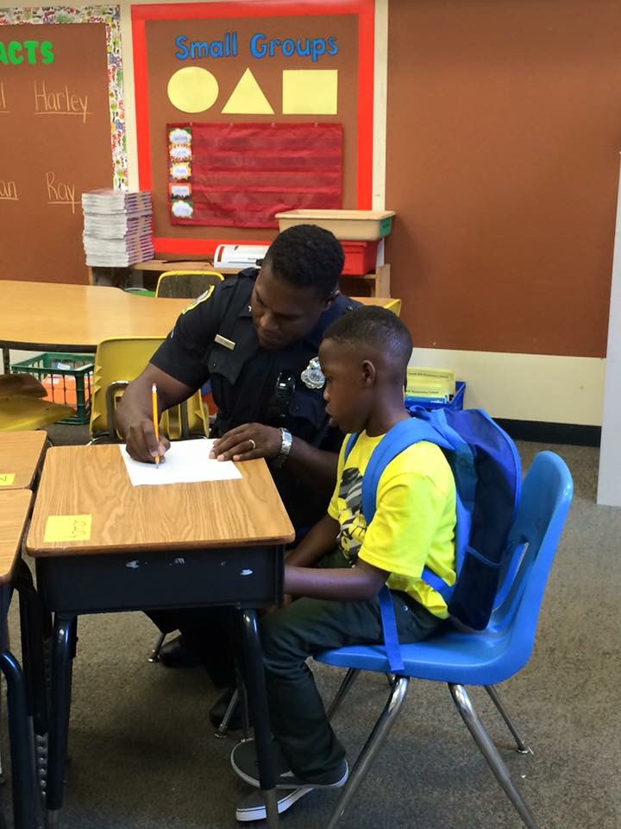
FY 18 Challenges
Reduce crime;
Develop our youth so they have a vision for the future (DARE and Police Explorer Program);
Recruit and retain officers who
will help the department mirror
our city’s diversity.

Slide 7
POLICE
Office of
Police Chief

Slide 8
Key Descriptors
Provide guidance and support for overall police operations.
Manage department personnel, equipment, budgeting, training, and policies.
The community-oriented police officers (COPs) play a significant role within the community. Their focus is building partnerships between community leaders and residents to create solutions using police resources.

Slide 9
Division Budget Overview
Fiscal Year | Budget | Positions
2018 | $898,519 | 9
2019 | $875,606 | 8
Deputy Chief position eliminated

Slide 10
Performance Measures - Selected
Measures | 2018 | 2019
Provide Officer Training (900 Minimum hours required) | 9777 | 10,000
Improve Officer deployment by using crime mapping software Lexis-Nexis | NA | 52 **Weekly**
Form neighborhood groups (Neighborhood Watch or Associations) | 4 | 4
Lower Violent Crime Rate | -30% | -2%
Explore the College Tuition Program | NA | 5 officers

Slide 11
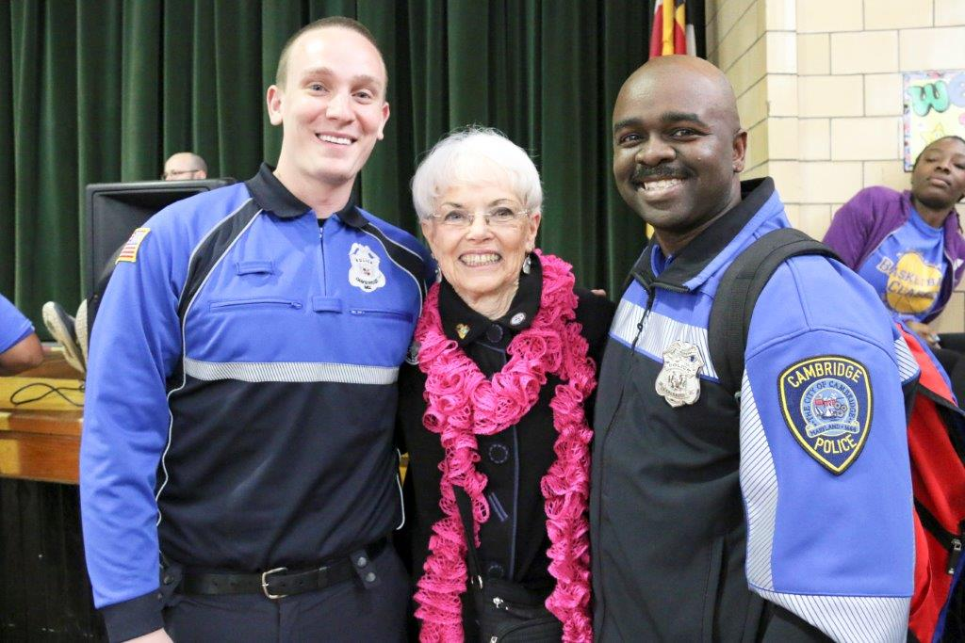
FY 19 Goals – Selected
Lower Violent Crime rate by an additional 2%.
Exceed MPTC mandatory training requirements.
Expand community visibility and outreach through residential patrols, community meetings, events and social media.
Explore additional grant funding.
Expand the City’s video camera program
Continue the Police Explorer Program.
Expand on recruitment and retention.
Explore College tuition program.

Slide 12
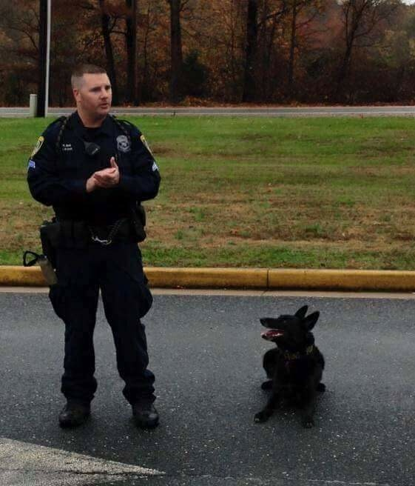
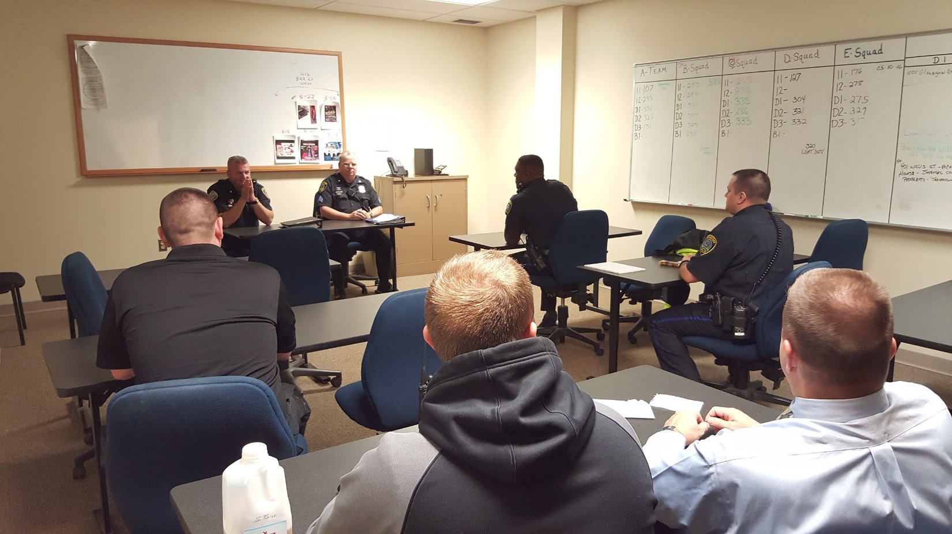
POLICE
PATROL

Slide 13
Key Descriptors
Patrol officers respond to calls for service
Five Patrols Squads comprised of
- Sergeant (Shift Supervisor)
- Corporal (Assistant Supervisor)
- Three to Four Patrol Officers
Supervisors have Extra duties like fleet maintenance, armorer, quartermaster
All officers are trained in first aid and Narcan
Two K-9 officers respond to assist officers on traffic stops and search warrants, and are frequently requested by other agencies
Body worn cameras are utilized by each officer

Slide 14
Division Budget Overview
Fiscal Year | Budget | Positions
2018 | $3,486,558 | 36/1
2019 | $3,389,022 | 36/1 (1st half) 34/1 (2nd half)
Two officers positions not replaced when retire

Slide 15
Performance Measures - Selected
Measures | 2018 | 2019
Number of downtown foot/bike patrols | 758 | 900
Reduce crime in downtown business district | -20% | -5%
Community meetings attended by neighborhood beat officers | 160 | 130
Directed traffic enforcement conducted based upon crash data | 100 | 100

Slide 16
FY 19 Goals – Selected
Reduce Crime through proactive patrols and omnipresence.
Institute additional Neighborhood Watch Program to build a relationship with residents and identify quality of life issues.
Improve pedestrian and vehicle safety through crash analysis and directed enforcement.
Utilize crime analysis software for analyzing criminal activity and effective deployment of resources.

Slide 17
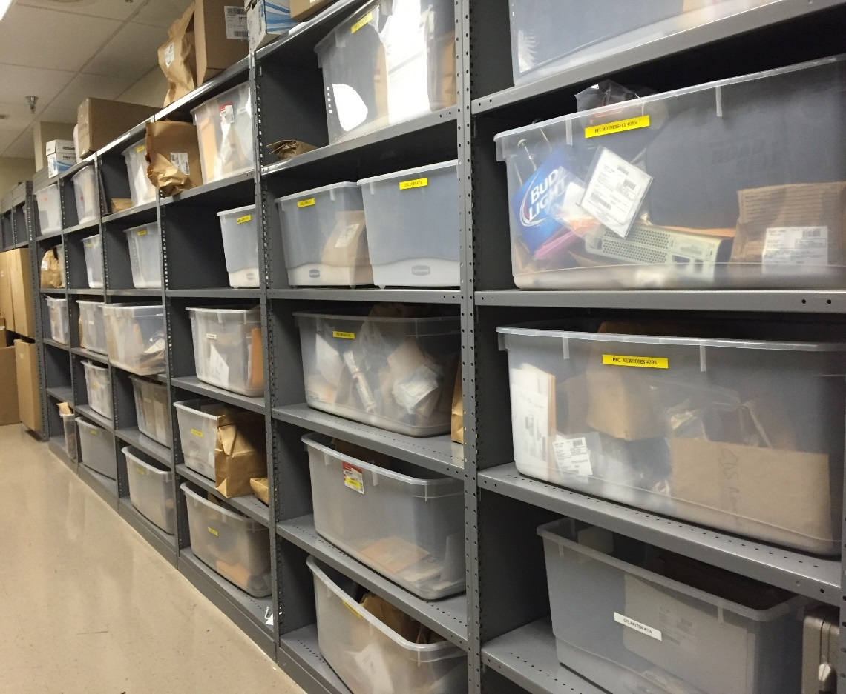
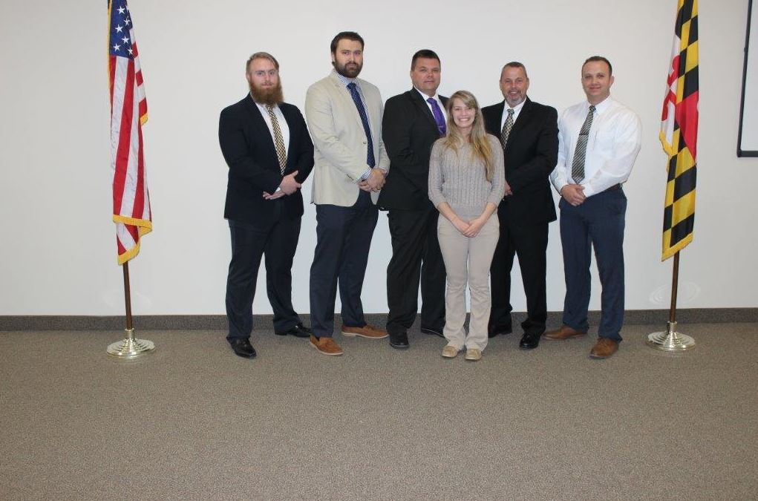
POLICE
Special Operations

Slide 18
Key Descriptors
Two narcotics detectives work on street-level activity and a third is assigned to the Dorchester County Narcotics Task Force.
Criminal and narcotics investigations.
Conduct background investigations for police applicants.
Prepare cases for trial with the State’s Attorney.
Conduct polygraph examinations for city employees and other police departments.
Conduct crime scene investigations, maintain evidence room, send evidence to state lab and prepare evidence and reports for court.

Slide 19
Division Budget Overview
Fiscal Year | Budget | Positions
2018 | $697,390 | 8
2019 | $717,653 | 8

Slide 20
Performance Measures - Selected
Measures | 2018 | 2019
High case closure rate for violent crime | 72% | 70%
Achieve a high warrant approval rate | 100% | 90%
Number Safe Streets grant operations targeting narcotics, prostitution, gangs | 20 | 12
Expand Operations of our Flex Team (Anti-Crime Team) | NA | 360

Slide 21
FY 19 Goals – Selected
Improve communication with State’s Attorney’s Office to ensure successful warrant approval and prosecution.
Improve evidence analysis and control with a civilian property and evidence technician.
Attempt to secure additional Safe Streets funding through the Governors Office.
Expand Specialized Training for Investigators.

Slide 22
POLICE DEPARTMENT
Over the past year the Police Dept. has begun to rebuild and restructure. We have placed an emphasize on enhanced training and positive community interaction. We will continue to work with the community to address quality of life issues in order to make Cambridge a better place to live and work.

Slide 23
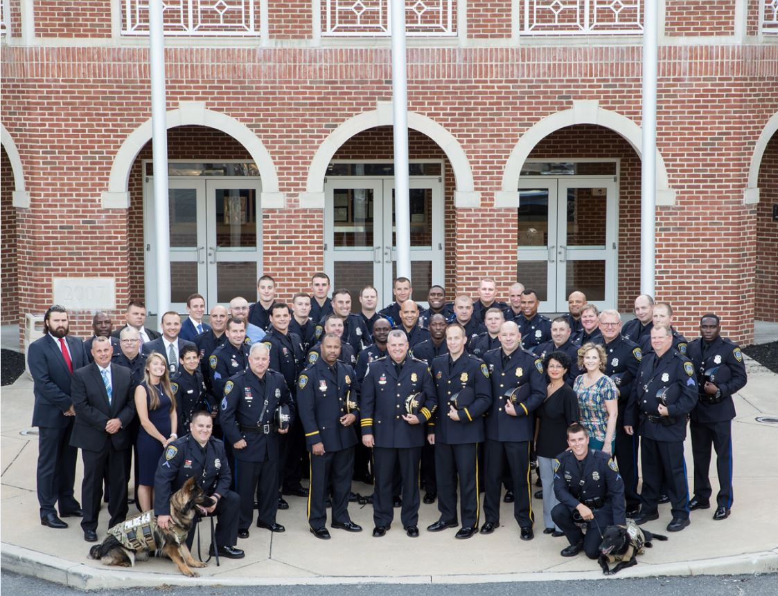
Thank you

Slide 24
Fiscal Year 2019 Proposed Operating and Capital Budget
Rescue Fire Company

Slide 25
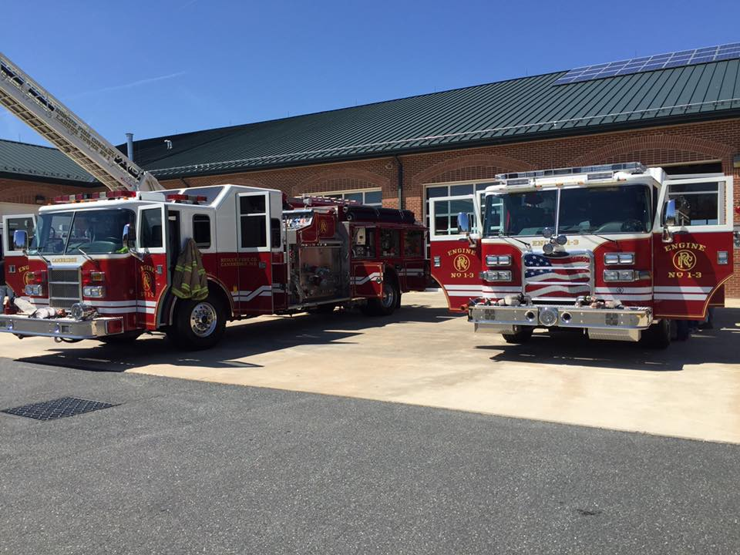
Rescue Fire Company
Operations

Slide 26
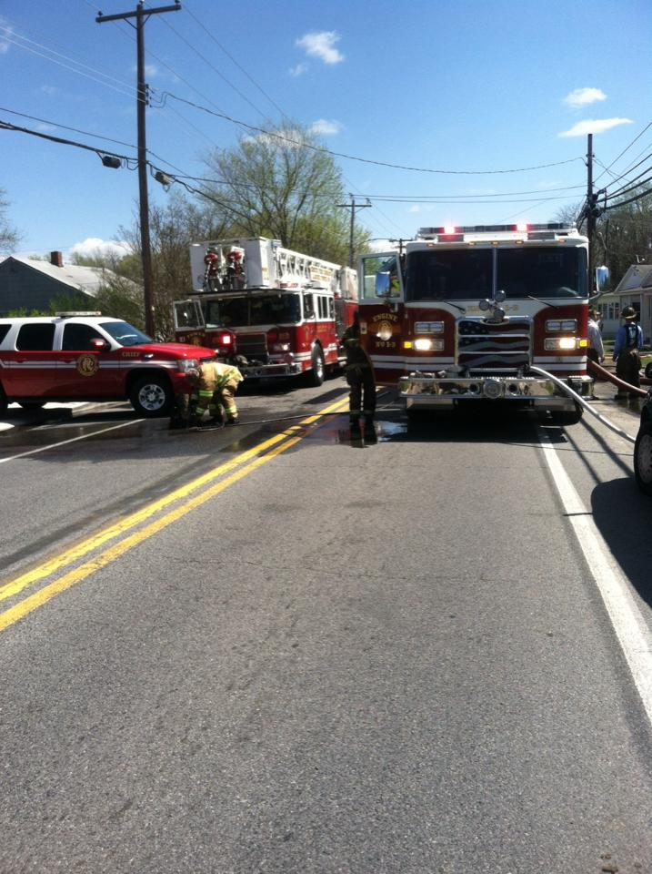
Organization
Fire Chief
Assistant Chiefs
Volunteers

Slide 27
Department Budget Overview
Fiscal Year | Budget | Positions
2018 | $620,539 | [none]
2019 | $620,539 | [none]

Slide 28
Key Descriptors
Rescue Fire Company established in 1882
All volunteer organization – 51 active members
1st due for 40 square miles area with 14,000 population

Slide 29
Performance Measures - Selected
Measures | 2018 (est.) | 2019
Total Responses | 995 | 1,050
Reported Structure Fires | 90 | 100
Training Classes attended | 380 | 450
Total Staff Hours | 24,000 | 25,000

Slide 30
FY 18 Accomplishments - Selected
Placed tablets in all fire apparatus for use with Active 911 and other apps.
Implemented Active 911.
Applied for Grant to replace Tower Truck.
Provided savings in training program by receiving scholarships.

Slide 31
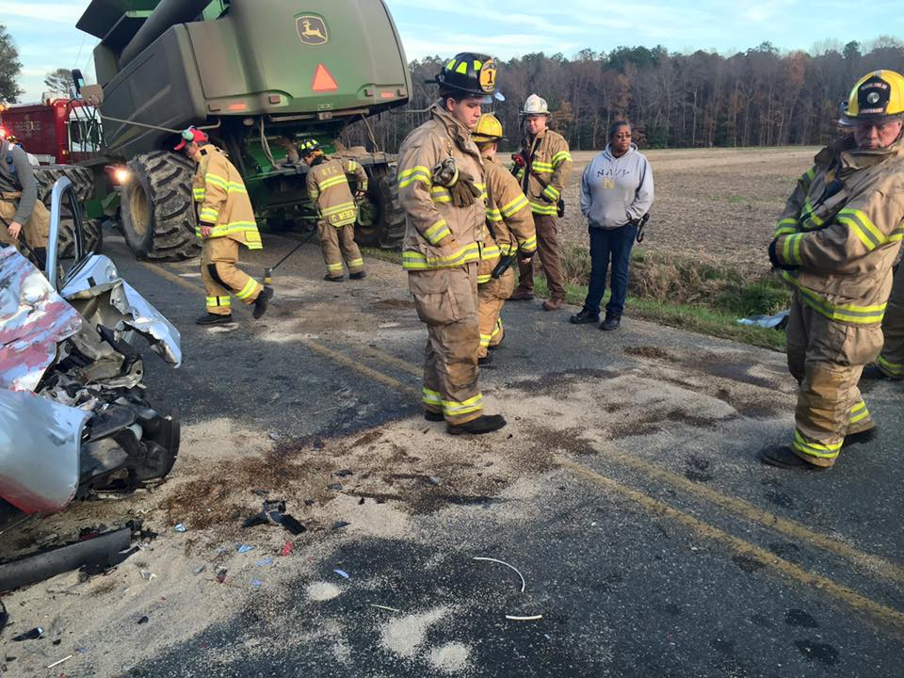

Slide 32
FY19 Significant Goals – Selected
Work with County 911 in integrating new CAD system with the Active 911 system.
Continue to improve on recruitment and retention of active membership.
Receive AFG grant and finalize contract to replace Tower Truck.

Slide 33
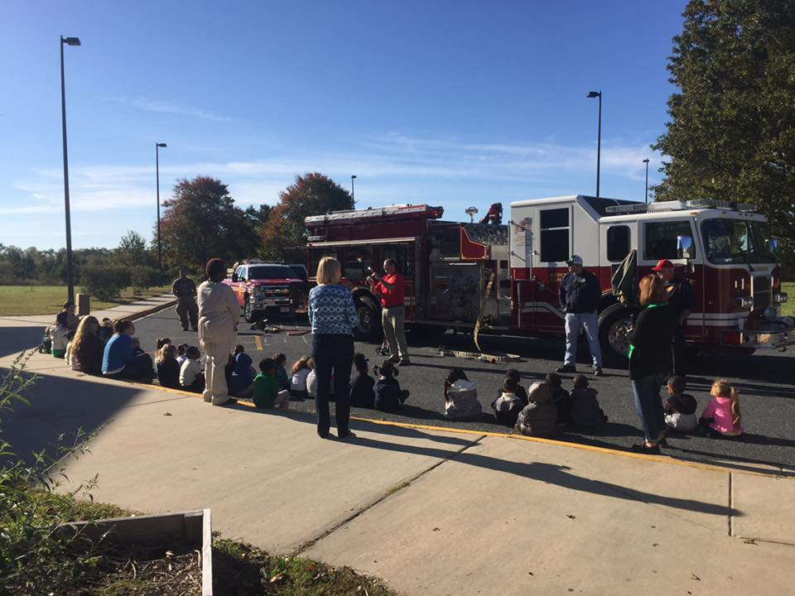
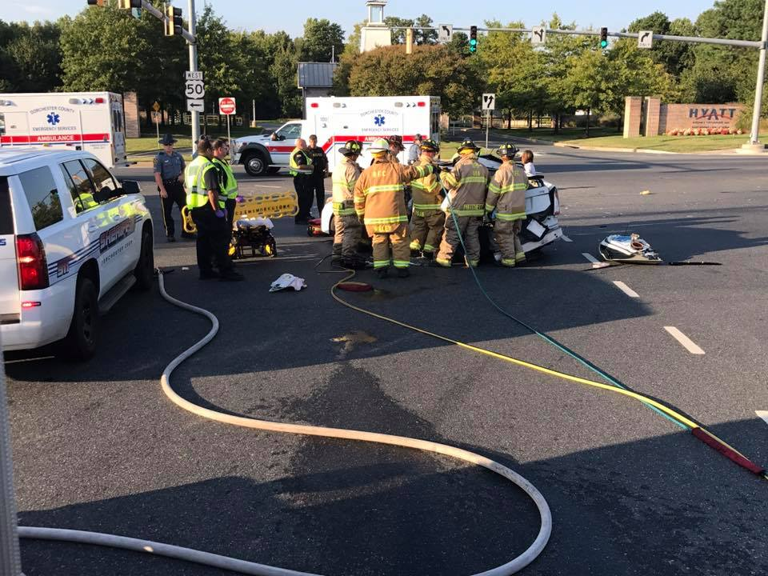
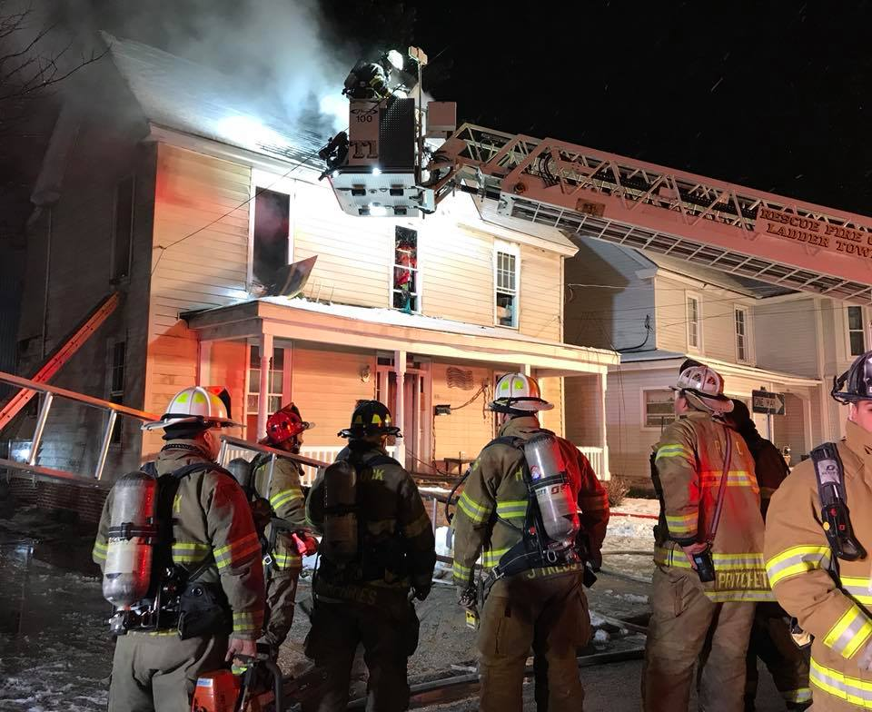
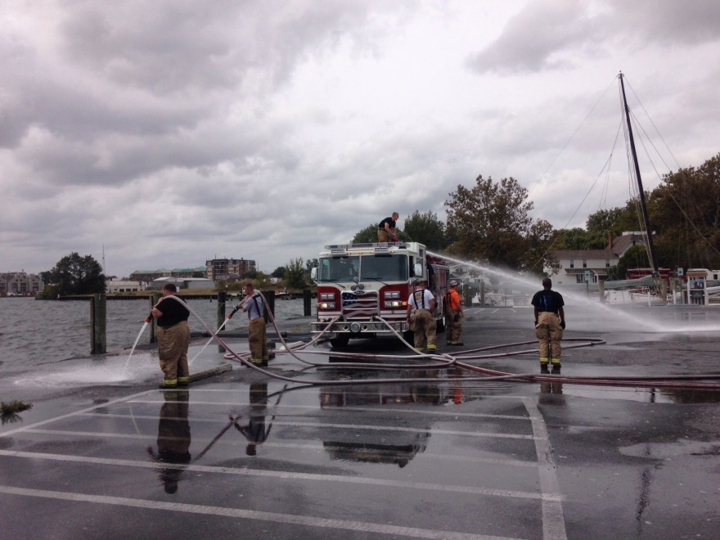
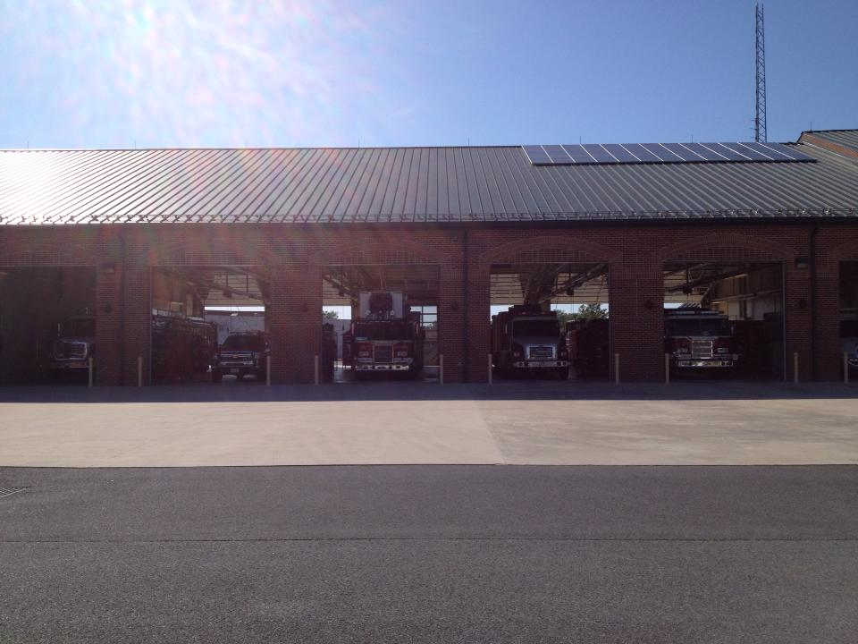
Thank you!

Slide 34
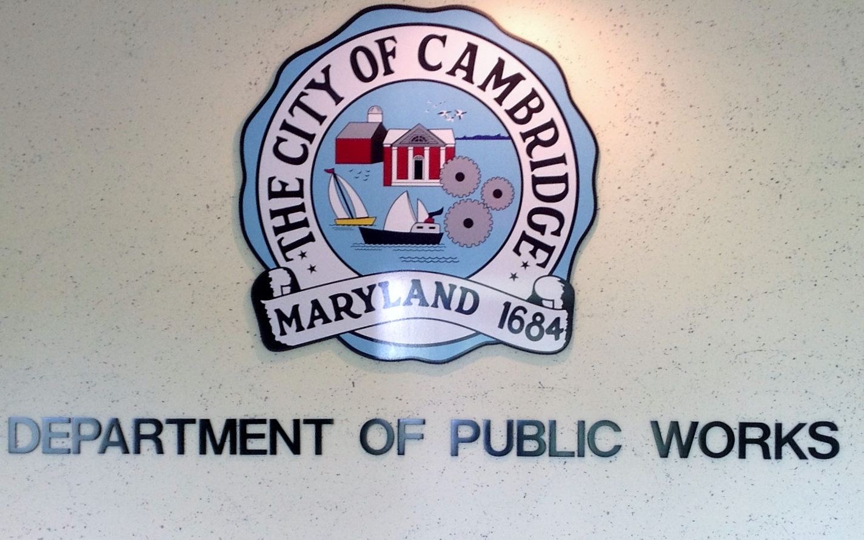
Fiscal Year 2019 Proposed Operating and Capital Budget

Slide 35
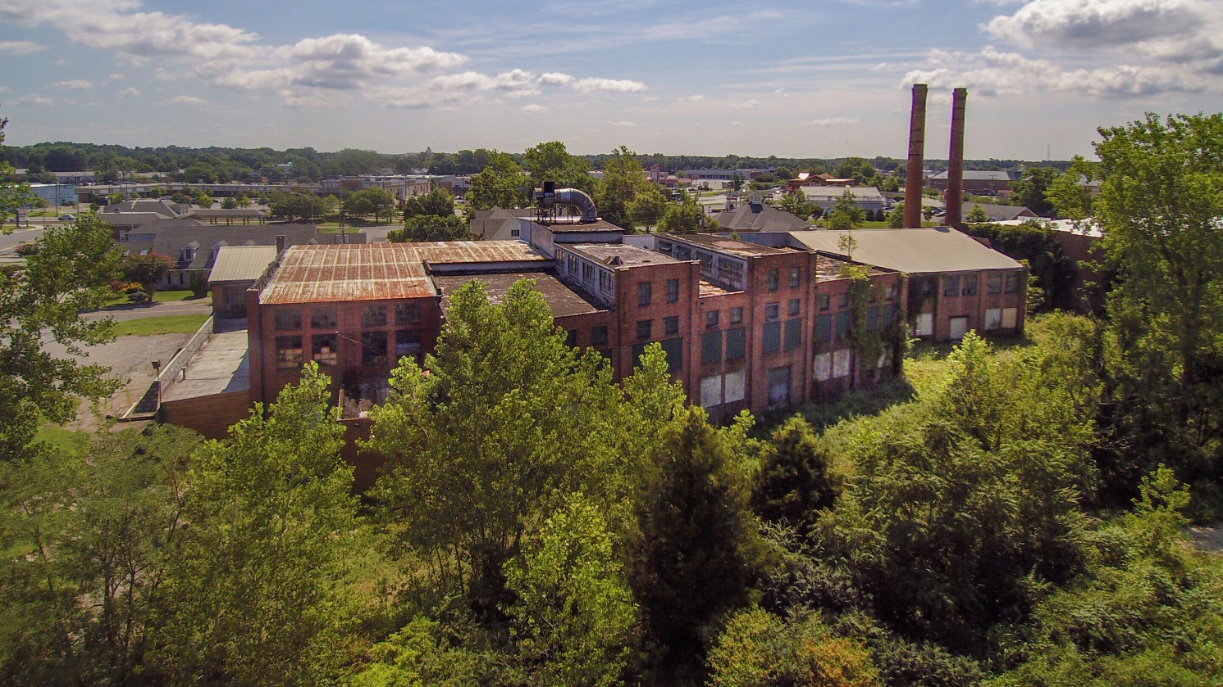
Department of Public Works
Planning
&
Zoning

Slide 36
Key Descriptors
Facilitate the use of solid planning principles and practices in order to enable superior land use development.
Prepare recommendations to and support the Planning & Zoning Commission, Appeals Board, & Historic Preservation Commission.
Amend and implement the City’s Zoning Code.

Slide 37
Division Budget Overview
Fiscal Year | Budget | Positions
2018 | $186,514 | 2
2019 | 219,325 | 2

Slide 38
Performance Measures - Selected
Performance Measures | 2018 (est.) | 2019
Planning & Zoning Building Permit Review | 71 | 100
HPC Applications Administered | 62 | 50
Monthly P&Z & HPC Meetings | 18 | 15
Text Amendments to UDC | 13 | 10

Slide 39
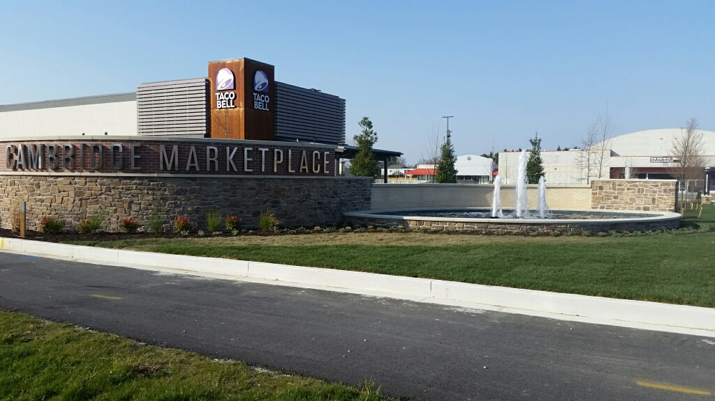
FY 2018 Accomplishments
Pine Street
Cambridge Marketplace
Cannery Park
Working Waterfront Implementation Plan
Historic Preservation Guidelines -
Comprehensive Plan Updated

Slide 40
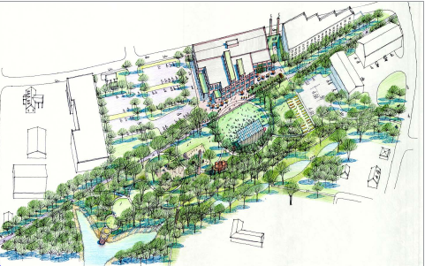
FY 2019 Goals
Cannery Park and Rails to Trails program.
Pine Street Area Plan.
Develop way finding/branding program.
More grants funding for blight reduction.
Continue working with Developer for Cambridge Market Place.
Work with developer for Dorchester Market Place the “Metro” building site.
Design guidelines for the Rte. 50 corridor.

Slide 41
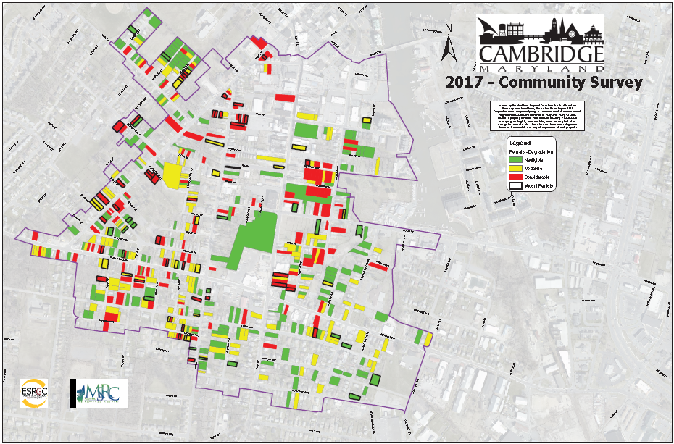
Department of Public Works
Housing Revitalization and Development

Slide 42
Division Budget Overview
Fiscal Year | Budget | Positions
2018 | $0 | n/a
2019/2020 | 748,749 | 1

Slide 43
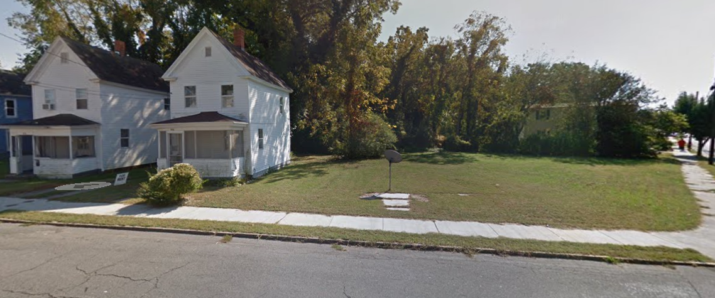
FY 2019/2020 Goals
Pine Street
CDBG Grant is a two year funding cycle;
Complete the redevelopment, rehab of dwellings in the area in conjunction with Habitat for Humanity Choptank;
Secure future funds for Pine Street Redevelopment and Neighborhood Enhancements.

Slide 44
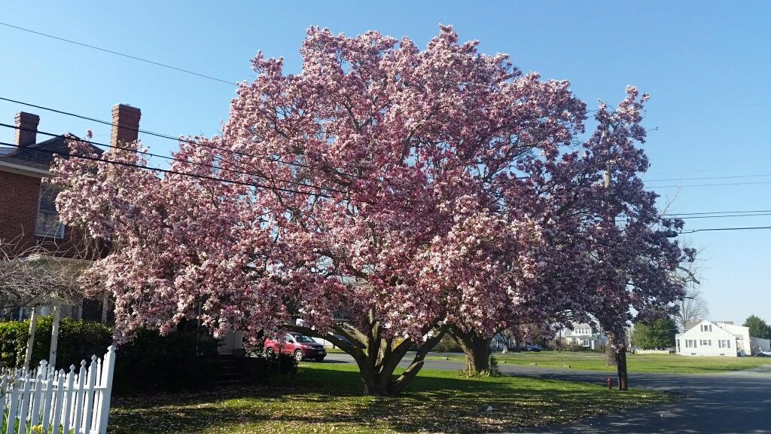
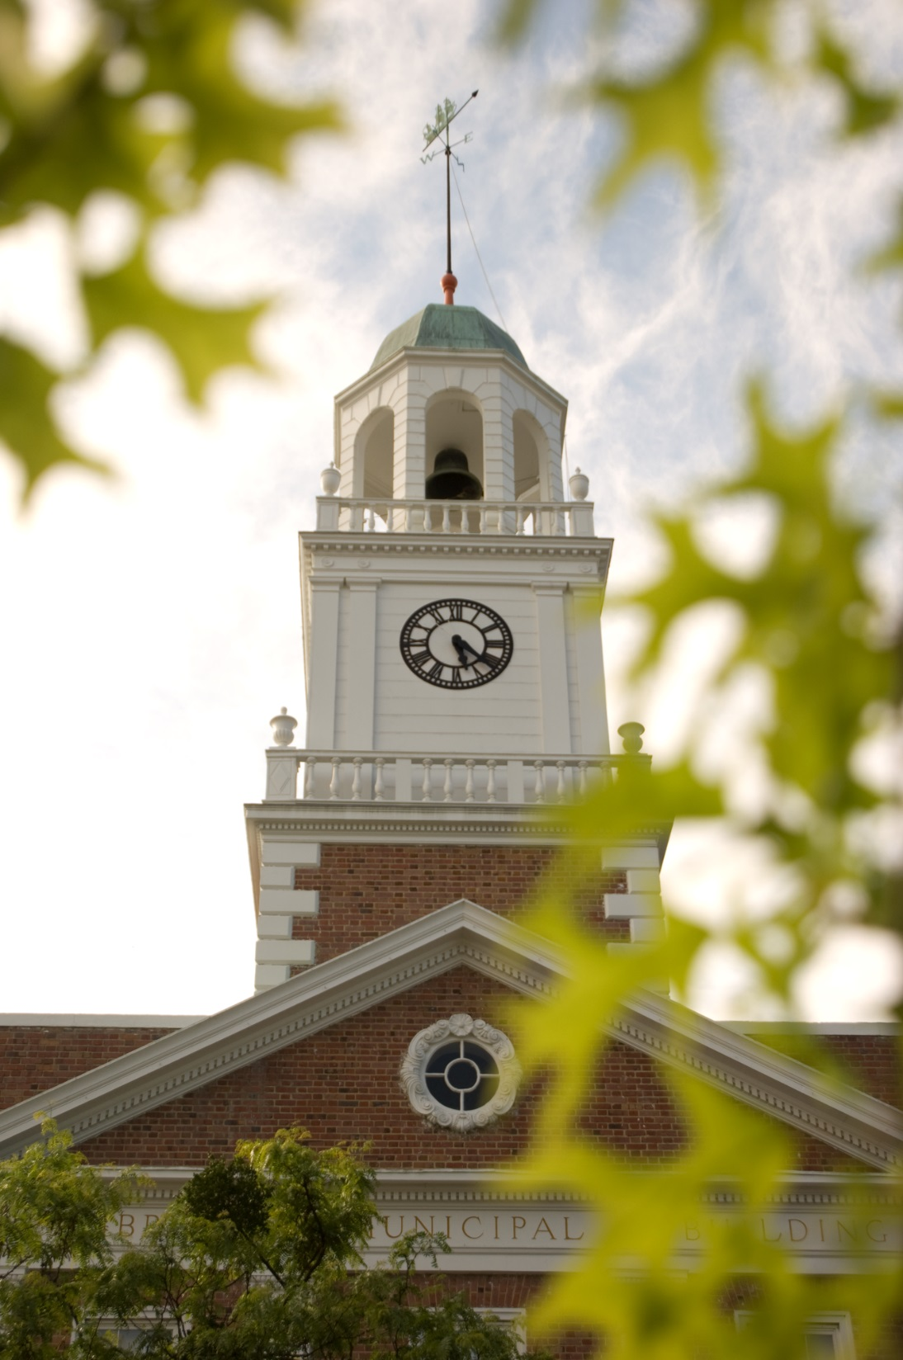
Thank you

Slide 45
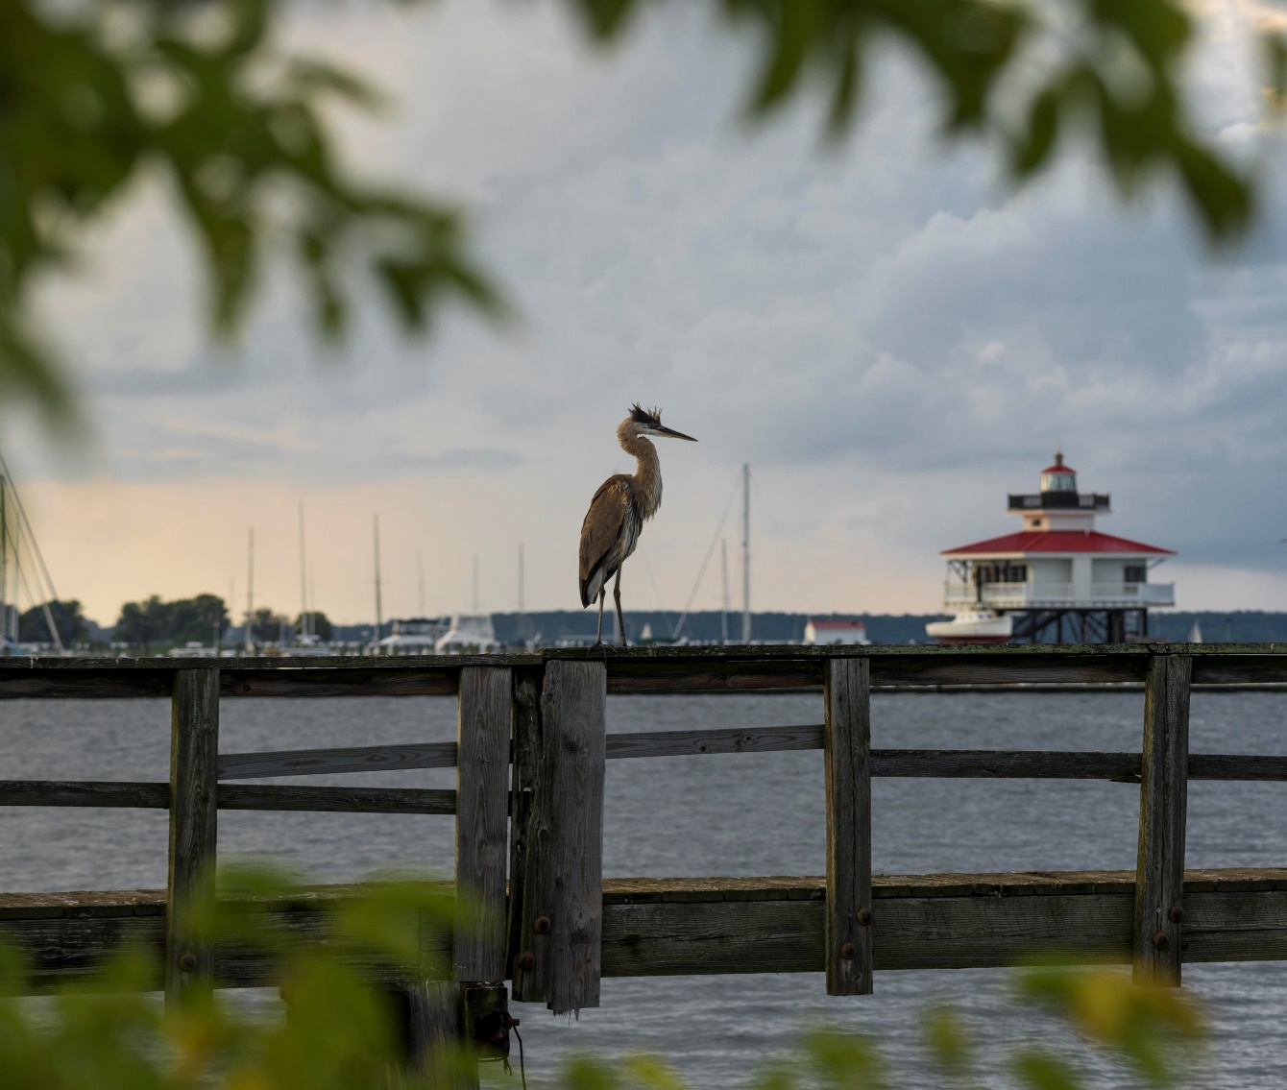
Department of Public Works
Economic Development

Slide 46
Key Descriptors
Business Retention.
Grants Administration, Marketing, A&E District, Façade Improvement Program, Community Events.
Supports Sailwinds project, Senior Resident Tax Credit, Economic Development Strategic Plan, Public Information, ChooseCambridge.com.

Slide 47
Division Budget Overview
Fiscal Year | Budget | Positions
2018 | $136,671 | 1.5
2019 | $128,999 | 1.5

Slide 48
Performance Measures - Selected
Measures | 2017 (actual) | 2018 | 2018 (projected) | 2019
Façade Improvement | $50,000 | $50,000 | $50,000 | $50,000
Outdoor/Indoor Events | 2 | 3 | 6 | 3
New Business Contacts | 12 | 12 | 16 | 12
New Businesses | - | - | 10 | 10
Grant Applications | 8 | 10 | 11 | 10
Existing Business Contacts | 65% | 225 | 195 | 200

Slide 49
FY 2019 Goals
Work more effectively with existing/new Business entrepreneurs and business prospects.
Facilitate improvements in Quality of Life through Community Development efforts, the Façade Improvement Program, special events and relationships with community partners.
Develop a more thorough inventory of vacant building assets and communicate with potential developers.
Complete two Arts & Entertainment District initiatives from the workplan, as well as two family-oriented events and the city’s Fourth of July fireworks.

Slide 50
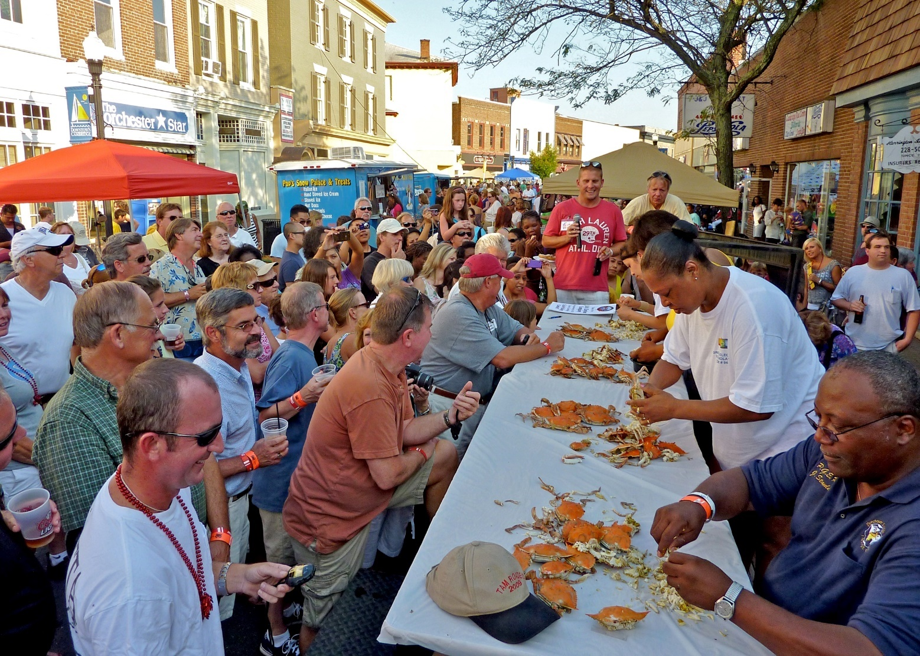
Department of Public Works
Special Events

Slide 51
Key Descriptors
Events held for the benefit of Cambridge residents, to promote tourism and stimulate the City’s economy.

Slide 52
Division Budget Overview
Fiscal Year | Budget | Positions
2018 | $134,400 | 0
2019 | $122,900 | 0

Slide 53
FY 2019 Goals
Staff and services for Ironman Maryland and Eagleman Triathlons.
Annual 4th of July Fireworks.
Support for other events – DT Second Saturday, Taste of Cambridge, High School Football & Basketball, Beer Festivals, Seafood Festival, Dorchester Center for the Arts Showcase.

Slide 54
Thank you

Slide 55
Fiscal Year 2019 Proposed Operating and Capital Budget
Municipal Utilities Commission

Slide 56
Department Budget Overview
Fiscal Year | Budget | Positions
2018 | $1,930,674 | 16
2019 | $2,479,058 | 16

Slide 57
Organization
Water Resources Administrator
Administration
Distribution

Slide 58
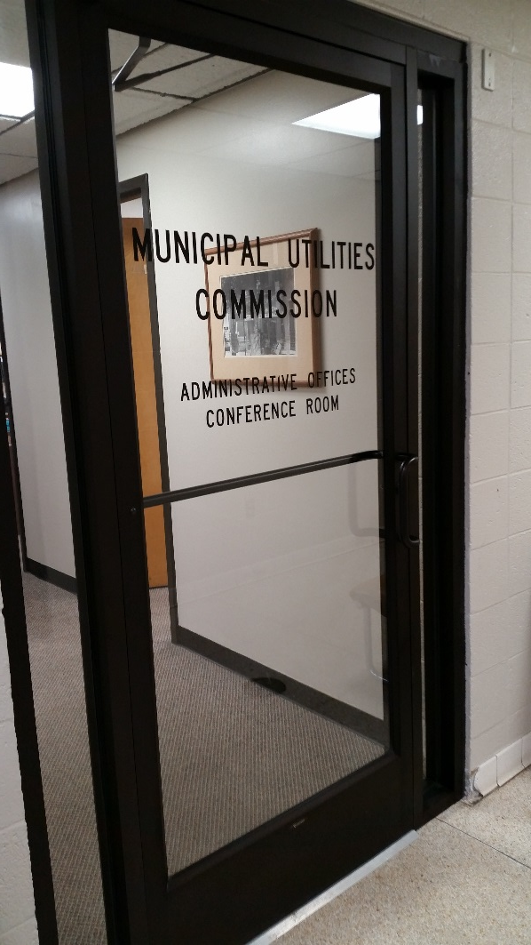
MUC
Administration

Slide 59
ADMINISTRATION
Water Resource Administrator
Accounting Clerk-Payroll
Accounting Clerk- Billing
(3)
Accounting Clerk-Customer Service

Slide 60
Division Budget Overview
Fiscal Year | Budget | Positions
2018 | $735,084 | 6
2019 | $742,048 | 6

Slide 61
Key Descriptors
Provide direction to the Administration and Distribution
Process all water/sewer/disposal bills for 5500 customers monthly.
Process all rental registration bills.
Handle all customer service requests.
Order new services, shut-offs, turn-ons, and all work order generated for Distribution.
Staff MUC/Commission.

Slide 62
Performance Measures - Selected
Measures | 2017 (est.) | 2018 (est)
Bills processed | 66,000 | 66,000
Design & distribute Water Quality Report | 4,900 customers | 4,900 customers

Slide 63
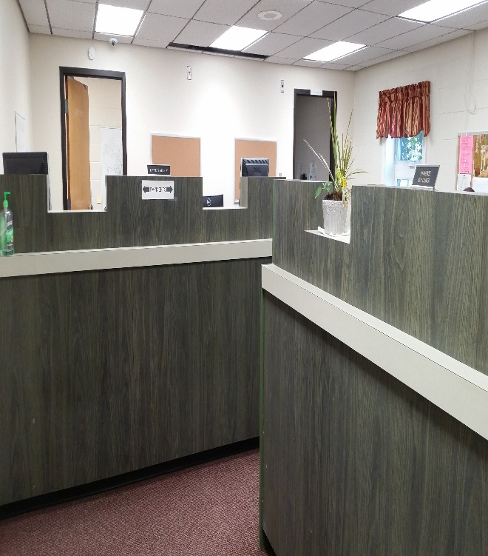
FY 18 Accomplishments - Selected
Replaced and upgraded customer counters and security in office.
Added new work station in office.
Completed cross training of office personnel for backup & efficiency.
Completed lead & copper testing
Completed rental registration billing
Completed water audit for MDE and all necessary reports on schedule

Slide 64
FY18 Significant Goals – Selected
Continue training of office personnel.
Continue for seek changes for excessive office work flow.
Strive to add to reserves to finance our capital improvement projects.

Slide 65
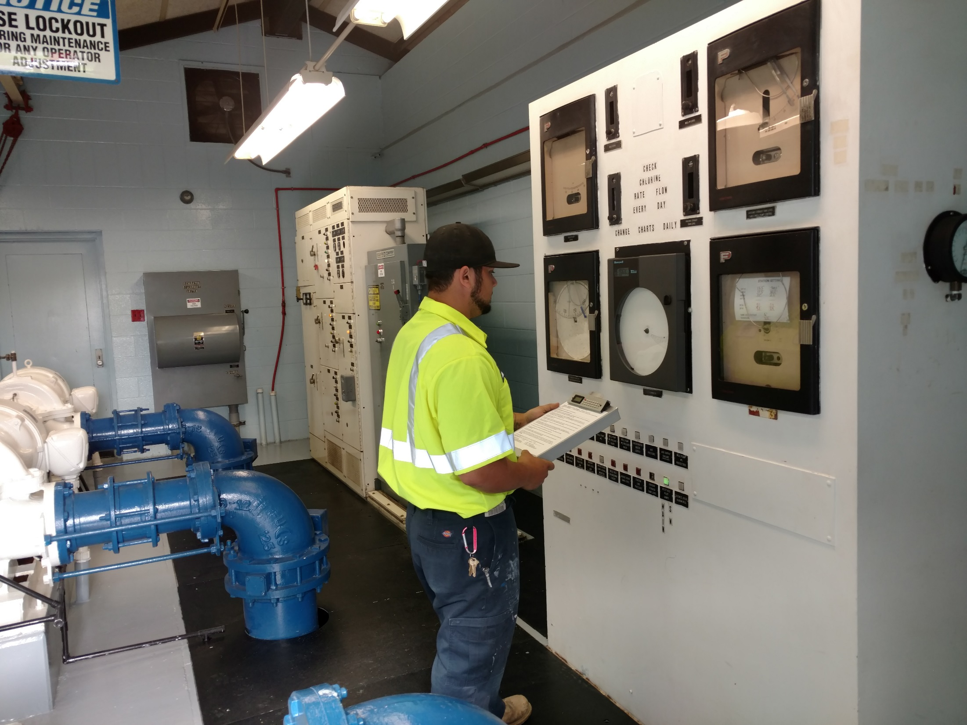
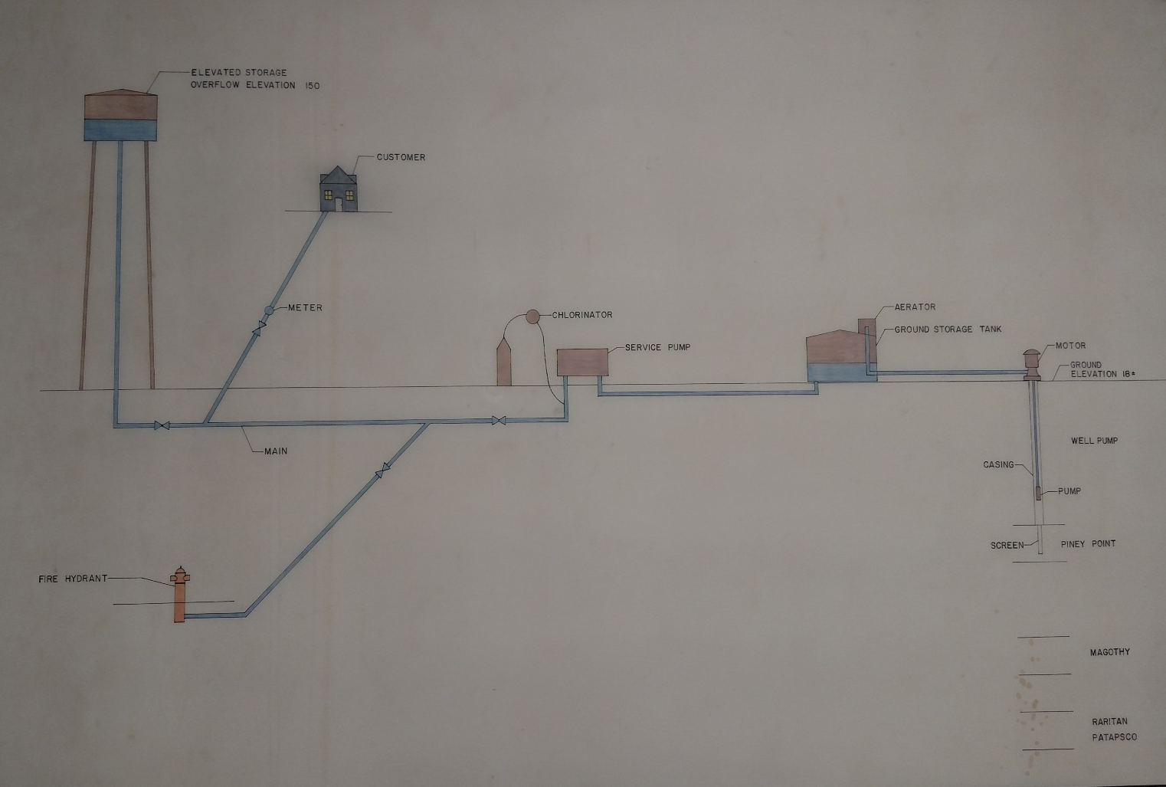
– MUC DISTRIBUTION

Slide 66
Organization
Superintendent
Assist. Superintendent
Operations
Distributions
Foreman/Service Coordinator
Meter Reading

Slide 67
Division Budget Overview
Fiscal Year | Budget | Positions
2018 | 1,195,590 | 10
2019 | 1,737,010 | 10

Slide 68
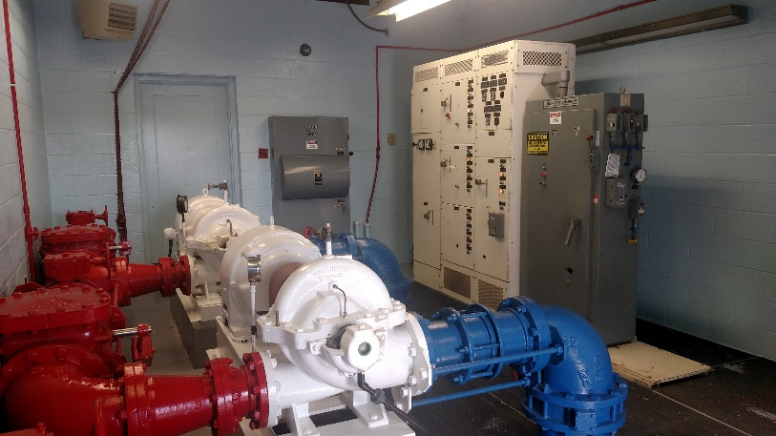
Key Descriptors
Provide a safe, reliable, and efficient public water system to the City and certain surrounding areas.
Maintain 10 wells and pumps at 4 stations.
Repair and replace piping in water system as needed.
Install water meters.

Slide 69
Performance Measures - Selected
Measures | 2018 (est) | 2019 (est)
Millions of gallons delivered to customers | 680 | 700
Leaks repaired by MUC | 50 | 50
Meters read | 62,628 | 62,628

Slide 70
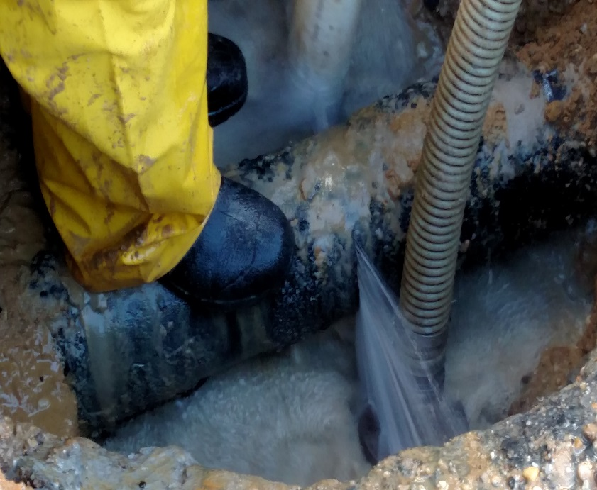
FY 2018 Accomplishments -selected
Installed larger main on Dobson St.
Installed larger main on Skinners Ct.
Installed larger main on Charles St.
Purchased new transit for service technician.
Upgraded Nathans Ave station for automation.
Washed out and inspected tanks at Woods Rd & Wash. St.
Maintained quality work for leak control.

Slide 71
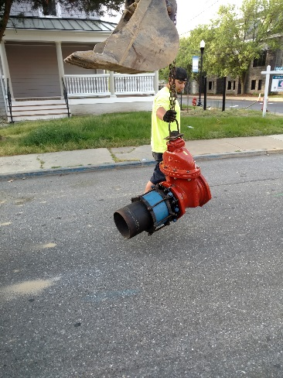
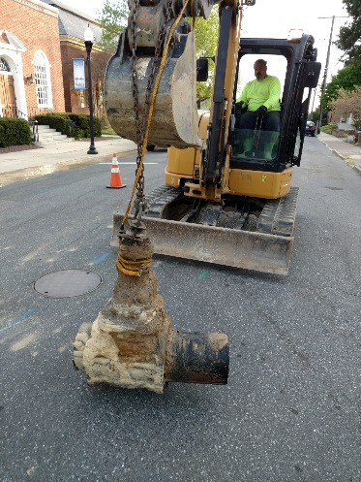
FY 19 Goals – Selected
Minimize the time of interruptions to services and restore water as quickly as possible even under adverse conditions.
Replace undersized mains – per Master Plan.
Upgrade pumps, valves & meters
when feasible.
Meet MDE requirements/pass inspections
without exceptions.

Slide 72
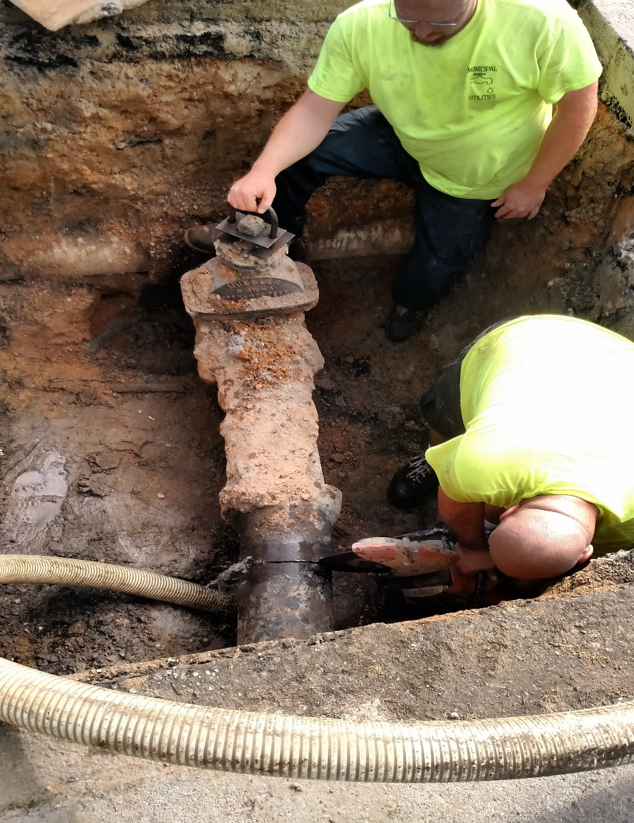
MUC Techs at work

Slide 73
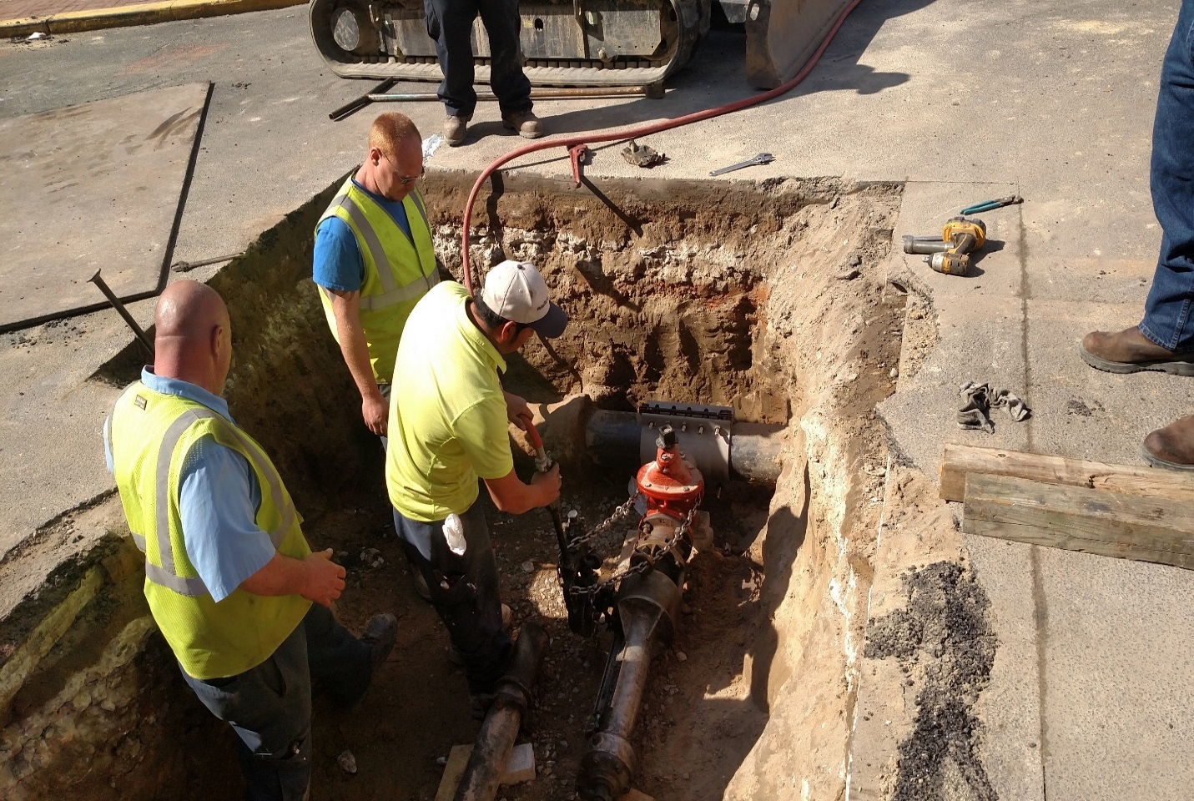
Team work is the reason for our success.

Slide 74
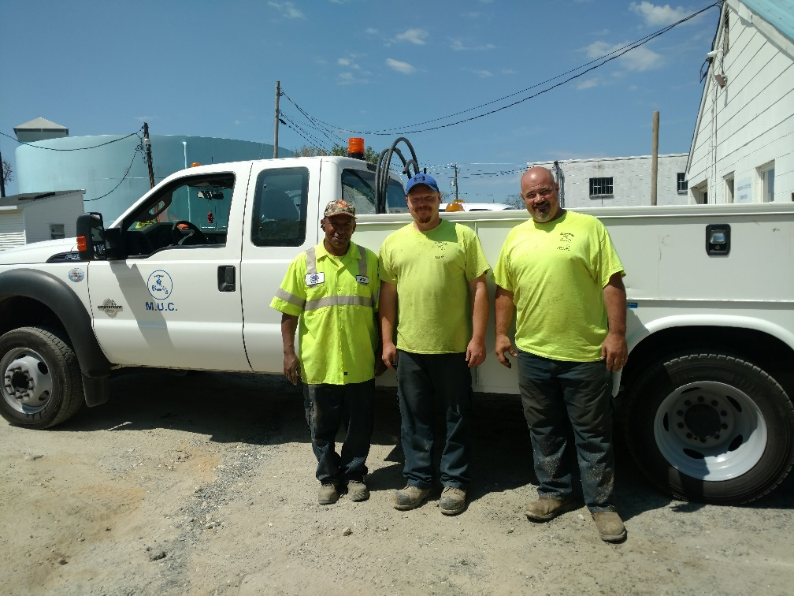
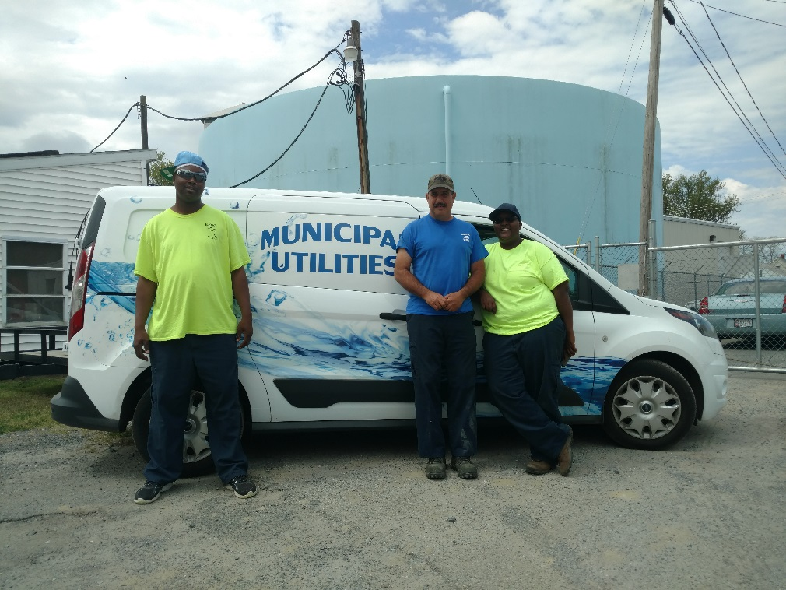
MUC
In closing, the MUC takes pride in our delivery of water services, our customers, and our employees.

Slide 75
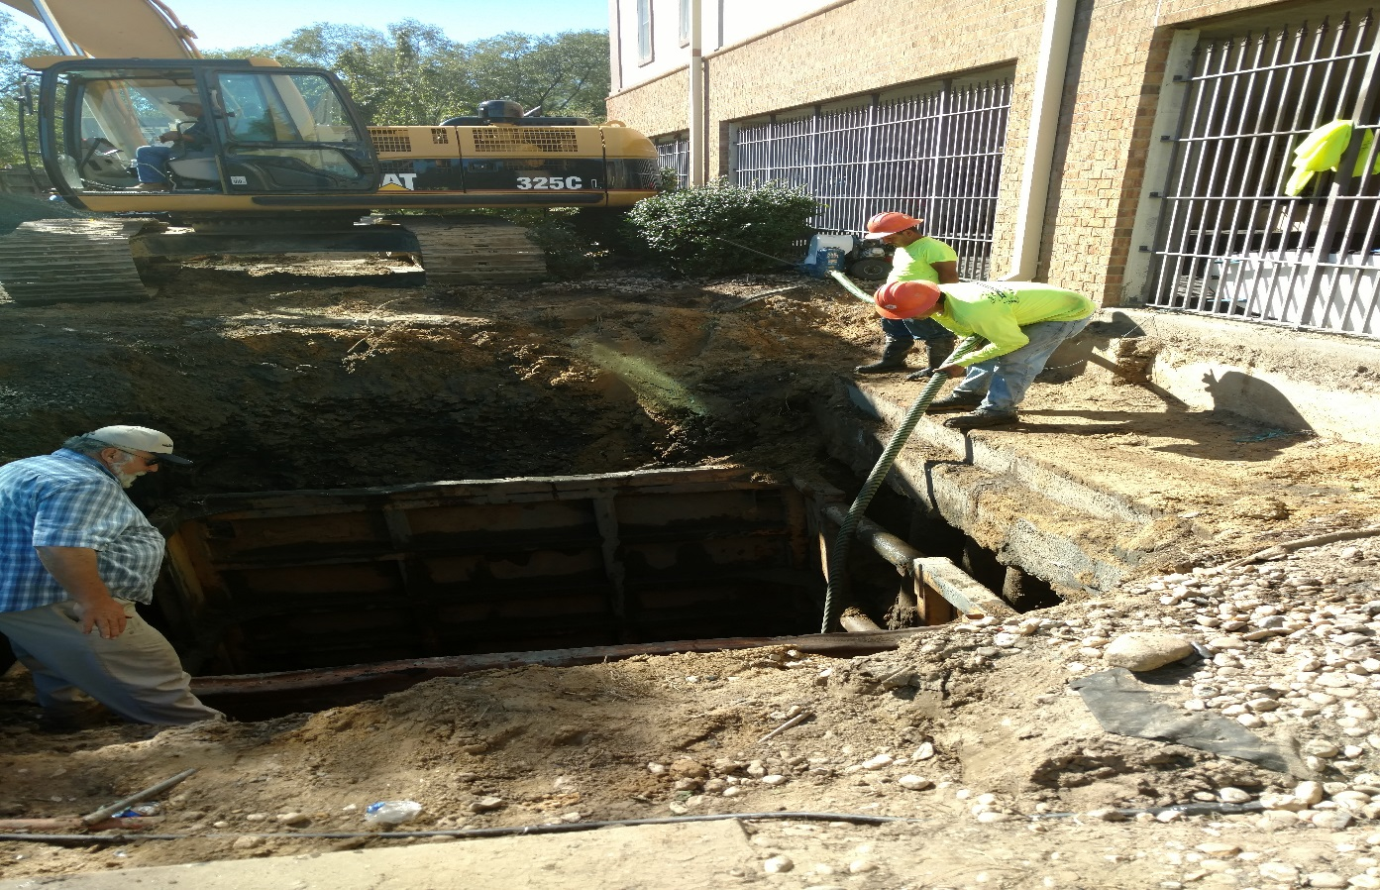
Thank you
From the staff of MUC

