Slide 1

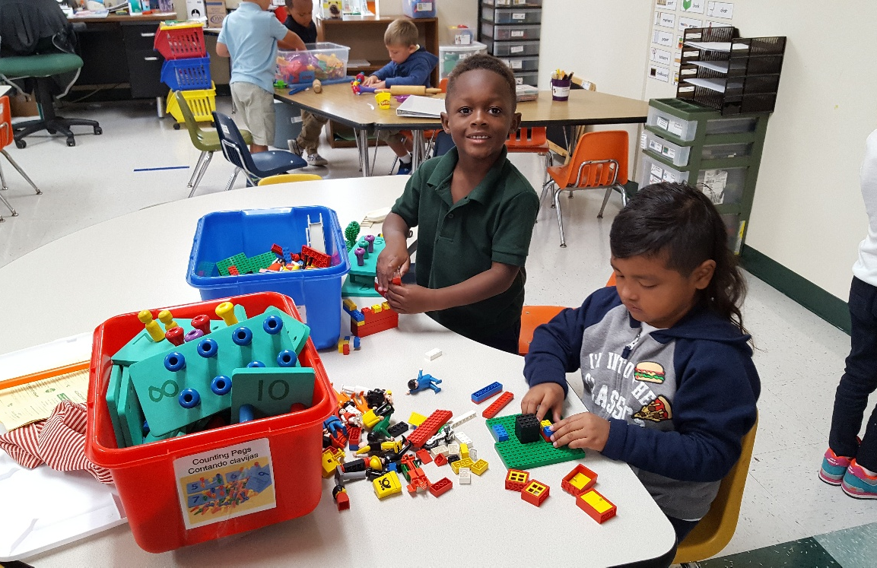
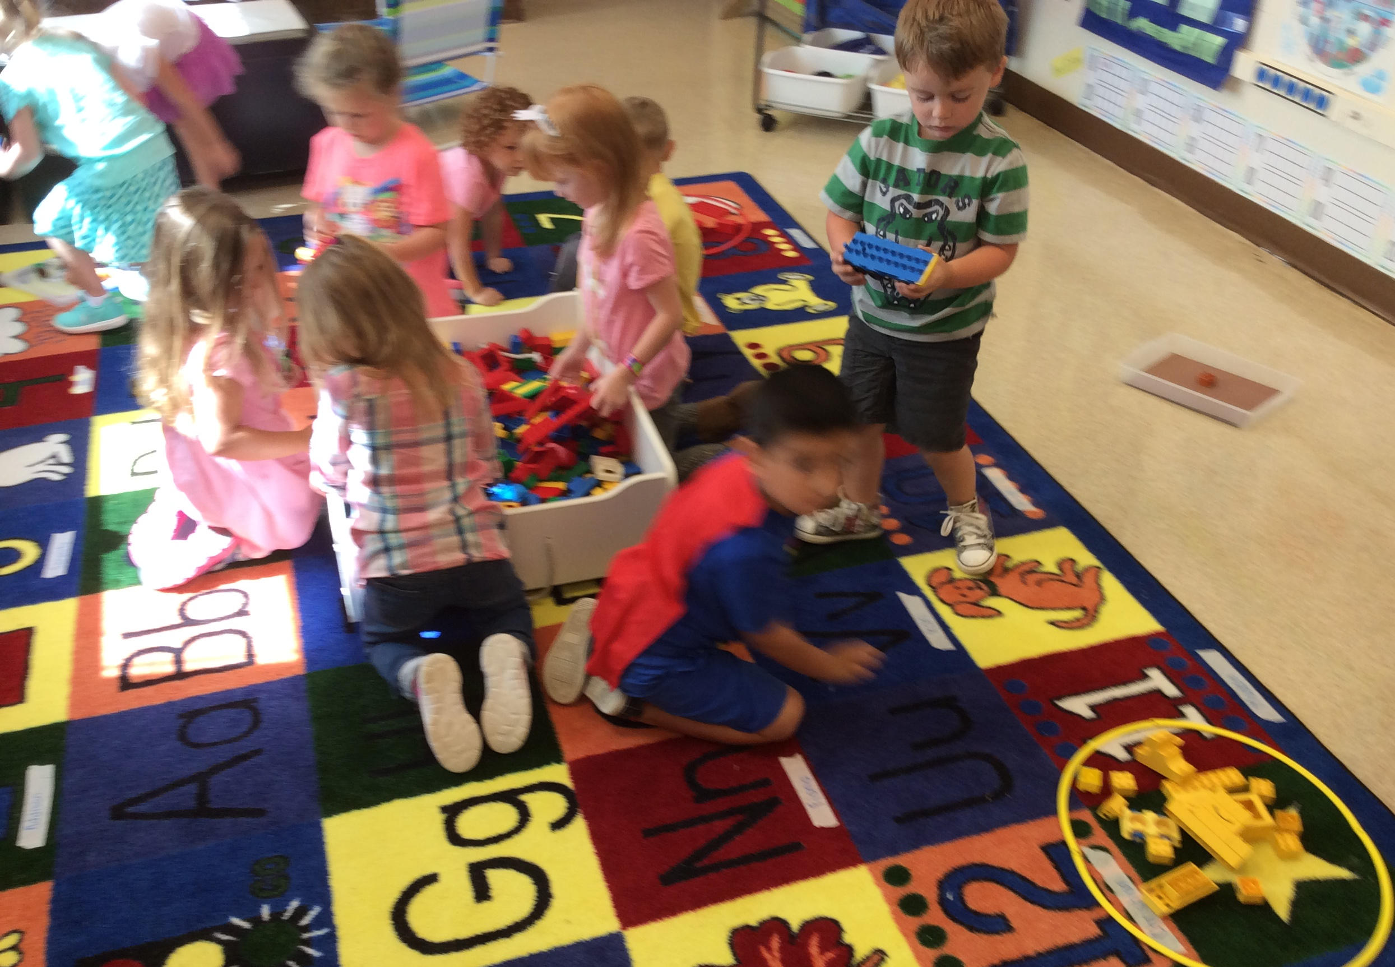
Ready for Kindergarten?
Supporting children to enter school successfully
Dorchester County Board of Education
April 19, 2018

Slide 2
November 2016
Dorchester County

Slide 3

Readiness
Matters
Kindergarten readiness is critical.
Early experiences lay the groundwork for a child’s lifelong success.
The years from birth to age five are the most crucial period of brain development in a child’s life.
Children who enter kindergarten not demonstrating the social-emotional, cognitive, and physical skills needed for success will continue to struggle academically throughout their school years.

Slide 4
Assessments Matter
ready for kindergarten
Ready for Kindergarten (R4K) is Maryland’s Early Childhood Comprehensive Assessment System. R4K is developmentally appropriate and aligns with the State’s rigorous PreK-12 College and Career-Ready Standards.
R4K has two components:
The Early Learning Assessment (ELA) measures the progress of learning in young children, 36 to 72 months (3 to 6 years), across nine levels in seven domains: language & literacy, mathematics, science, social foundations, social studies, physical well-being and motor development, and the arts.
The Kindergarten Readiness Assessment (KRA) looks at the knowledge, skills, and behaviors of kindergarteners across four domains: social foundations, language & literacy, mathematics, and physical well-being and motor development.

Slide 5
Assessments Matter
Maryland’s kindergarten readiness assessment
Kindergarteners are assessed as:
  demonstrating readiness
      Consistently demonstrates the foundational skills and behaviors that enable a child to fully participate in the kindergarten curriculum.
  approaching readiness
      Exhibits some of the foundational skills and behaviors that are needed to participate in the kindergarten curriculum.
  emerging readiness
      Displays minimal foundational skills and behaviors that prepare him/her to meet kindergarten expectations.
  Children whose readiness skills are “approaching” and/or “emerging” require differentiated instruction, targeted supports, or interventions to be successful in kindergarten.

Slide 6
Assessments Matter
Maryland’s kindergarten readiness assessment
Administering the KRA
Local boards of education and individual schools choose to administer the KRA in one of the following ways:
Census Administration. Each kindergarten teacher administers the KRA to all incoming kindergarteners.
  12 jurisdictions, including Dorchester County, conducted a census administration.
Sample Administration. Each kindergarten teacher administers the KRA to a sample of students in his/her classroom. MSDE determines the sample size based on enrollment data.
  12 jurisdictions used a sample administration.
census administration (100% assessed) | sample administration (sample size)
Allegany Baltimore City Caroline Dorchester Garrett Kent Queen Anne’s Somerset Talbot Washington Wicomico Worcester | Anne Arundel (22%) Baltimore County (20%) Calvert (26%) Carroll (32%) Cecil (30%) Charles (20%) Frederick (30%) Harford (30%) Howard (31%) Montgomery (12%) Prince George’s (12%) St. Mary’s (32%)

Slide 7
Maryland data

Slide 9
OVERALL
readiness
School Readiness in Dorchester County
More than 335 children entered Dorchester County’s kindergarten classrooms.
Teachers used the KRA tool to assess 100% of kindergarteners.
44% of the County’s kindergarteners demonstrate readiness, entering classrooms fully prepared to participate in the kindergarten curriculum.
44%
demonstrate
readiness
339
kindergarteners
100%
kindergarteners
assessed

Slide 10
OVERALL
readiness
Overall Kindergarten Readiness
Progress, but more work to do.
44% of Dorchester County’s kindergarteners demonstrate readiness, up from 28% in 2016-2017!
The majority of kindergarteners (approximately 190 children) do not demonstrate the knowledge, skills, and behaviors needed to succeed in school.
Children identified as emerging readiness (19%) are the most vulnerable and display minimal foundational skills, often requiring differentiated instruction, targeted supports or interventions.
Demonstrating
Approaching
Emerging

Slide 11
Dorchester
District Comparison
Data
Major jurisdictional improvements.
9 jurisdictions, including Dorchester County, saw one-year gains of 15% or higher.
High poverty jurisdictions show lower readiness.
5 of the 8 jurisdictions with lower than average readiness levels have a higher percentage of kindergarteners living in poverty.

Slide 12
19 20 54 64 350 55 6 62 70

Slide 16
RACE/ETHNICITY
demographics & readiness¹
  Readiness gaps exist for Dorchester County’s children of color.
  28% of African American kindergarteners and 29% of Hispanic kindergarteners demonstrate readiness, compared with 66% of white kindergarteners.
African American
Asian
Hispanic/Latino
Two or More
White
¹ Readiness and demographic information for students of American Indian (0.3% of Maryland’s kindergarten enrollment) and Native Hawaiian/Pacific Islander (0.2%) ethnic backgrounds are not reported due to limited sample size.

Slide 17
Subgroup
demographics & readiness
  Some of Dorchester County’s kindergarteners face barriers to academic success.
Dorchester County
Children from
Low-Income Households*
27pt GAP
Children from Mid-/
High-Income Households
English Learners
25pt GAP
English Proficient Children
Children with Disabilities
24pt GAP
Children without Disabilities
* Reflects only children who are direct-certified. District no longer collects individual FaRMS documentation
56%
of kindergarteners
live in low-income
households
6%
of kindergarteners
are english learners
5%
of kindergarteners
have identified disabilities

Slide 18
Prior Care
experience & readiness
Benefits of high-quality early education are clear.
98% of Dorchester County’s kindergarteners attended a formal early learning setting the year prior to starting school.
Kindergarteners enrolled in formal early learning settings, like PreK, outperform their peers who were at home or in informal care the year prior to kindergarten.
Child Care
Family Child Care
Head Start
Home / Informal
Non-Public Nursery
PreK
* Fewer than 5 kindergarteners assessed.

Slide 19
Equity
Matters
Educational inequity impacts school readiness.
Many of our youngest children live in communities with significant barriers that can prevent them from reaching their full potential.
Children from disadvantaged environments are the least likely to get the supports they need.³
Personal or social circumstances – such as immigration status, ethnic background, socioeconomic status, English proficiency, or disability – must not be barriers or obstacles to academic success.⁴
³ James J. Heckman, “Invest in early childhood development: Reduce deficits, strengthen the economy” (The Heckman Equation, n.d.).
⁴ Patte Barth, “Educational Equity. What Does It Mean? How Do We Know When We Reach It?” (Center for Public Education, January 2016).

Slide 20
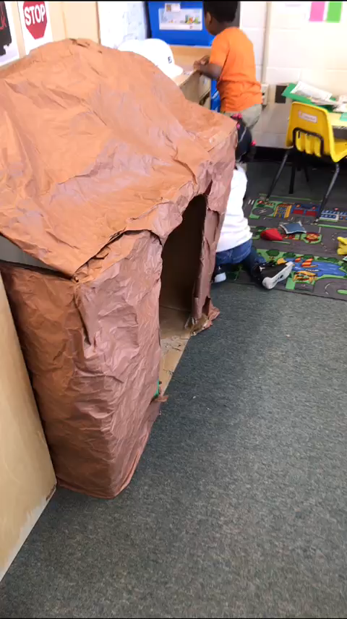
PreK Programs are making a difference!

Slide 21
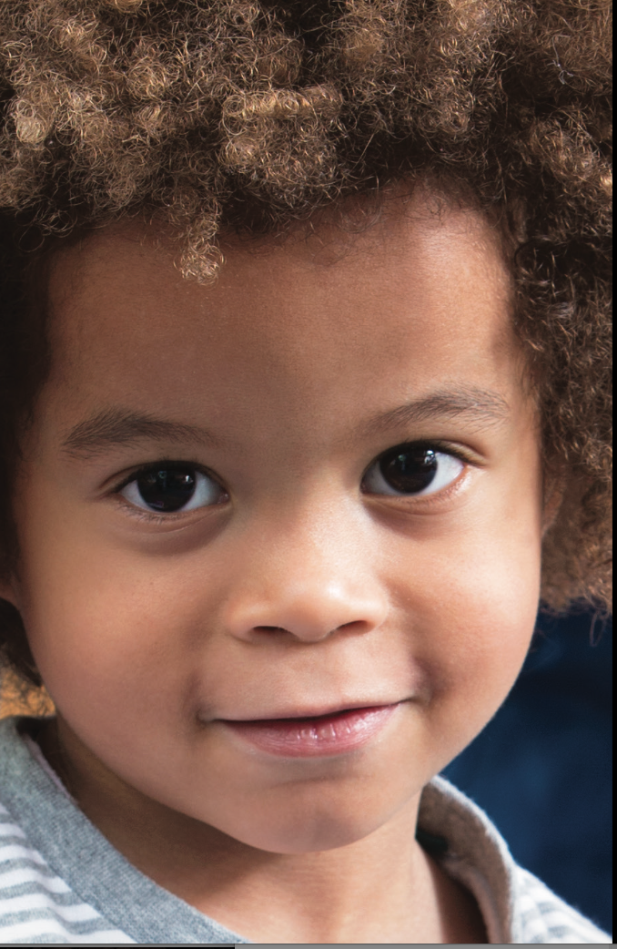
A Collective Obligation
Help all children achieve and thrive
Learn More
The following materials are available to help jurisdictional leaders and key stakeholders use the KRA data:
  Statewide Resources
    Statewide Report
    Technical Report
    Statewide Infographic
    Statewide PowerPoint Presentation
  Jurisdictional Resources
    Jurisdiction-specific Issue Briefs
    Customized PowerPoint Presentations
www.ReadyAtFive.org
Celebrate Young Children, Celebrate Families!
Thank You!

