Slide 1
Cambridge Police Department
2019 Community Informational Meeting Presentation

Slide 2

Proudly Serving the Citizens of Cambridge

Slide 3
CHIEF OF POLICE
MARK LEWIS
EXECTIVE ASSTANT JONES
SPECIAL OPERATIONS CAPTAIN TODD
ADMINISTRATIVE CAPTAIN NICHOLS
PATROL LIEUTENANT LEWIS
D SQUAD SGT. BALL
SPECIAL OPS LIEUTENANT HINSON
B SQUAD SGT. PATTON
CPL. MOTHERSELL
PFC SCHMIDT
CPL. NEWCOMB
PFC GOSNELL
CPL. DANIEL
PFC SHAYNE
CPL. HOWARD
PFC SIMMONS
DET. CPL DICKERSON
EVIDENCE TECH STUBBS
DET. SGT MCCRAY
RECORDS TECH GUTERMUTH
DET. PHILLIPS
RECORDS TECH
COOK
CPL. BENTON
PFC JONES
PTL HULTS
PFC GONZALEZ
PTL JACKSON
PTL BUGLIO
PFC
LA MONICA
PFC RIPPONS
PFC MILLER
PFC MILLS
PFC COPPER
FLEX TEAM
ALLEN
NARCOTICS SERGEANT FOSTER
NARCOTICS HACKETT
NARCOTICS DRAKE
COMMUNITY POLICE FOSTER
COMMUNITY POLICE WASHINGTON
1ST. SGT. LOWE
A SQUAT SGT. HERNANDEZ
CROSSING GUARD
VACANT
RECRUIT WEBBER
PFC WOOTERS
E SQUAD SGT. FLYNN
TEMP PFC MCCALL
VACANT
VACANT
VACANT
VACANT
VACANT
C SQUAD SGT. JONES
VACANT

Slide 4
Cambridge Police Department Authorized Sworn Manpower
2000- 50
2005- 52
2010- 52
2018- 48
2019- 46(41 Currently / 5 Openings)

Slide 5
2018 PART 1 CRIMES
MURDER – 1
RAPE – 2
ROBBERY – 24
AGGREVATED ASSAULT – 98
BURGLARY – 155
THEFT – 437
MOTOR VEHICLE THEFT – 9
TOTAL PART ONE CRIMES - 726

Slide 6
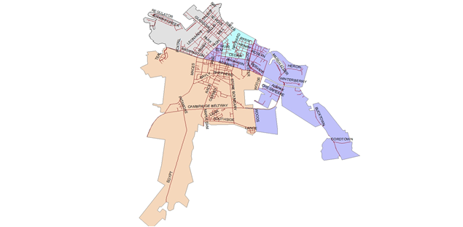
PART 1 CRIME – CITY WIDE

Slide 7
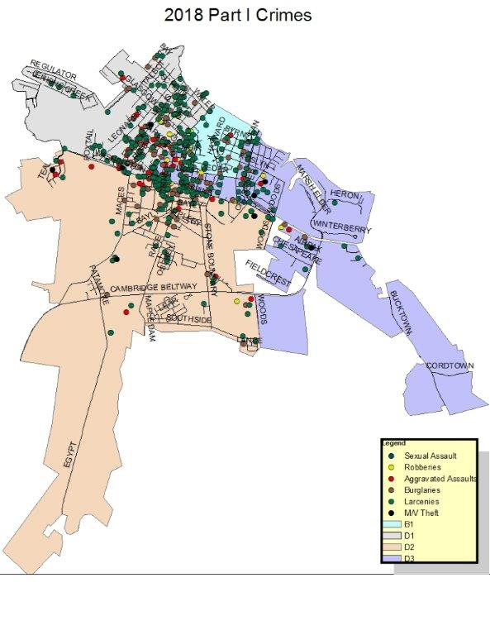

Slide 8
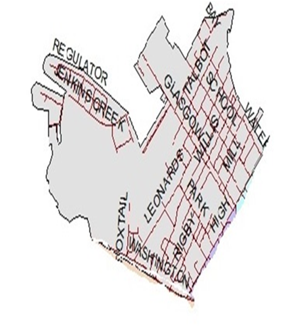
PART 1 CRIME - DISTRICT 1
West side of city bounded by High Street and Washington St.

Slide 9
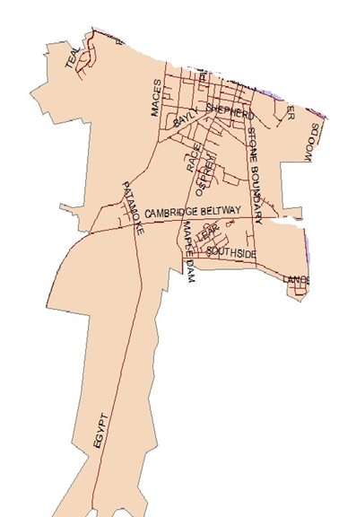
PART 1 CRIME – DISTRICT 2
South of Washington Street from Teal Lane to Woods Road

Slide 10
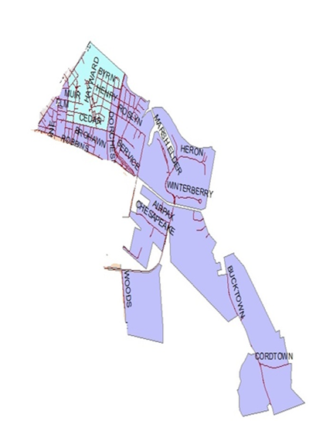
PART 1 CRIME – DISTRICT 3
High Street, across Ocean Gateway to Bucktown Road

Slide 11







OTHER POLICE STATISTICS

Slide 12
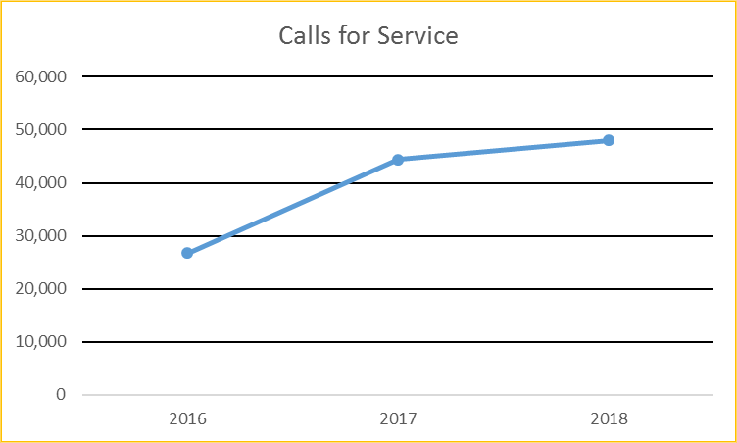
Calls for Service
Last year’s report show that calls for service had been declining. Noting that self-initiated calls had been removed from the data which showed only those call which had been initiated by the public. This year’s calls for service include all calls for service. Whether initiated by an officer or the public the officer is still tied up on a work assignment and this should be noted to show the true amount of incidents our police officers actually handle.

Slide 13
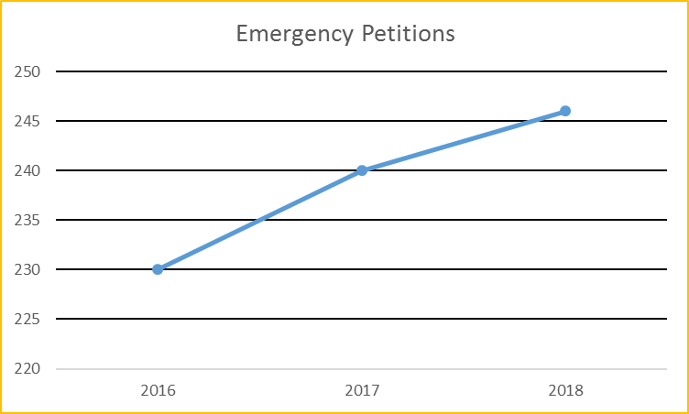
Emergency Petitions are the process by which we encounter a person who may be threat to themselves or others and refuses medical treatment. We complete the petition and transport the individual to the hospital for evaluation. This is a very time consuming process for our officers and has been steadily increasing since 2013.

Slide 14
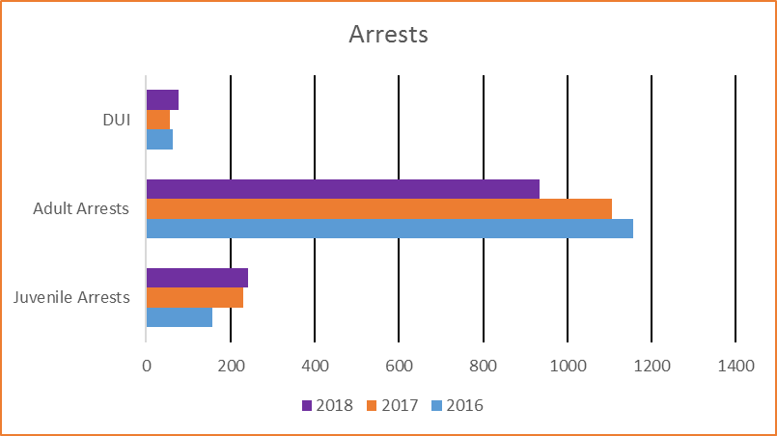
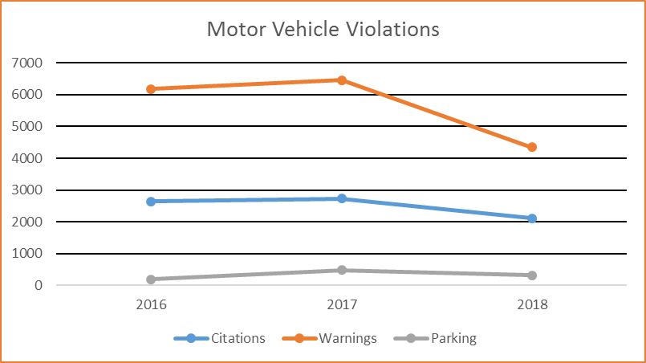
Arrests and traffic enforcement are not only indicators of the presence of violations, but are also a reflection of the motivation and professionalism of our officer.

Slide 15
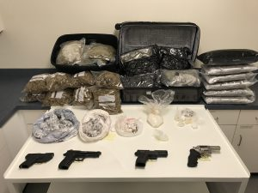
Cambridge Police Department 2018 Narcotics Investigations

Slide 16
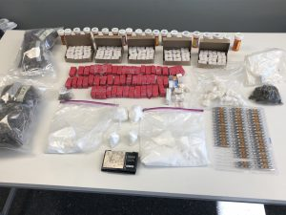

Slide 17
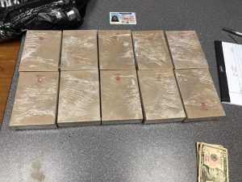

Slide 18
Cambridge Police Department 2018
Pay Study

Slide 19
The Cambridge Police Department Starting Pay is $37,197
Starting pay for a Certified Officer is $40,444
The Cambridge Police Department is one of the lowest starting pay for Police Officers on the entire Eastern Shore $37,197.00

Slide 20
Pay Comparison Study
The next several slides are pay comparisons between Cambridge PD and other surrounding police agencies.
Each slide will show the AVERAGE Pay for each rank
At the bottom of each slide are other agencies benefits

Slide 21

Cambridge PD Difference in Pay Easton PD
PFC $42,190.00 $16,008.00 $58,198.00
CPL $52,211.00 $16,512.00 $68,723.00
SGT $63,993.00 $12,301.00 $76,294.00
LT $71,196.00 $15,664.00 $86,860.00
CPT $74,126.00 Did not Disclose
49 Sworn Officers
Take Home Cars: Command Staff (6), SWAT Officers (14), K-9 Officers (3), Detectives (10), 33 Total
Easton City Retirement 55% at 22 years

Slide 22

Cambridge PD Difference in Pay Salisbury PD
PFC $42,190.00 $13,131.00 $55,321.00
CPL $52,211.00 $13,689.00 $65,900.00
SGT $63,993.00 $ 8,610.00 $72,603.00
LT $71,196.00 $10,503.00 $81,699.00
CPT $74,126.00 $16,654.00 $90,780.00
101 Sworn Officers
Command Staff (9), SWAT Officers (14), K-9 Officers (5), Detectives (15),
Officers that live in city limits (5)
LEOPS State Retirement

Slide 23

Cambridge PD Difference in Pay Ocean City PD
PFC $42,190.00 $22,507.00 $64,697.00
CPL $52,211.00 $17,339.00 $69,550.00
SGT $63,993.00 $10,773.00 $74,766.00
LT $71,196.00 $37,751.00 $108,947.00
CPT $74,126.00 $53,378.00 $127,504.00
105 Sworn Officers / 35 Seasonal Officer
Take Home Vehicles: Command Staff, SWAT, CID and Narcotics
Ocean City Retirement 25 years at 60% and they have a 4 year drop program

Slide 24

Cambridge PD Difference in Pay Denton PD
PFC $42,190.00 $ 3,476.00 $45,666.00
CPL $52,211.00 $ 7,941.00 $60,152.00
SGT $63,993.00 $ 3,008.00 $67,001.00
LT $71,196.00 $ 7,199.00 $78,395.00
CPT $74,126.00 No Captain (Chief $84,138.00)
15 Sworn Officers
All have Take home cars (Estimated $5,000 value)
State Retirement

Slide 25

Cambridge PD Difference in Pay Dorchester SO
PFC $42,190.00 $ 4,268.00 $46,458.00
CPL $52,211.00 $ 2,952.00 $55,163.00
SGT $63,993.00 $ 1,498.00 $62,495.00
LT $71,196.00 $ 1,615.00 $72,811.00
CPT $74,126.00 $ 4,420.00 $78,546.00
40 Sworn Officers
All have Take home cars (Estimated Value $5,000)
LEOPS State Retirement

Slide 26

Cambridge PD Difference in Pay Talbot SO
PFC $42,190.00 $16,625.00 $58,815.00
CPL $52,211.00 $15,179.00 $67,390.00
SGT $63,993.00 $ 9,890.00 $73,883.00
LT $71,196.00 $14,782.00 $85,978.00
CPT $74,126.00 $25,522.00 $99,648.00
37 Sworn Officers
All have Take home cars (Estimated $5,000 value)
State Retirement

Slide 27

Cambridge PD Difference in Pay Wicomico SO
PFC $42,190.00 $16,095.00 $58,285.00
CPL $52,211.00 $11,650.00 $63,861.00
SGT $63,993.00 $ 8,395.00 $72,388.00
LT $71,196.00 $16,987.00 $88,183.00
CPT $74,126.00 $20,316.00 $94,442.00
93 Sworn Officers
All Officers have Take Home Cars (Estimated $5,000 value)
State Retirement

Slide 28

Cambridge PD Difference in Pay Caroline SO
PFC $42,190.00 $ 4,187.00 $46,377.00
CPL $52,211.00 $ 9,743.00 $61,954.00
SGT $63,993.00 $ 934.00 $63,059.00
LT $71,196.00 $ 512.00 $71,708.00
CPT $74,126.00 $ 9,388.00 $83,514.00
36 Sworn Officers
All have Take home cars (Estimated $5,000 value)
LEOPS State Retirement

Slide 29
Cambridge PD Sworn Officer Positions
2005: 52
2017: 48
2018: 46
Since 2015 Cambridge Police Department has had the following cut from its budget:
-10 Dispatcher Positions
- 1 Police Department IT Position and $30,000.00 IT Budget
- 1 Records Tech Position
- 2 Police Officer Positions

Slide 30
2007-2019 69 Officers have left employment
AA Males 12
AA Females 1
Caucasian Males 48
Caucasian Females 5
Hispanic Males 2
Hispanic Females 1
31 Officers have gone to other Agencies
15 Retired / Medical Retirement
8 Terminated
15 Resigned and out of Police work

Slide 31
New Recruit Hiring Costs for the
6 month Police Academy
Total Estimated Cost Per New Employee $30,000.00
-Salary and Benefit Package
-Equipment
-Uniforms
-Training Costs (Police Academy Fees)
-Transportation costs
-Background Costs
-Pre-Employments Costs

Slide 32
Since 2007 we have had to refill approx. 69 Positions.
The cost to refill these positions and send each to the 6 month academy is approx. $2,070,000.00

Slide 33
Repercussions of losing any additional officers
-OPTION #1-Restructure Divisions- Move officers back to Patrol
-Remove 2 Officers from Flex Team
-Remove 1 Officer from DCNTF
-Remove 2 Officers from Community Policing Unit
-DARE to 5th Graders
-Police Athletic League
-Explorer Program
-Citizens Police Academy
-Shop with a COP
-Back Pack Give-a-way

Slide 34
Option #2
Restructure the Department
- Go from a 9 hour shifts to 12 hour shifts
- Go from 5 patrol squads to 4 patrol squads.

Slide 35

Salisbury PD Current Offer for Entry Level Officers

Slide 36
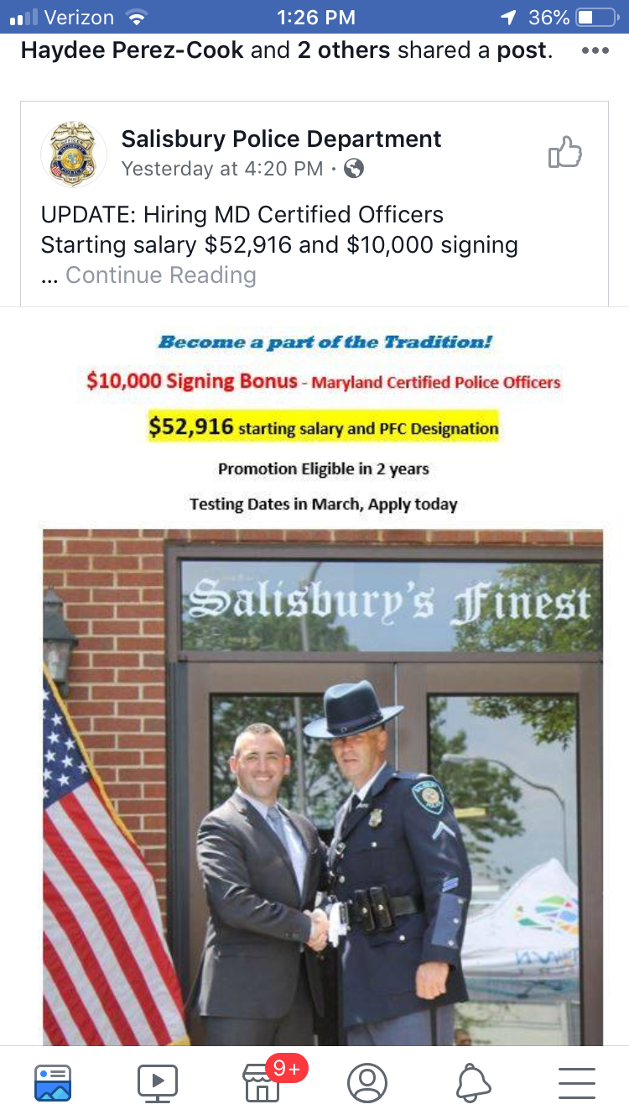
Salisbury PD Current Offer for Certified Officers

Slide 37
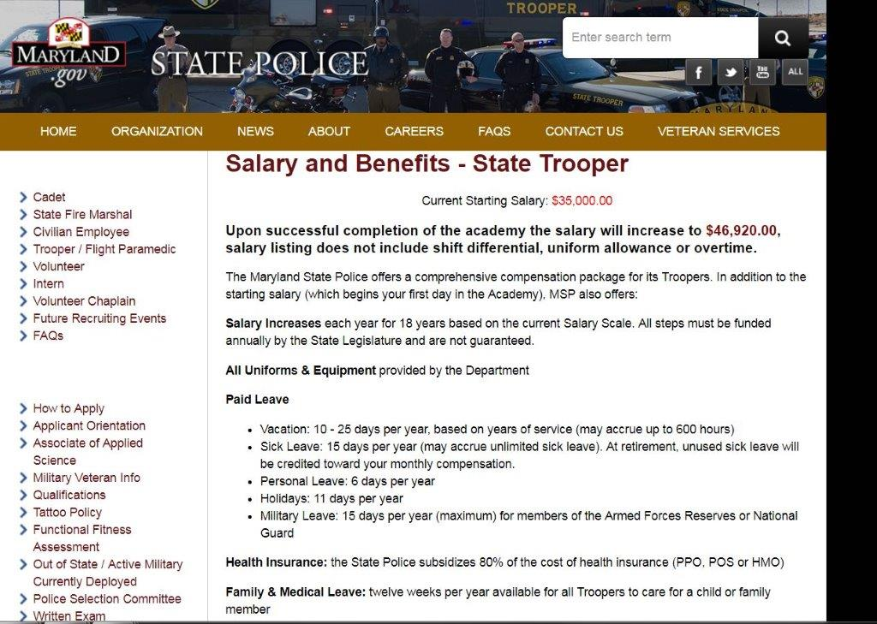
Maryland State Police current starting and after Academy pay

Slide 38

Delaware State Police current offer for entry level officers

Slide 39
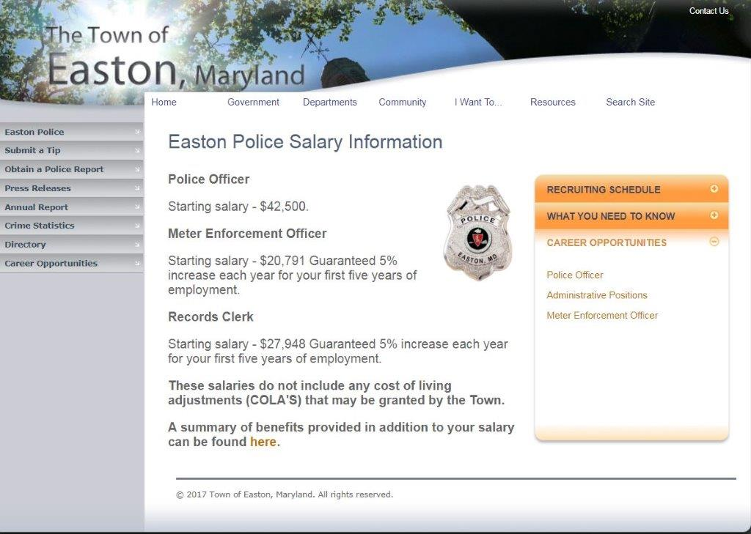
Easton PD Current offer for Entry Level

Slide 40

Federalsburg PD PD Entry Level

Slide 41
FY 2020 Requested Funding for Pay Increases
Requesting $6,000.00 across the board for all Sworn Officers
Averaging all above Salaries (PFC Scale) we are currently behind by approx $11,000.00
The Cambridge Police Department is the lowest starting pay on the entire Eastern Shore $37,197.00

Slide 42
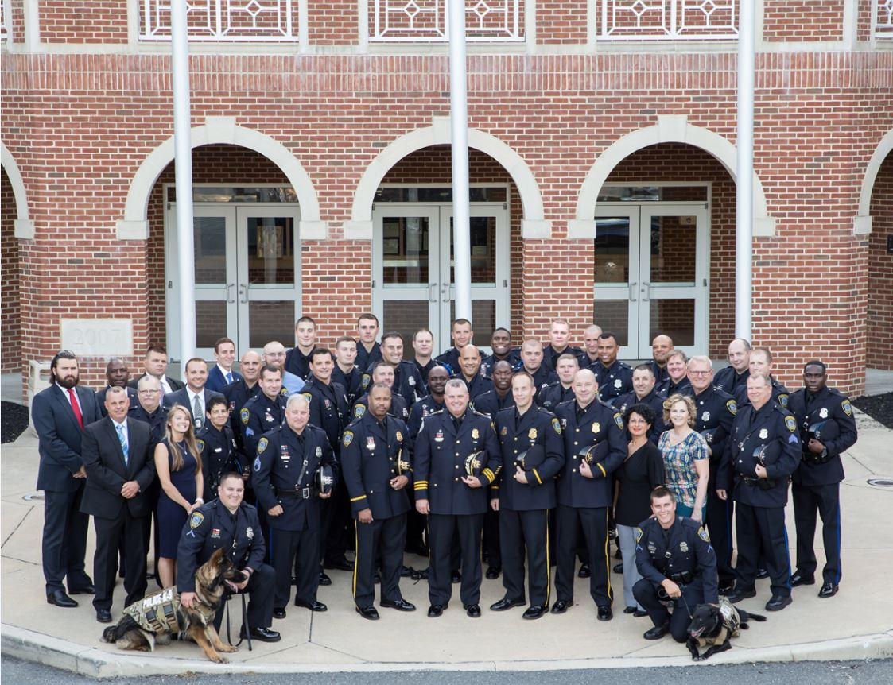
Thank you

