Slide 1
Board Meeting
February 17, 2022
Data Update
Attendance and ELA/Math
2021-2022 Mid-Year Review

Slide 2
Notes:
These average decline is 5.5% from the 2020-2021 SY, resemble the second semester of SY 20-21

Slide 3
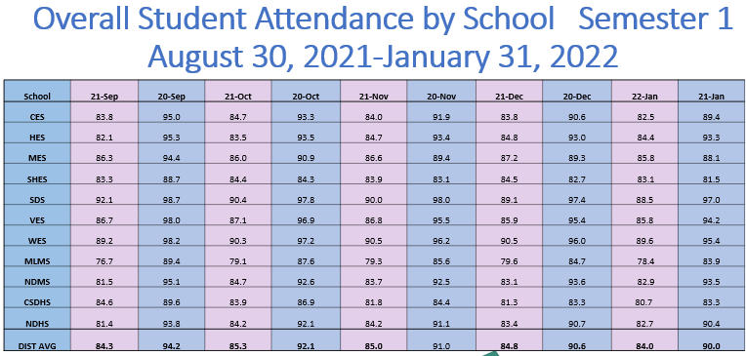

Slide 4
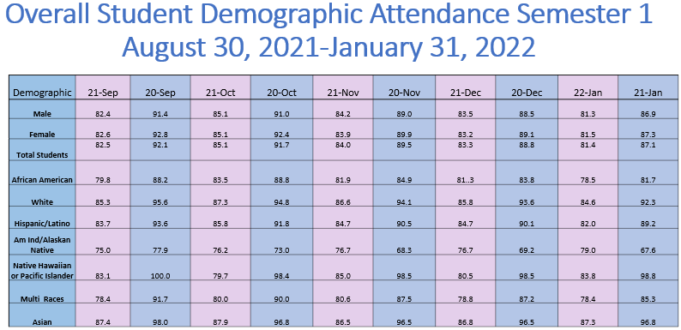
Notes:
- % Dist Attend by month which is calculated at the end of each month and the % Attend by Race and Gender is based on the current data which now has many more transfers in/out now

Slide 6
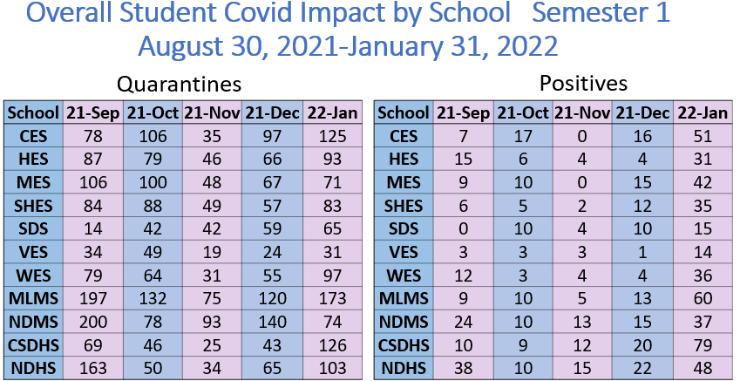
Notes:
__ students have been impacted 2 or more times, demographic break down pending

Slide 7
Early Fall MCAP
Dorchester County Early Fall MCAP 2021 Data
Grade | Assessment
4 | 3
5 | 4
6 | 5
7 | 6
8 | 7
9 | 8
10 | Alg
11 | Eng 10

Slide 8
Early Fall MCAP
English/Language Arts Grades 3-10 Average
Grade Span | Level 1 | Level 2 | Level 3
Elementary DCPS | 85% | 15% | 1%
Middle DCPS | 77% | 20% | 3%
High DCPS | 72% | 25% | 3%
State of Maryland | 65% | 29% | 6%

Slide 9
Early Fall MCAP
Mathematics Grades 3-10 Average
Grade Span | Level 1 | Level 2 | Level 3
Elementary DCPS | 94% | 5% | 1%
Middle DCPS | 92% | 7% | 1%
High DCPS | 98% | 2% | 0%
State of Maryland | 85% | 10% | 5%

Slide 10
i-Ready District Data
101 students moved up from 3+ GL Behind
145 students moved up from 2+ GL Behind
246 student increase in our 1+ GL to on GL

Slide 11
Elementary i-Ready District Data
92 students moved up from 3+ GL Behind
124 students moved up from 2+ GL Behind
216 student increase in our 1+ GL to on GL

Slide 12
Middle i-Ready District Data
8 students moved up from 3+ GL Behind
22 students moved up from 2+ GL Behind
30 student increase in our 1+ GL to on GL

Slide 13
Fall 2021 KRA Data
Fall 2021 Kindergarten Readiness Assessment
The Kindergarten readiness assessment evaluates students’ skills in several domains including social foundations, language and literacy, mathematics, and physical well-being and motor skills. Students fall within three ranges: emerging (at risk), approaching (some risk), and demonstrating (negligible or no risk). The KRA provides teachers with actionable data that allows them to plan instruction specific to the domains of greatest need and specific to each student based on student level data.

Slide 14
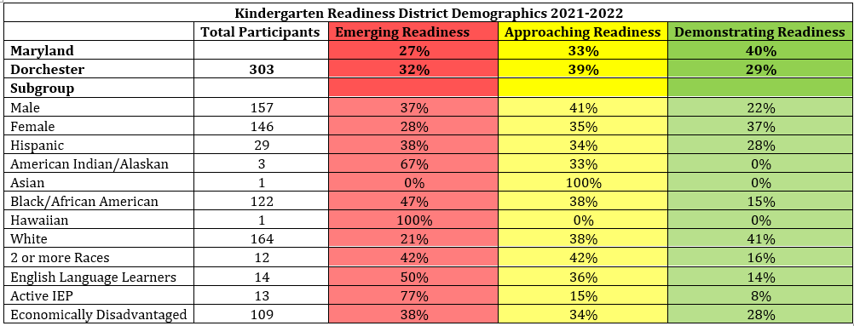
Fall 2021 KRA Data

Slide 15
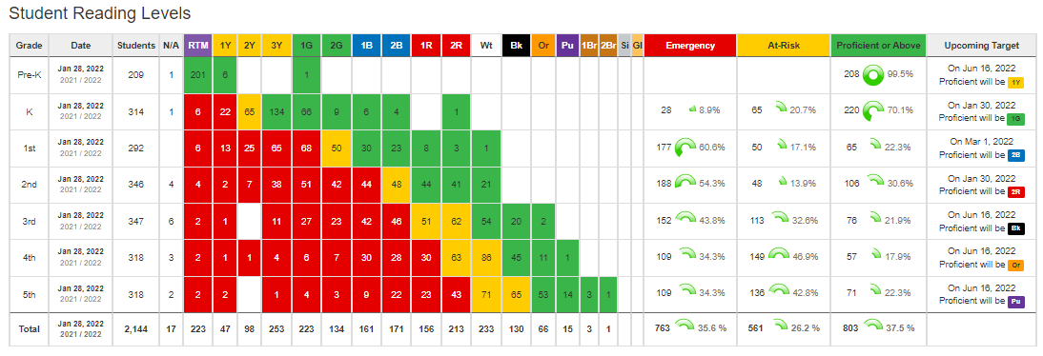
Current IRLA Levels
The IRLA (Independent Reading Level Assessment) measures each student’s independent reading level and is identified and monitored through one-on-one conferences with the teacher on a regular basis (at least one conference every two weeks, below grade level students receive additional conferences).

Slide 16
Current IRLA Growth
Since the fall, the percent of students considered emergency (>2 years below grade level) has reduced by 6.1%. (108)
Since the fall, the percent of students considered proficient or above has increased by 7.7%. (181)
Teachers hold additional conferences and provide targeted small group instruction to students in the emergency and at-risk levels to promote accelerated growth.

Slide 17
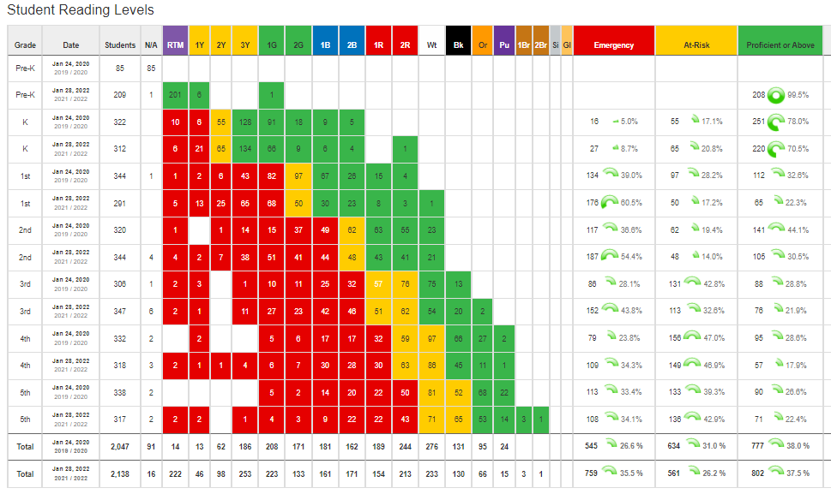
Data January 2020 vs. January 2022
Notes:
IRLA Reading Level - percentage of students reading at grade level independently - this does not reflect the instructional level. All students still receive grade level instruction during the core reading block.
Reading Practice - the percentage of students that are at the step goal. Students are expected to reading 4 steps (15 minute increments) independently per day. At least 2 in school and 2 at home.
Conferencing - the percentage of students that have had a conference documented in schoolpace within the last two weeks. Teachers conference with students while the class is independently reading and practicing power goals. The actual percentage may be higher than what is reflected if some conferences are not recorded in SchoolPace. Some quick check-ins are not always documented.

Slide 18
DIBELS
Dynamic Indicators of Basic Literacy Skills
DIBELS 8th Edition is a set of short (one minute) fluency measures that can be used for universal screening, benchmark assessment, and progress monitoring in Kindergarten to 8th grade. DIBELS 8th Edition provides educators with standards for gauging the progress of all students.

Slide 19
Kindergarten and 1st Grade
Beginning & Middle of the Year Data
Kindergartners increased their on level and above students by 4%. First graders decreased their on level and above students by 3%.

Slide 20
Current 2nd and 3rd Grade DIBELS Data
Second and third graders decreased their on level readers by 3%.

Slide 21
Current 4th and 5th Grade DIBELS Data
Fourth graders have the same percentage of on or above grade level students from the beginning of the year to the middle of the year; however their above level students increased by 12%. Fifth graders increased their on and above level students by 4%.

Slide 22
Lexia Core5
Lexia Core5 Reading is a technology-based reading program that provides explicit and in-depth instruction in six areas of reading for students in Pre-K through Grade 5.
Phonological awareness
Phonics
Vocabulary
Structural analysis
Automaticity/fluency
Comprehension

Slide 23
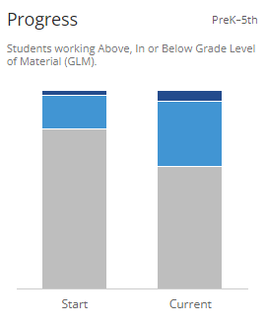
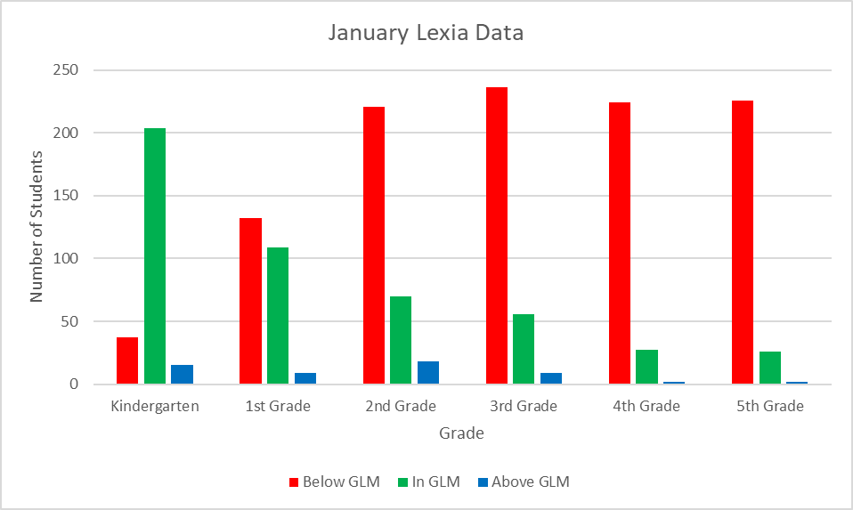
Current Lexia Data
2%
5%
17%
33%
81%
62%

Slide 24
Lexia PowerUp
Lexia PowerUp Reading is a technology-based reading program, much like Lexia Core5, that provides explicit and in-depth instruction in three areas of reading for students in grades 6-12.
Grammar
Word Study
Comprehension

Slide 26
Lexia Power Up - Word Study
Grade | Students | Placement Foundational % | Current Foundational % | Placement Intermediate % | Current Intermediate % | Placement Advanced % | Current Advanced %
6th Grade | 313 | 62 | 48 | 36 | 47 | 2 | 5
7th Grade | 325 | 59 | 39 | 38 | 46 | 3 | 15
8th Grade | 352 | 54 | 34 | 42 | 46 | 4 | 20
9th Grade | 362 | 52 | 32 | 44 | 49 | 4 | 19
10th Grade | 224 | 42 | 27 | 53 | 52 | 5 | 21
11th Grade | 70 | 53 | 47 | 43 | 46 | 4 | 7
12th Grade | 29 | 56 | 45 | 41 | 52 | 3 | 3

Slide 28
Lexia Power Up - Grammar
Grade | Students | Placement Foundational % | Current Foundational % | Placement Intermediate % | Current Intermediate % | Placement Advanced % | Current Advanced %
6th Grade | 311 | 79 | 74 | 19 | 24 | 2 | 2
7th Grade | 324 | 71 | 60 | 26 | 36 | 3 | 4
8th Grade | 352 | 60 | 51 | 33 | 38 | 7 | 11
9th Grade | 361 | 59 | 48 | 33 | 40 | 8 | 12
10th Grade | 223 | 42 | 35 | 42 | 43 | 16 | 22
11th Grade | 66 | 42 | 41 | 43 | 44 | 15 | 15
12th Grade | 29 | 55 | 52 | 45 | 48 | 0 | 0

Slide 30
Lexia Power Up - Comprehension
Grade | Students | Placement Foundational % | Current Foundational % | Placement Intermediate % | Current Intermediate % | Placement Advanced % | Current Advanced %
6th Grade | 314 | 45 | 35 | 49 | 56 | 6 | 9
7th Grade | 327 | 43 | 29 | 48 | 54 | 9 | 17
8th Grade | 355 | 35 | 23 | 46 | 52 | 19 | 25
9th Grade | 366 | 34 | 23 | 51 | 50 | 15 | 27
10th Grade | 226 | 17 | 15 | 57 | 51 | 26 | 34
11th Grade | 74 | 9 | 9 | 49 | 49 | 42 | 42
12th Grade | 29 | 3 | 3 | 76 | 73 | 21 | 24

Slide 31
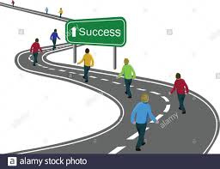
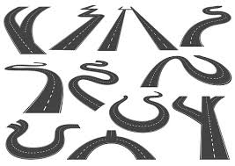
Thank you!
Kirk Howie
Director of Student Services
Michael Collins
Director of Curriculum & Assessment

