Slide 1
DCTC February 2022
Katelyn Masden
DCTC Student Board Representative Alternate
February 17, 2022

Slide 2
February is CTE Month
Notes:
February is CTE Month. We use this month to celebrate and spread awareness about the importance of Career and Technical Education for our students and our nation’s economy with some of these outreach opportunities.

Slide 3
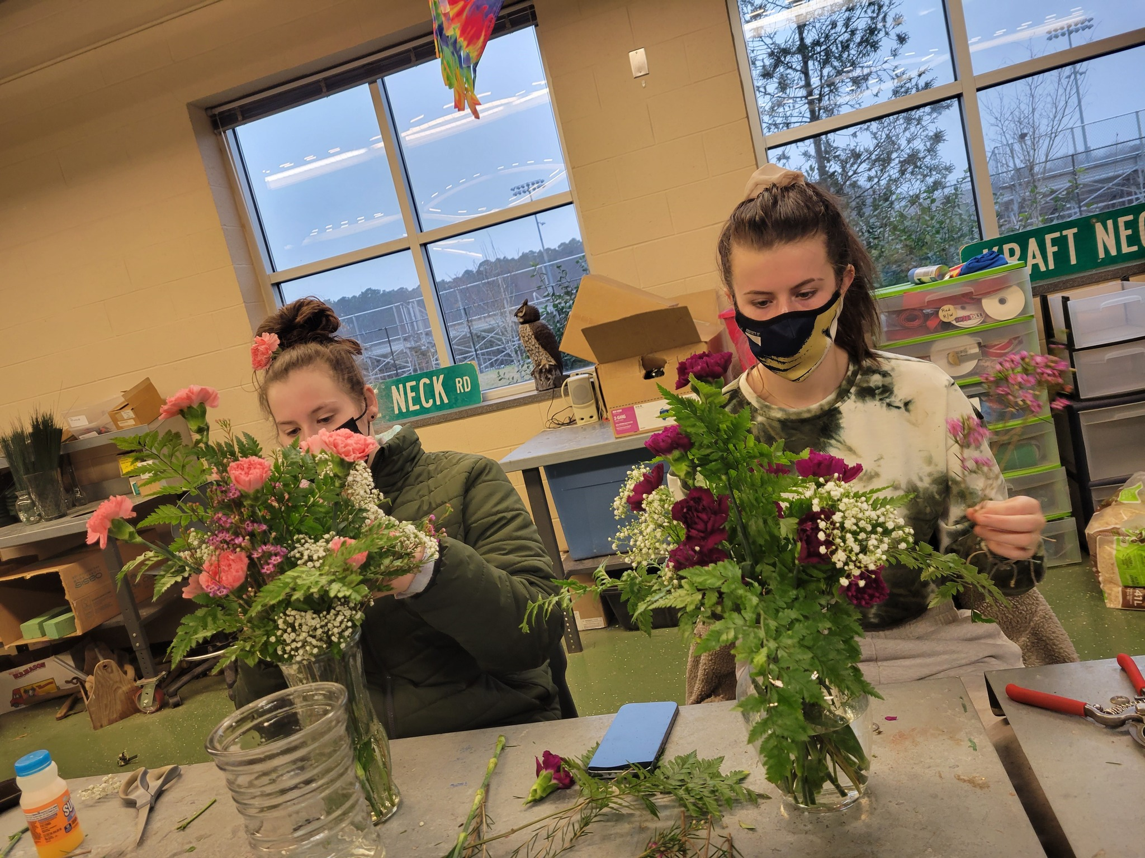
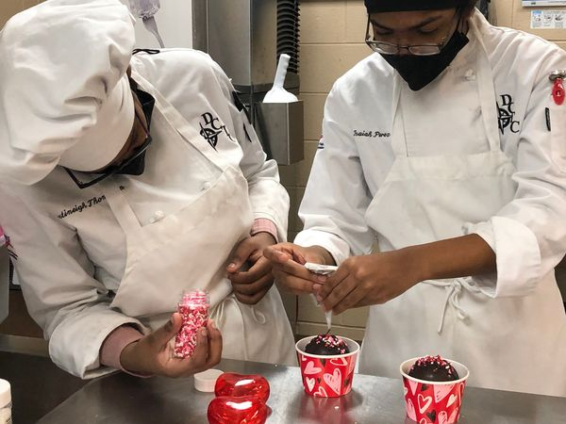
Culinary Arts and CASE
Notes:
Culinary Arts and CASE students were highlighted in a news segment on WMDT, Channel 47 as they created special gifts for Valentine’s Day.

Slide 4
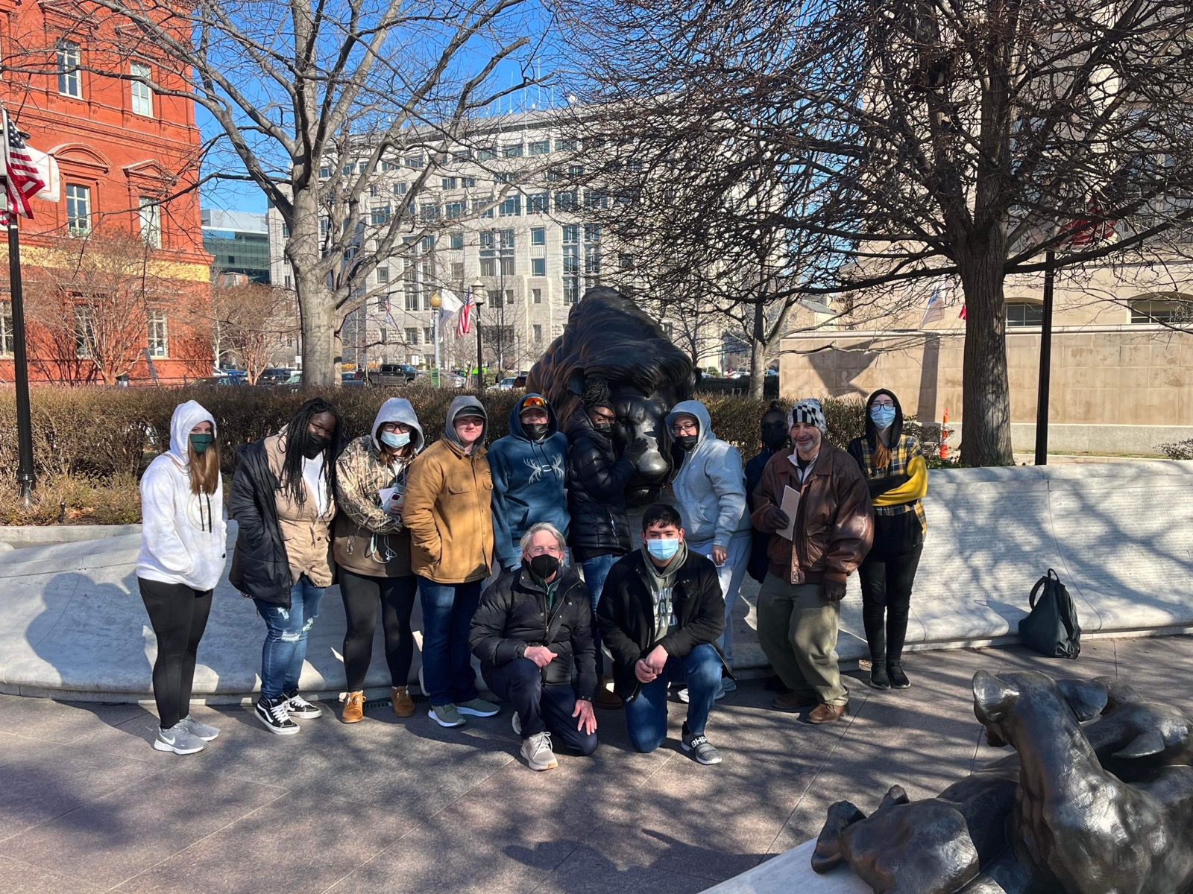
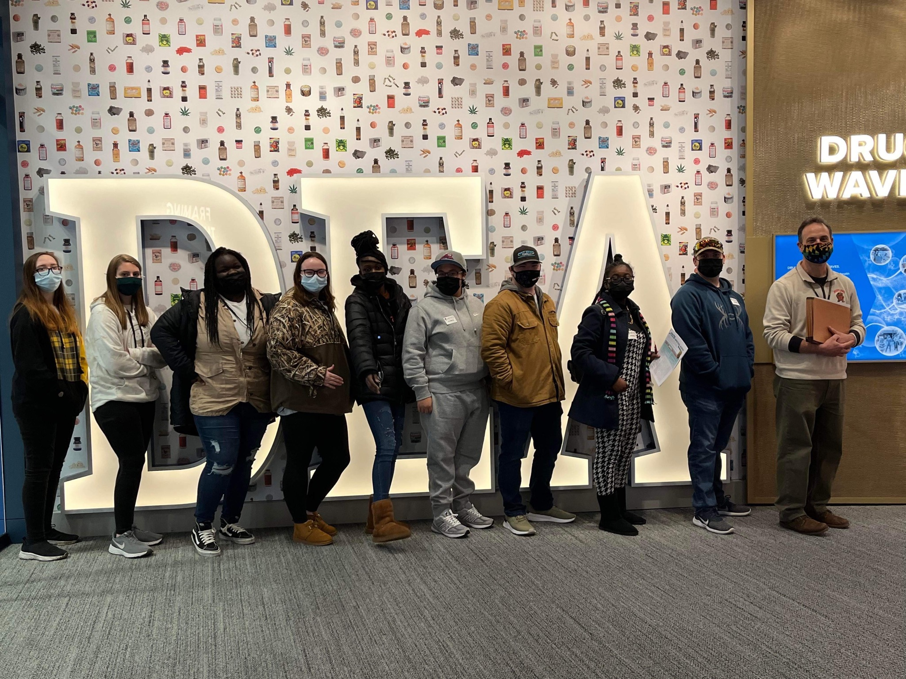
Homeland Security/Criminal Justice Field Trip
Notes:
On Wednesday January 26th 2022 Forensic Science students travelled to the Drug Enforcement Agency (DEA) Museum in Arlington, VA. There, students looked through a history of the agency through interactive exhibits and artifacts. They also heard from agents involved in the Fingerprint, Digital and Chemistry Divisions of the agency. Students learned about other jobs in the DEA and how their grades and behaviors today can help or hinder their futures.
The class also travelled to the National Law Enforcement Officers Memorial Wall in Washington, D.C. Students had previously researched the history of an officer who was killed in the line of duty. At the wall, they made a rubbing of the officer’s name. They also learned about the history of the wall itself, which is represented by adult lions looking over their cubs.

Slide 5
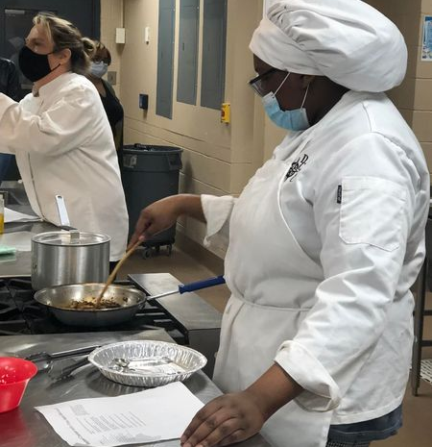
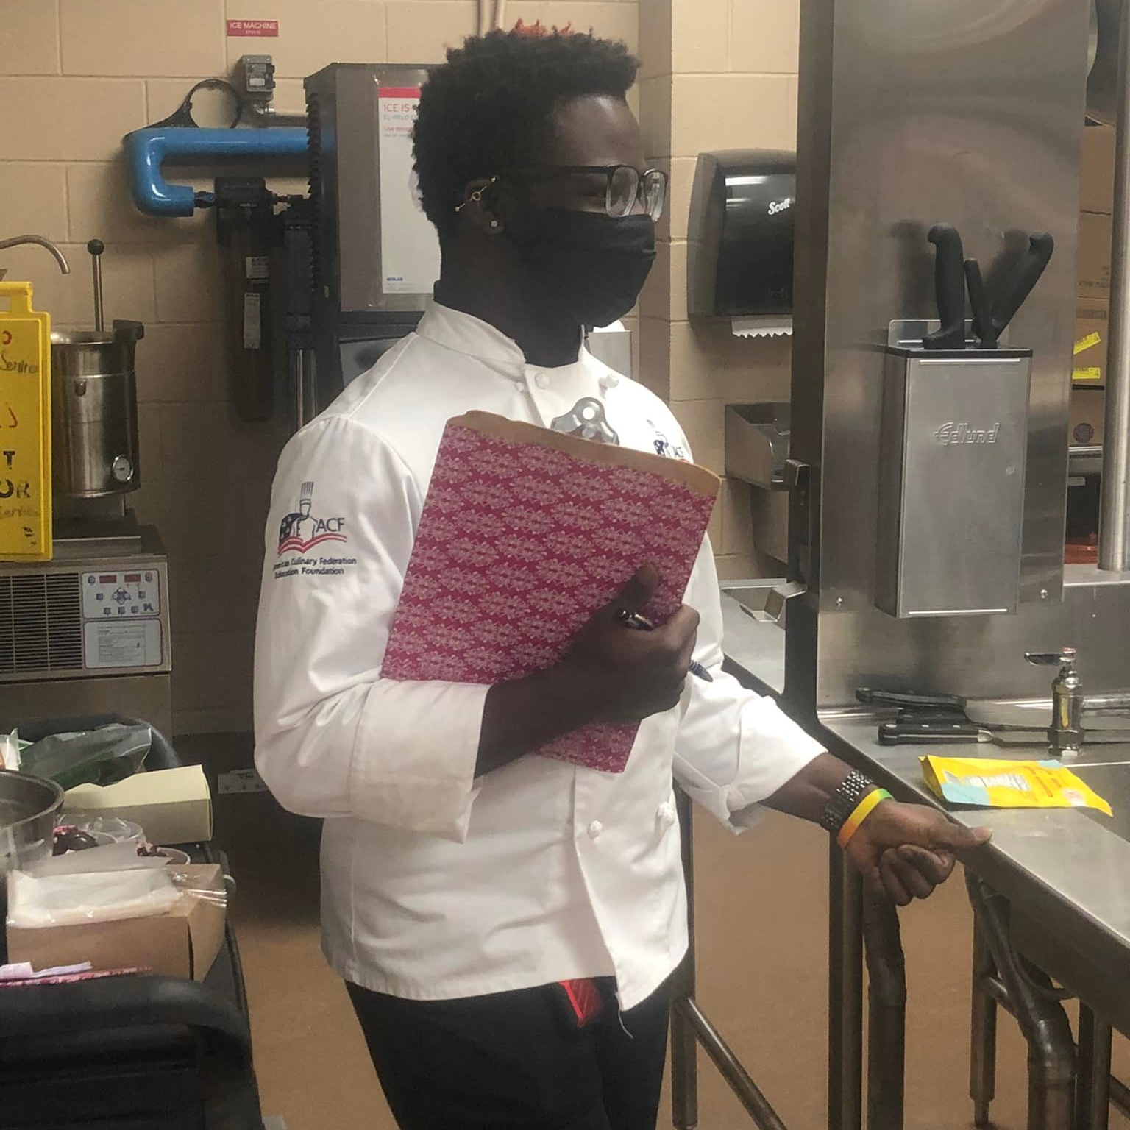
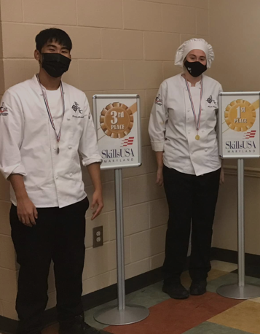
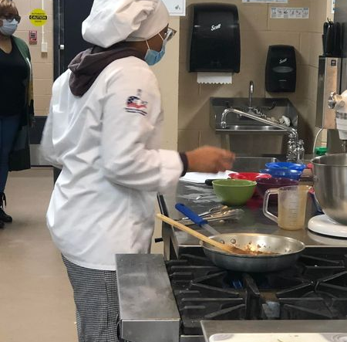
Culinary Arts – Local SkillsUSA Competition
Notes:
There’s nothing like a competition to help sharpen skills. DCTC Culinary Arts students had the opportunity to take part in a SkillsUSA local competition. Congratulations to Myra Peters, a C-SD senior, and Madison Horsman, a junior at NDHS, who both qualified for the SkillsUSA statewide competition in April! Thank you to all the competitors and their cheering sections for giving up their Saturday, and a special thank you to the judging team of Philip Cropper, Culinary Arts teacher at Worcester Technical High School and Quadry Lake, C-SD/DCTC Class of 2019 and 2nd place winner in the 2019 state competition.

Slide 6
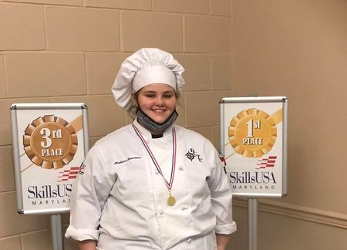
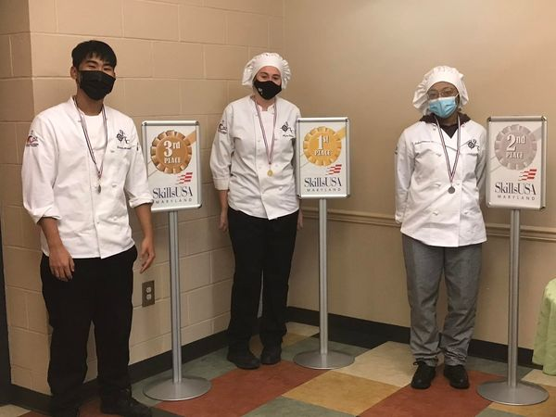
SkillsUSA Local Competition Winners
Notes:
Culinary Arts Medialists
3rd Place – Kheevin Moeurk
2nd Place- Jaloni Watson
1st Place – Myra Peters
Baking – 1st Place – Madison Horsman

Slide 7
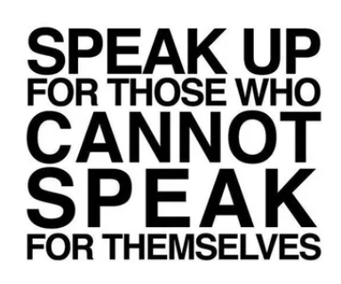
Medical Services
Guest Speaker – Julie Crain from Harriett’s House spoke to students in January to bring more awareness about how human trafficking is a community health issue that is increasing on the Eastern Shore of Maryland.

Slide 8
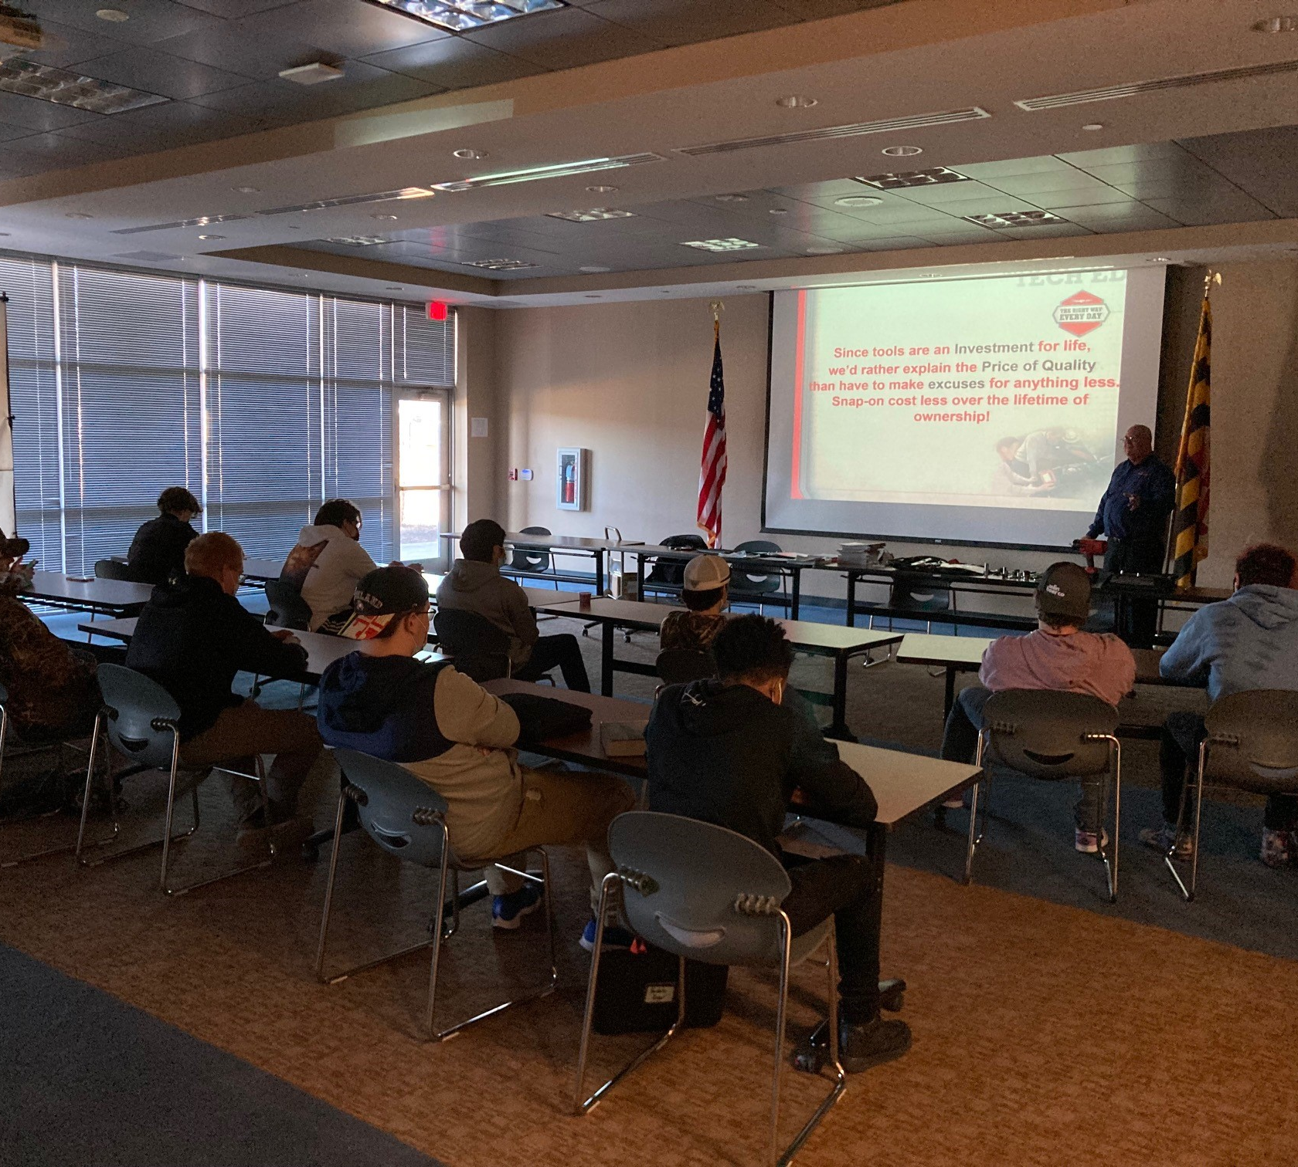
Transportation Technologies
Company: Snap-On
Presenter: John Wolski
Notes:
John Wolski presented to our students at DCTC and explain productivity and the need for tools that won’t let you down.

Slide 9
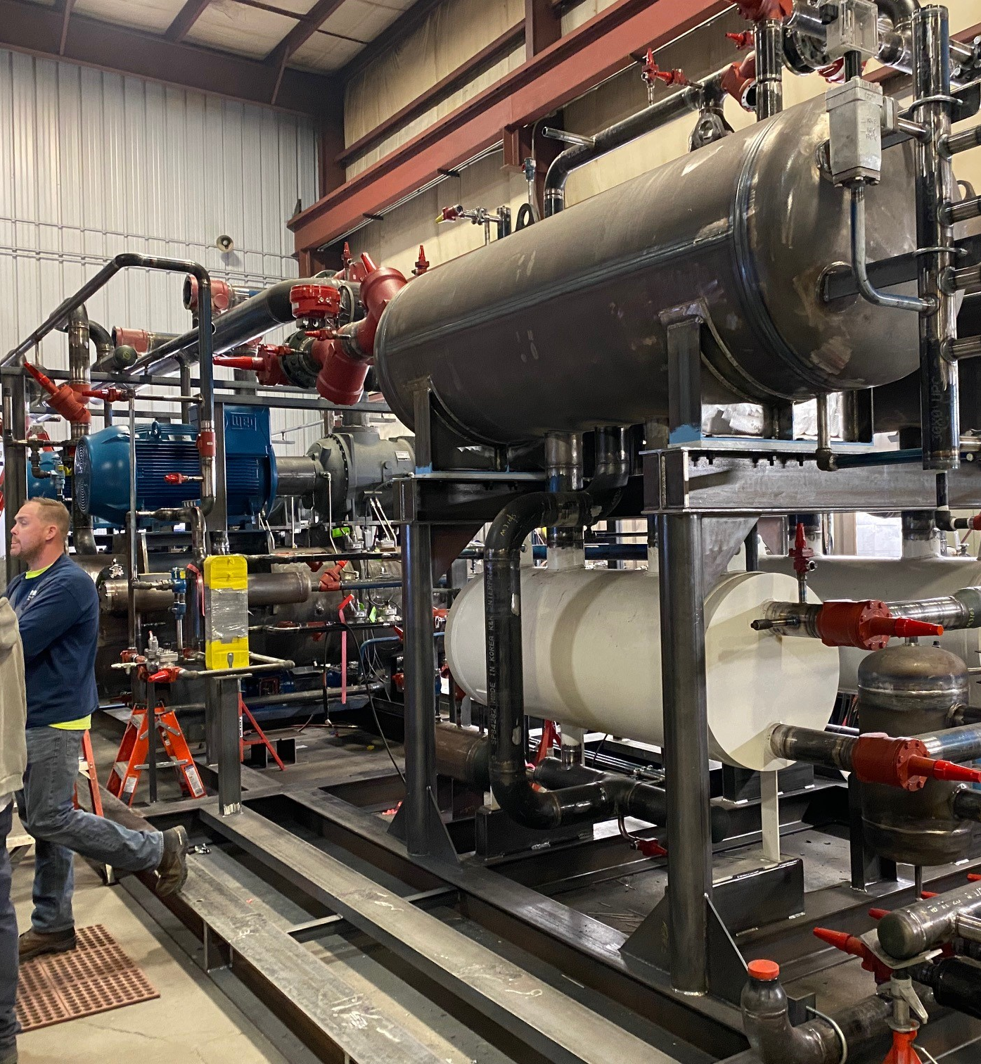
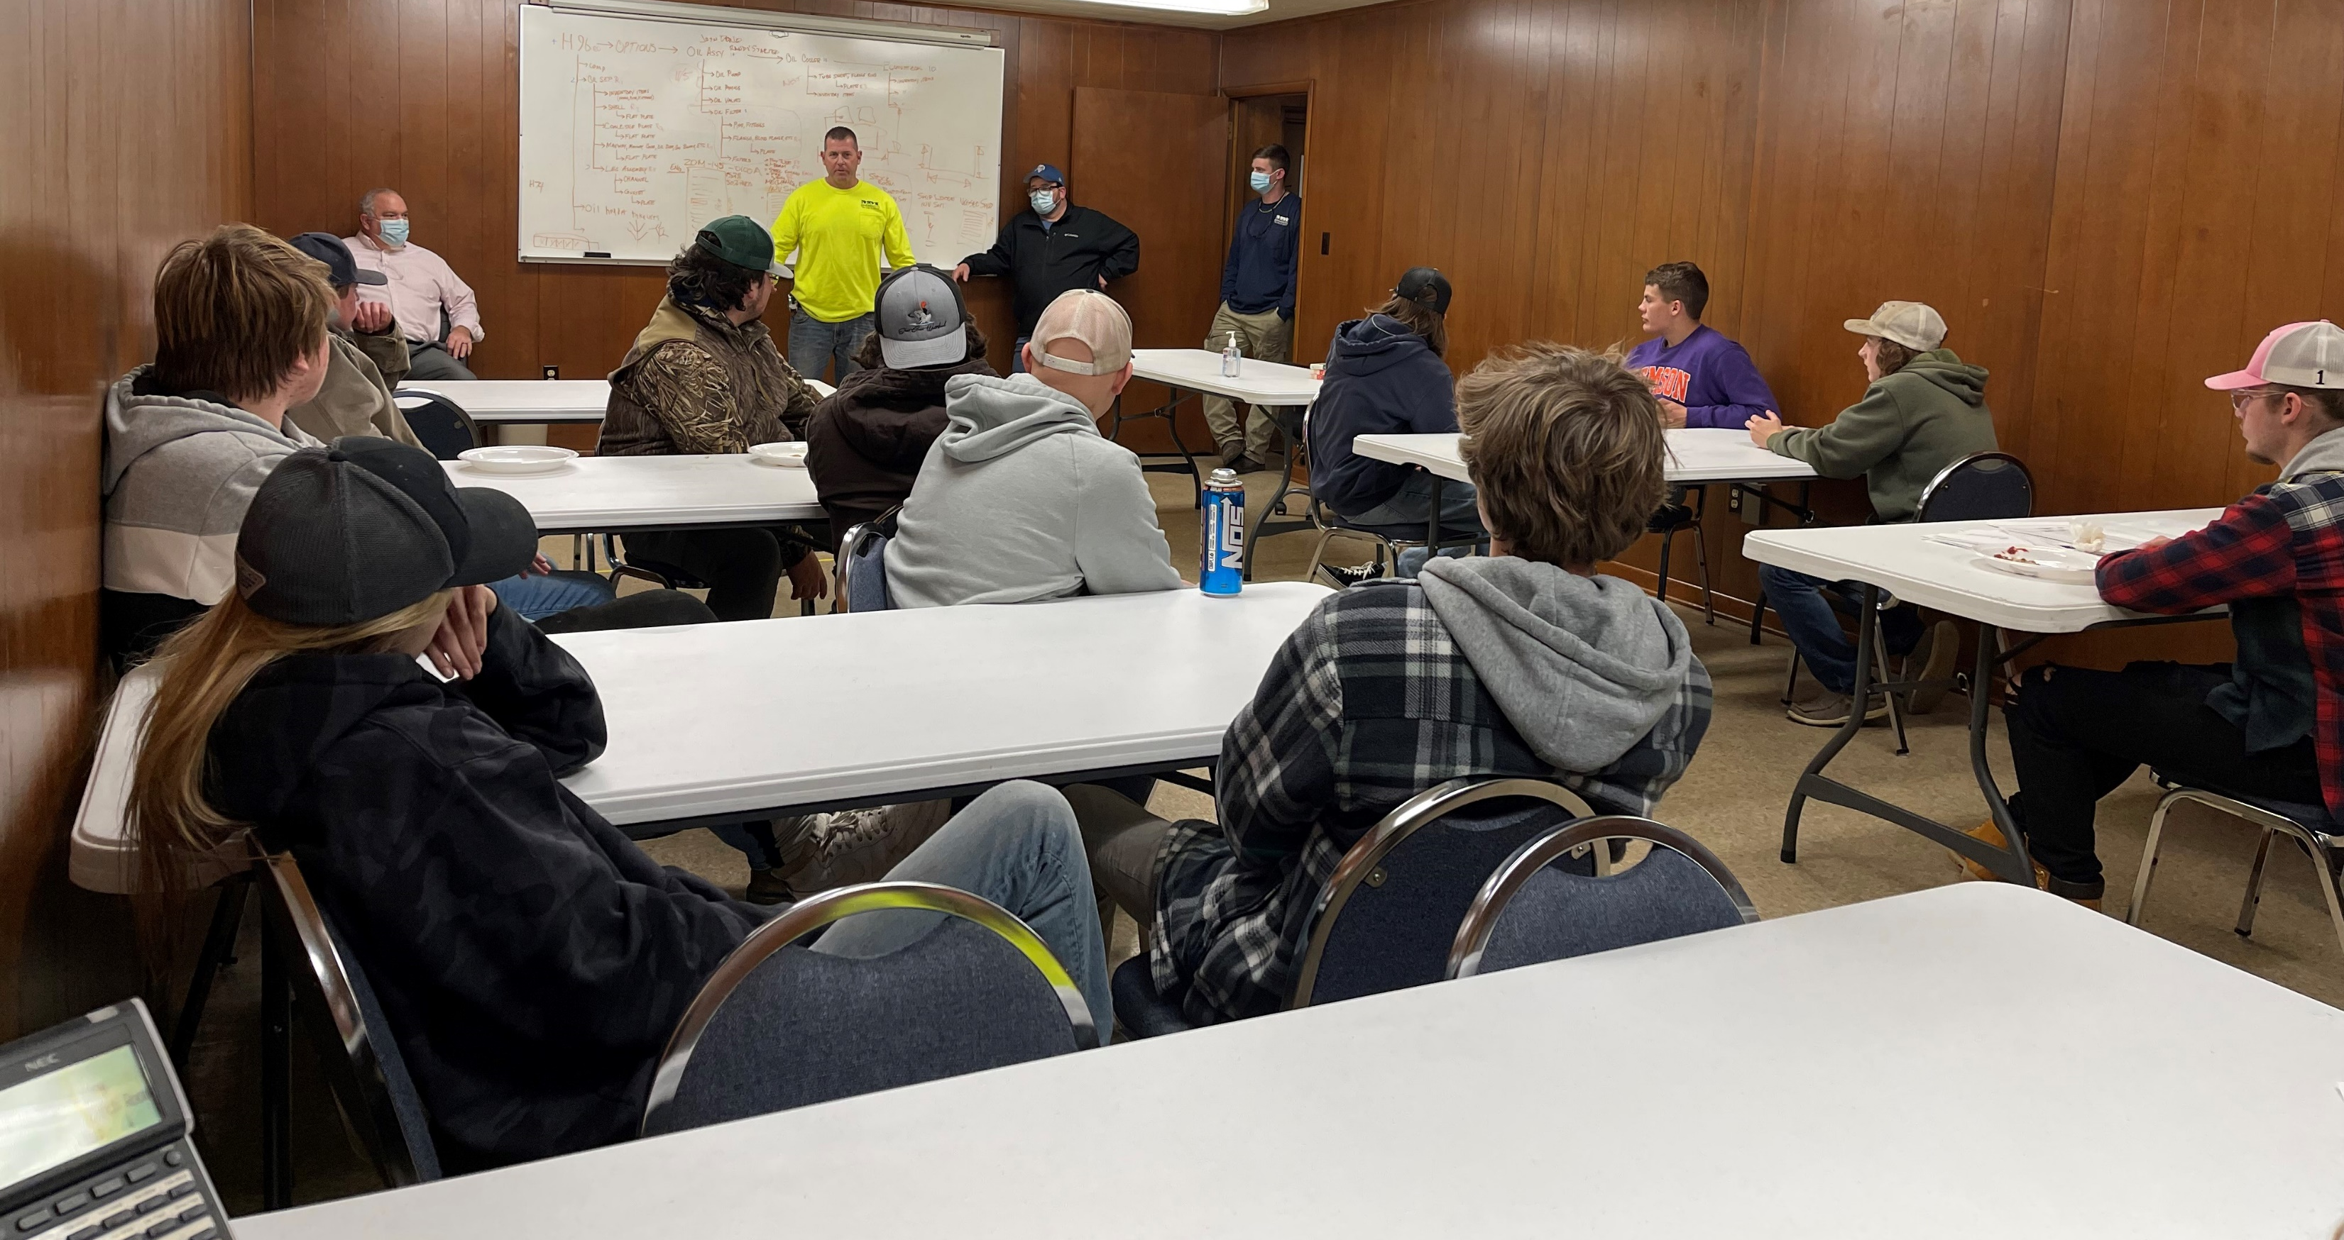
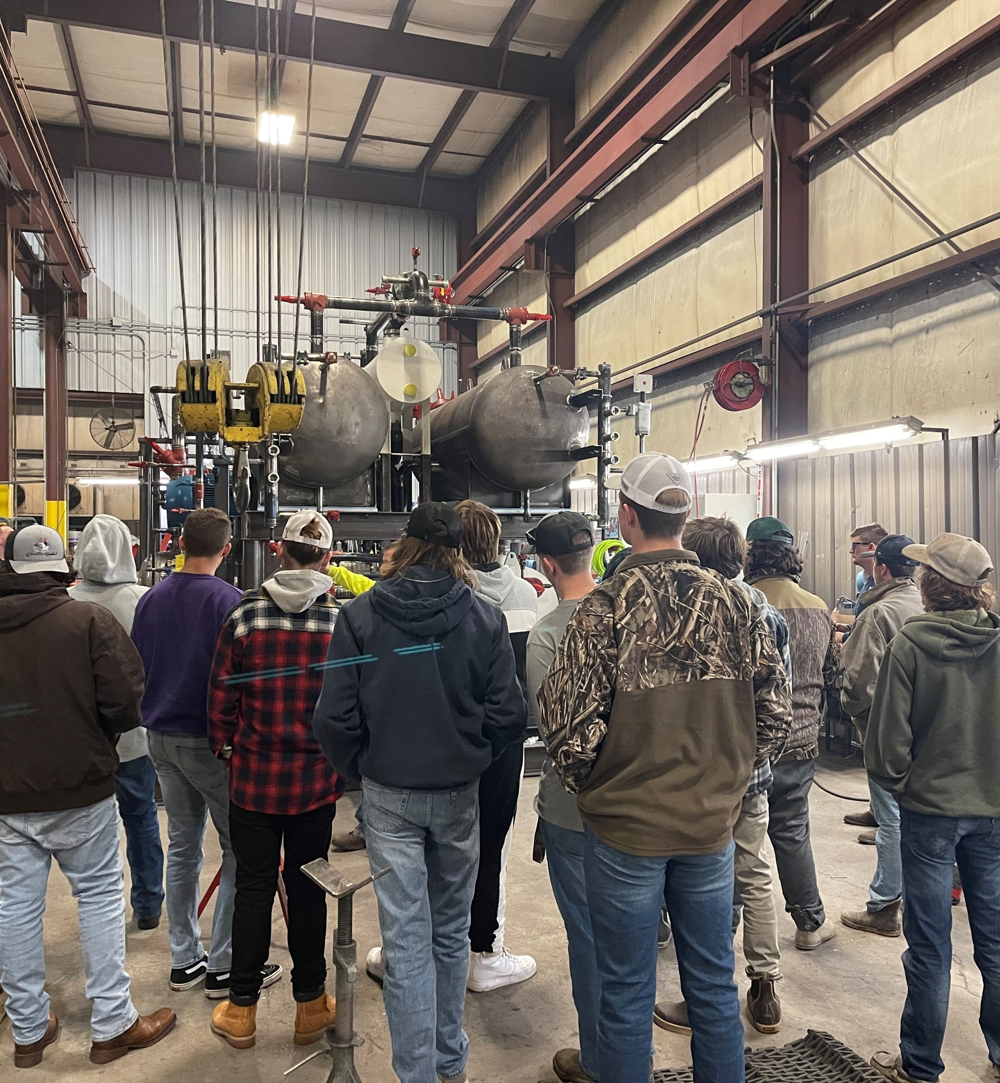
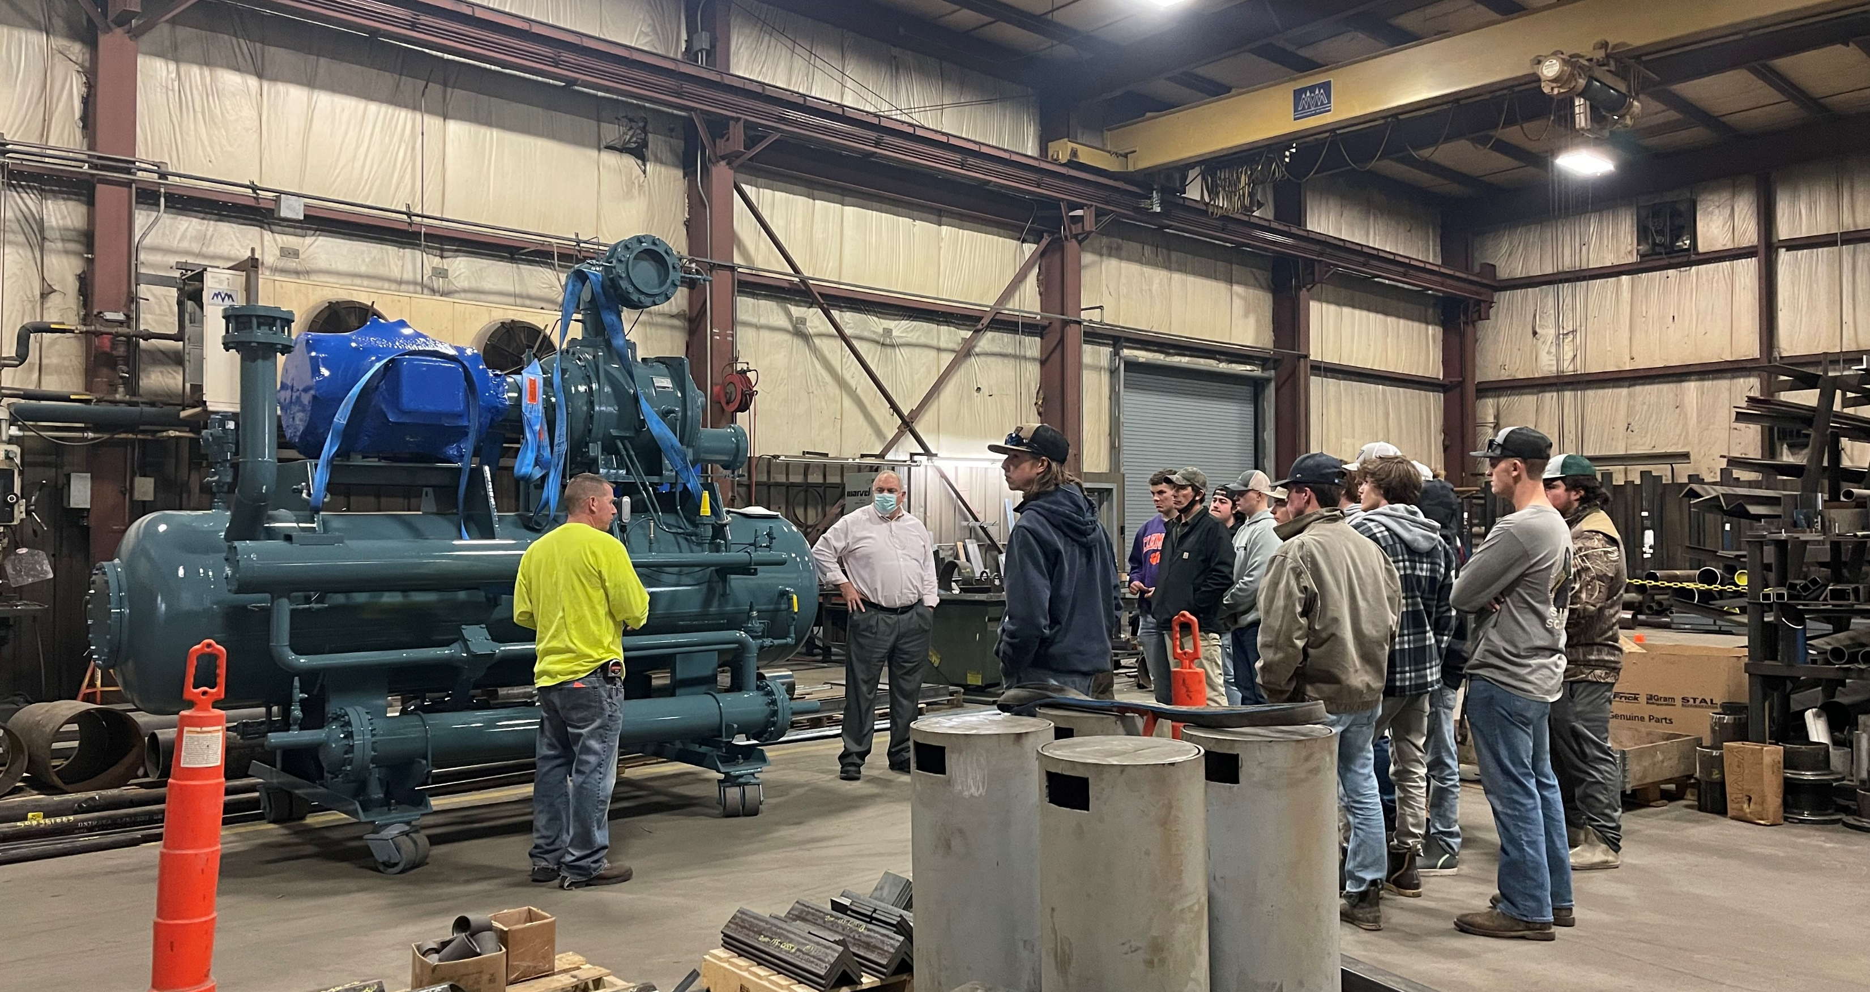
American Welding Society
Notes:
The DCTC American Welding Society Student Chapter visited M and M Carnot Refrigeration in Federalsburg, MD. Students had the opportunity to meet with the owners, managers, inspectors, and welders on the floor for a first-hand look at what is expected of them in the field as a welder. M and M Carnot is a worldwide company home based in Federalsburg with a customer base that consists of large well-known meat distributors as well as the LEGO Corporation. Yes, refrigerated equipment is used in our favorite childhood toy. Students were also able to meet graduates from the Welding program, Austin Kimmey, Payton Thomas, Gavin Mowery, and Shane Hallbrook.

Slide 10
THANK YOU

