Slide 1
News from The Nest
By: The NDHS Representative Team
February 17, 2022

Slide 2
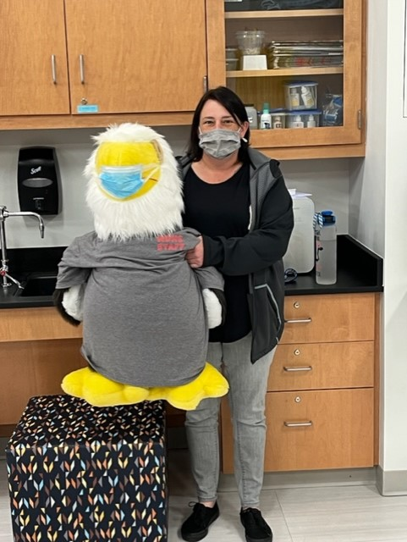
Introduction
Hello Mr. Bromwell, President Layton, Board members, and families at home.
I'm very happy to see everybody. Happy Valentine's Day!
January 31st marked the beginning of the 3rd quarter and 2nd semester! New Classes means new goals!

Slide 3
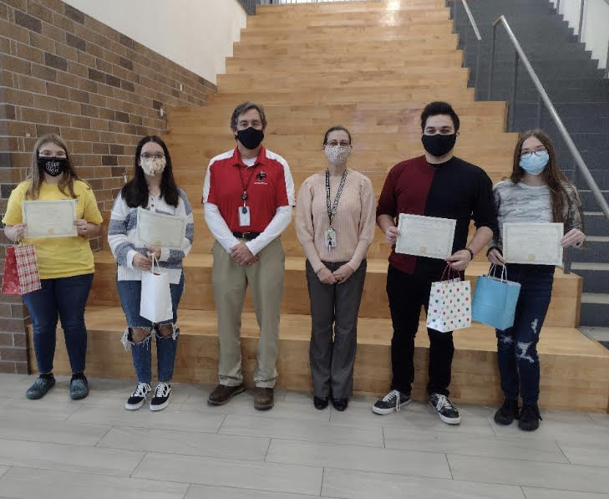
Student Shout Outs
Ashton Alvis paired with Luke Dukes (C-SD) to win the Unified Strength and Conditioning Gold Medal in the deadlift.
Avlynn Bennett and Milan Jiggetts for making Posters and Slideshows for Black History Month
PBIS Students of the Month for January 2022:
Freshman: Madison Tobat and Liam Douglas
Sophomores: Harlan Hill and Emilee Cohee
Juniors: Alexander Crannell and Harlie Knox
Seniors: Jaime Fonseca Gonzalez and Cartney Jarrell
NDHS Writing Contest Winners:
Hailey Stivers: Best Realistic Fiction
Hope Benjamin: Best Historical Fiction
Joshua Gravenor: Best Psychological Thriller
Mackenzie McCarter: Best Use of Figurative Language

Slide 4
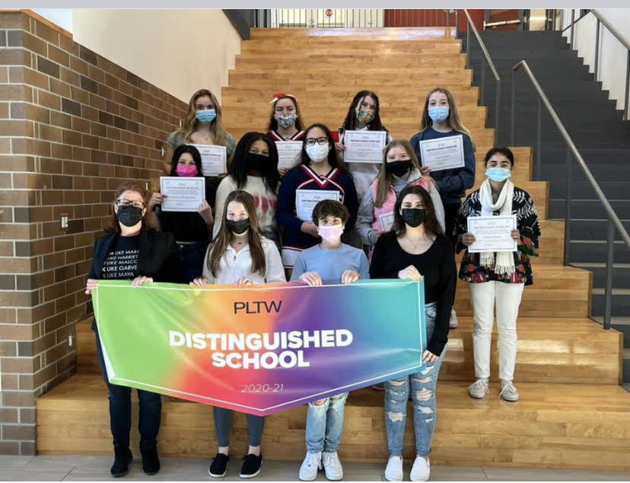
Student Shout Outs
PLTW students honored for their National Exam Scores on 2/10:
Alyssa James
Alexis Lednum
Emilee Cohee
Ta’Tyana Maradiaga
Laila Stafford
Cristina Lopez
Landon Green
Maddie Tobat
Sydney Santos
Katelyn Hopkins
Fatima Kaleem
Chloe Carpenter
Raven Molock received the Presidential Scholarship at Stevenson University for her work with the PLTW Program!

Slide 5
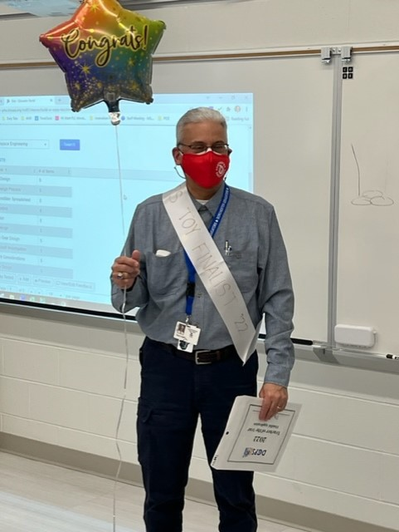
Staff Shout Outs
PBIS Staff of the Month for January 2022:
Dr. Laura Aberg and Brock Boland
Bubba Recipients since January:
Matthew D’Amario, Brock Boland, Kaitlyn Prekrel , and Jennifer Walter
Congratulations to Mr. Phil Albert for being NDHS Teacher of the Year nominee!!
New Teachers to The Nest
Ms. Milagros Pabon - Cabrera
Mr. Cecil Johnson
Mr. Brandon Hallbrook

Slide 6
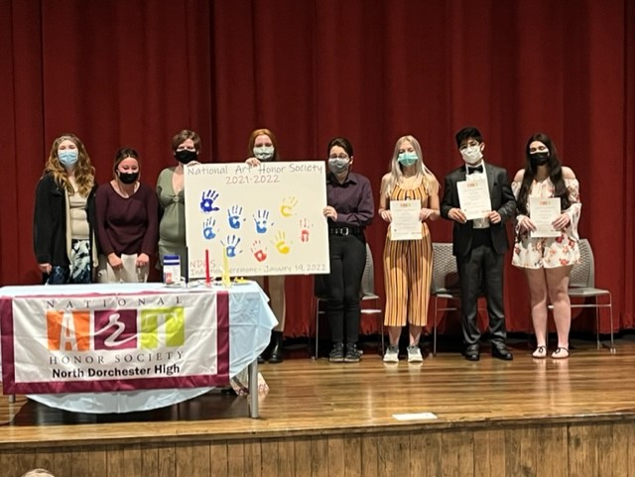
Clubs & Programs
January 19 - Club Pictures were held
January 19 - National Art Honor Society Induction was held with 4 new members inducted.
Kindness Club is putting out a Google Form to vote for Club Officers
Mentorship Club is picking a new Club Name
Prom Committee meet at their monthly meeting and chose the theme of Prom.
National Honor Society is having a canned food drive that started on February 14.

Slide 7
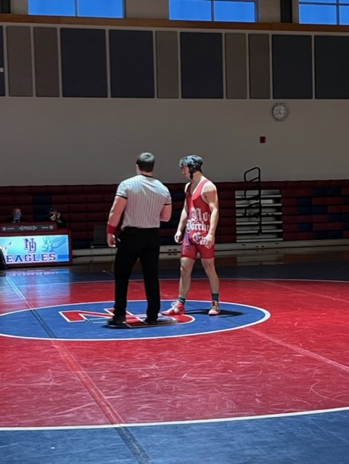
Athletics
January 22- Virtual Unified Athletics Summit held
February 5- Bayside Swimming Championships held with Doc as the administrator.
February 11/12- Annual Care and Prevention/CPR classes for athletic coaches held
NDHS is preparing for spring sports!
NDHS wrestling hosted its first ever State Regional Duals on February 7!
Athletic Winter Pictures were taken on February 8
Winter Sports had their Senior Nights

Slide 8
Current Events
MCAP Winter ELA/Math and MISA testing was in full-force led by Ms. Bennett.
For the Celebration of Black History Month, Kindness club is hosting a Door Decorating Contest for Staff.
NDHS has been participating in HBCU Spirit Wear every Friday of February!
Morgan State University (Orange and Blue)
University of Maryland Eastern Shore ( Maroon and Grey)
Delaware State University ( Red and Blue)
Bowie State University (Yellow and Black)
Multiple posters have been hung around ND with famous quotes and pictures
Kindness Club will also be holding a Black History Month Trivia that will be announced every Friday.

Slide 9
AVID Plans @ND
Even though ND does not have any AVID classes for this semester, AVID students are helping share AVID principles through daily instruction and activities.
The 9th grade AVID students are looking forward to going on a college tour soon
AVID Students also enjoyed learning about college loans and how those work in relation to grants, scholarships, etc. This will hopefully encourage them to do the best they can to qualify for some "free" college money as they continue their high school path.

Slide 10
Thank You All

