Slide 2
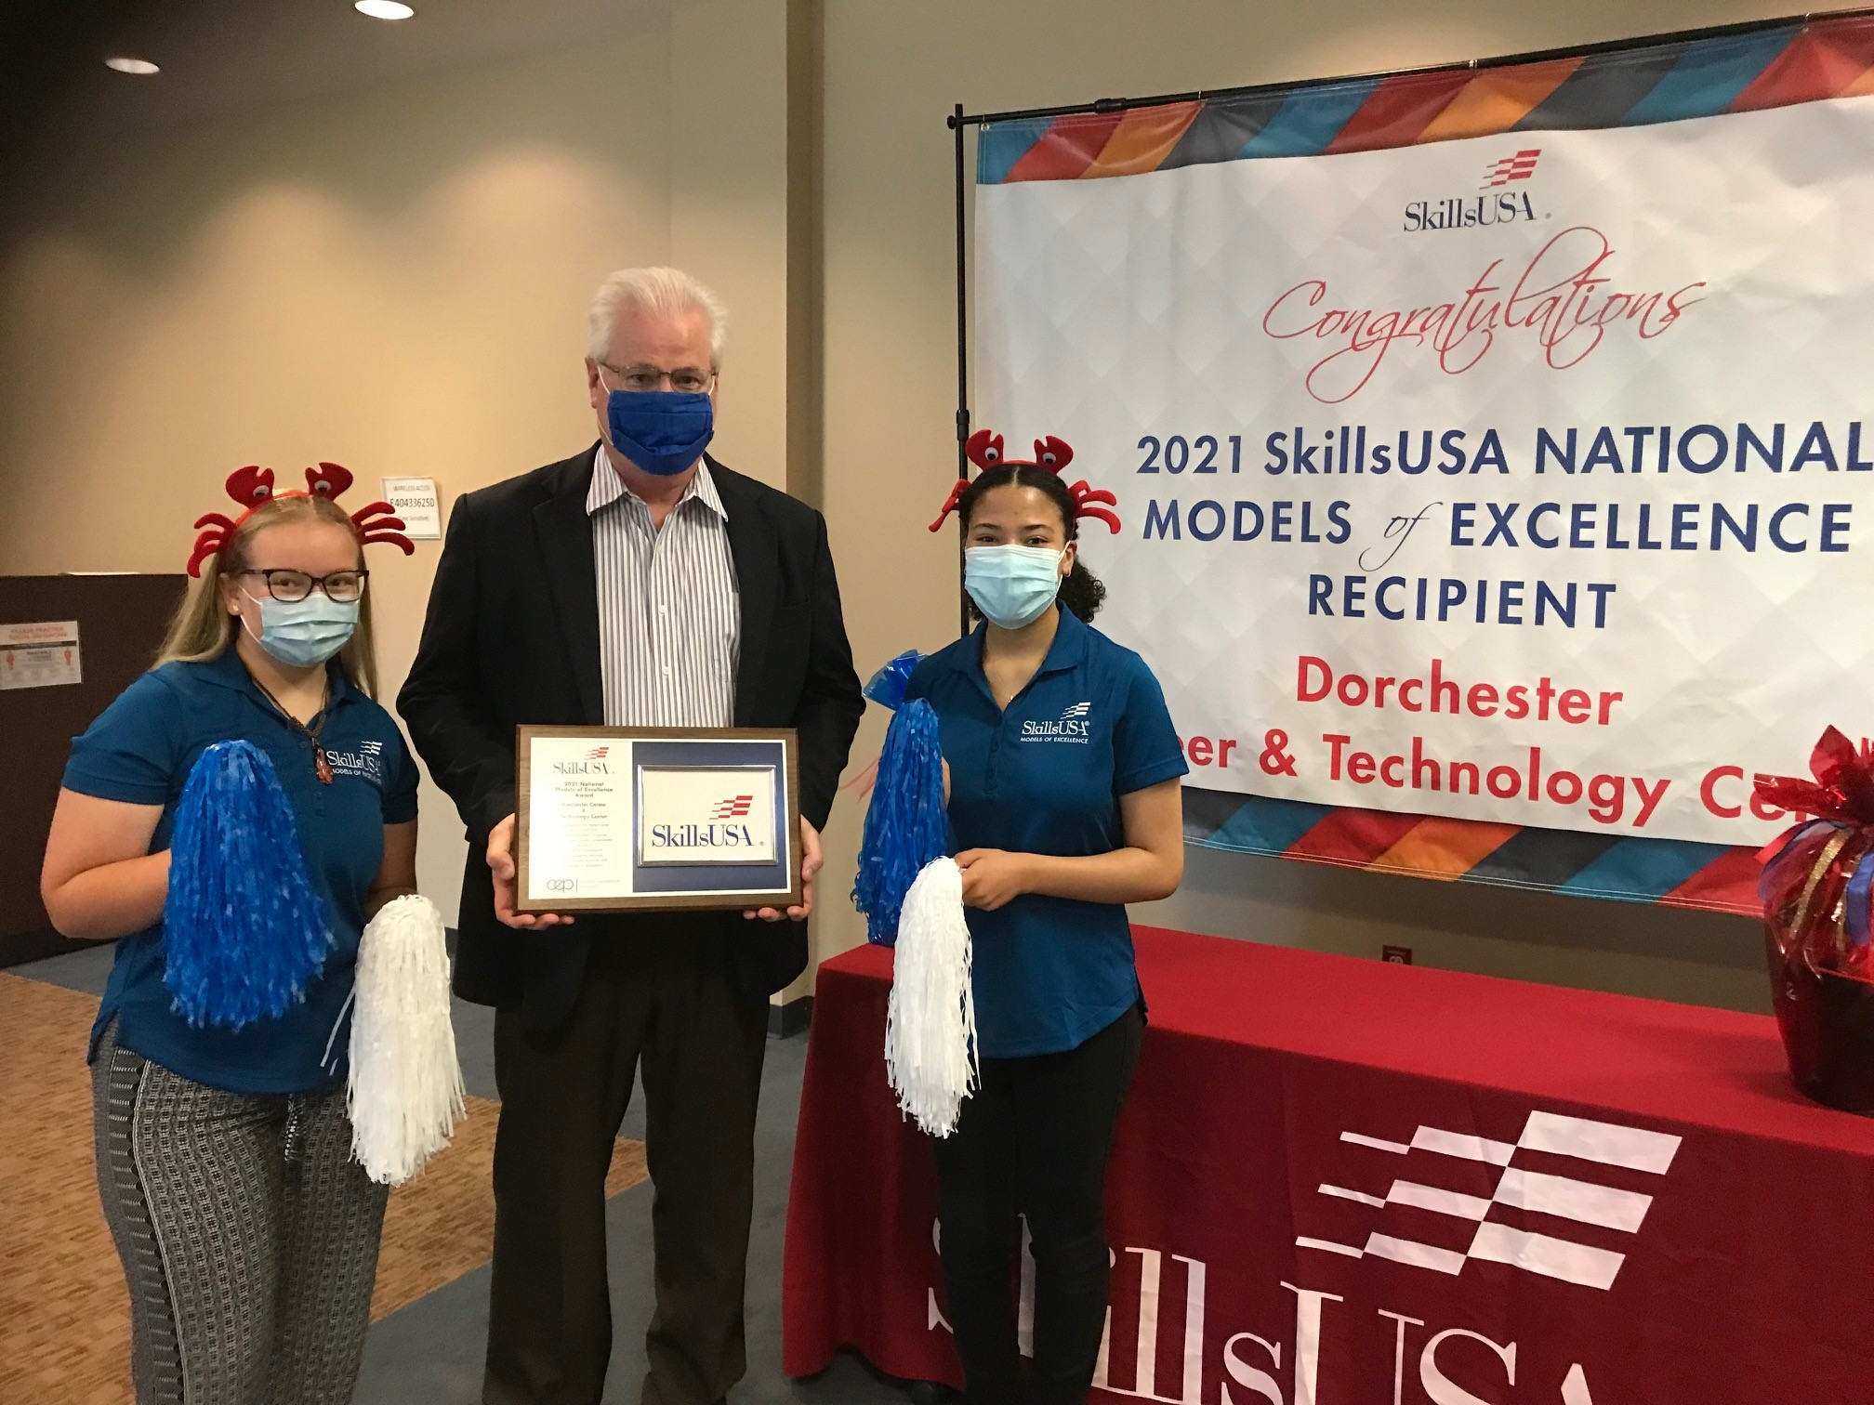
Models of Excellence
SkillsUSA DCTC Chapter won the Chapter Excellence Distinction of
Models Of Excellence for the 2nd time in 4 years. This is only given to the top 24 Chapters in the Nation.
Members Brianna Pinder and Katelyn Masden headed this endeavor for the 2020-2021 school year.

Slide 3
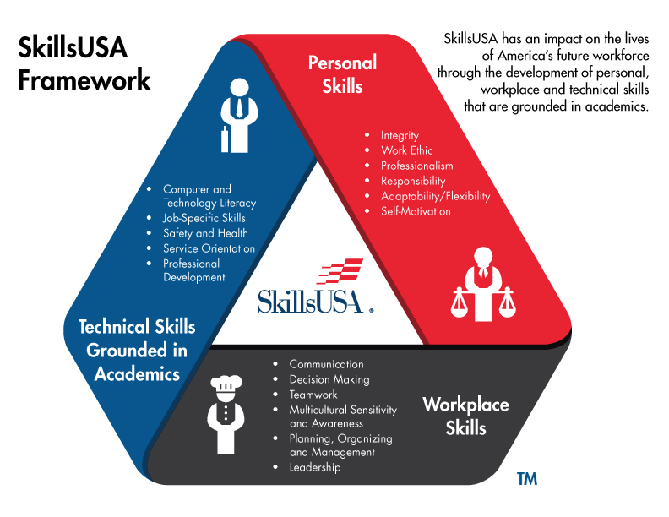
SkillsUSA Framework

Slide 4
Member Meetings and Fun incentives
SkillsUSA Kick-off Meeting:
Icebreaker called “musical chairs beach ball”.
SkillsUSA background information and the importance of the Framework and essential elements.
Fun events and compositions SkillsUSA has to offer
Ice Cream Social
First Member meeting including; Chapter officer voting, revealing future ideas for events, and overall socializing/meeting other members over ice cream.
Notes:
Kick off meeting: mention the essential element related questions

Slide 5
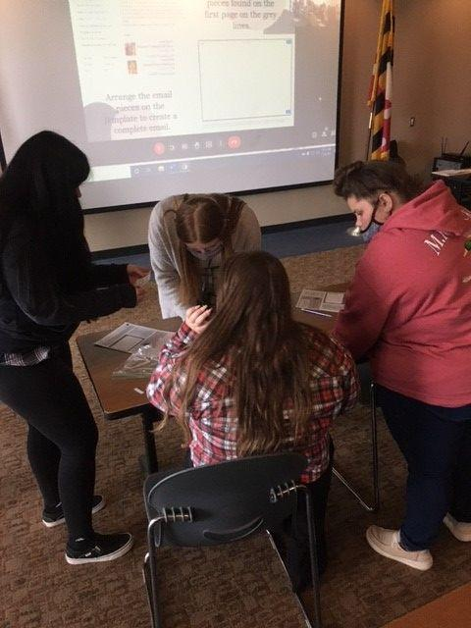
Fall Leadership Conference
An interactive virtual conference.
DCTC Chapter won a $75.00 Gift card as the 1st place winners in the Framework Scavenger Hunt
15 of our members completed their statesmen award!

Slide 6
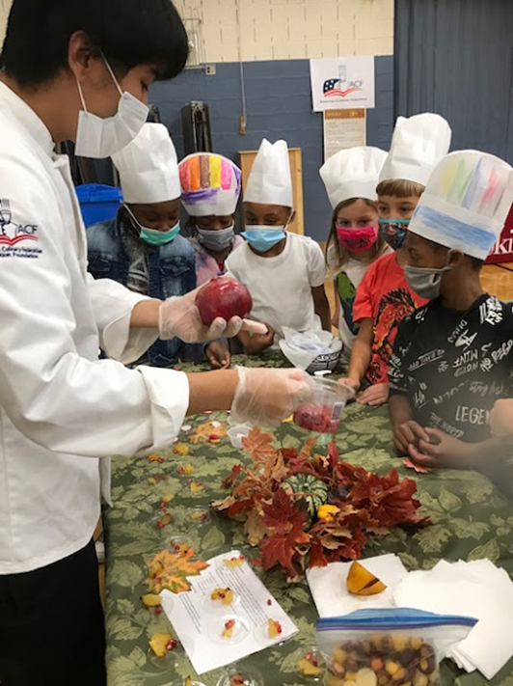
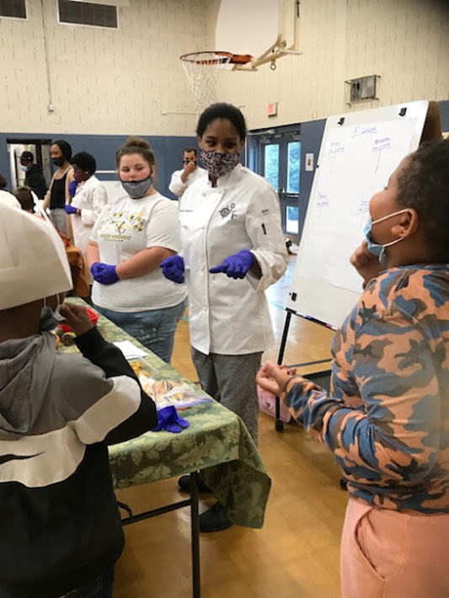
Childhood Nutrition Day
Culinary Arts Students along with TAM SkillsUSA members taught and explored healthy foods Sandy Hill students.
Notes:
Speaking Notes: Students from kindergarten to 5th grade visited three taste sessions to sample different foods.
- Foods tasted include; Edamame, Guacamole, Rainbow carrots, star fruit, and Pomegranate.

Slide 7
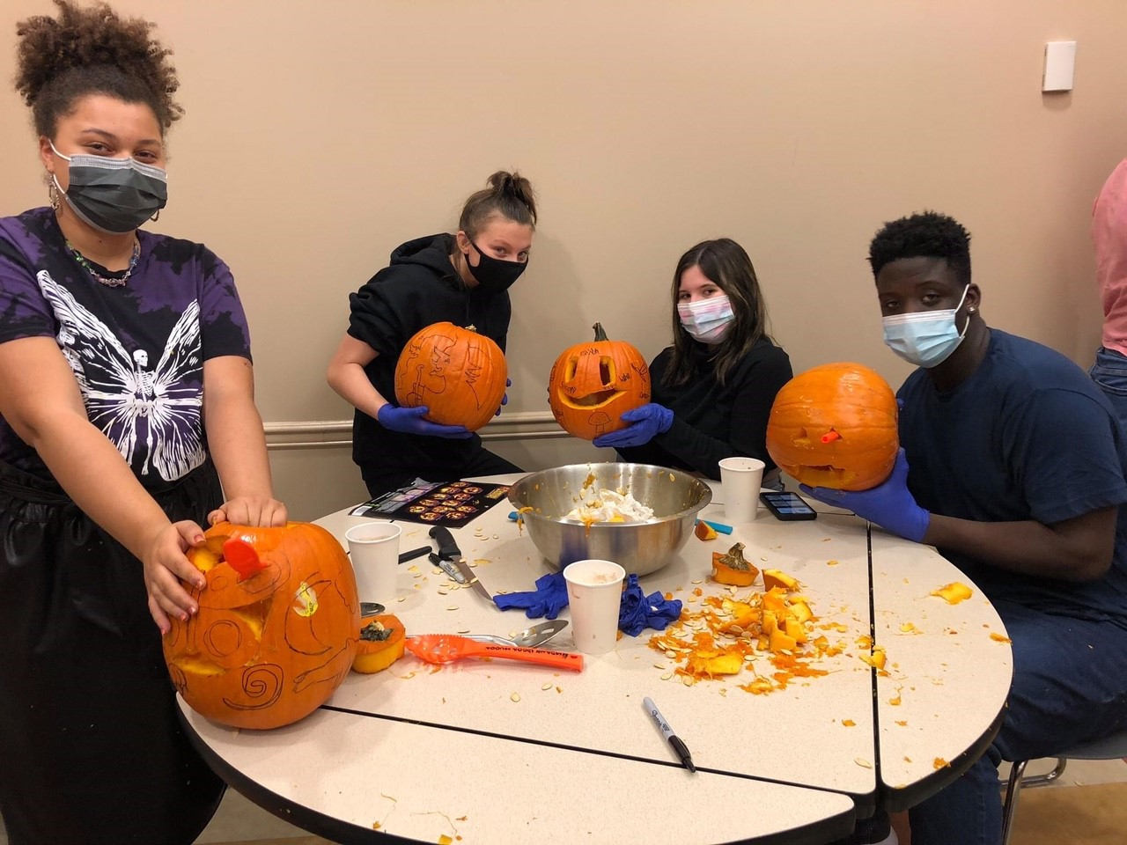
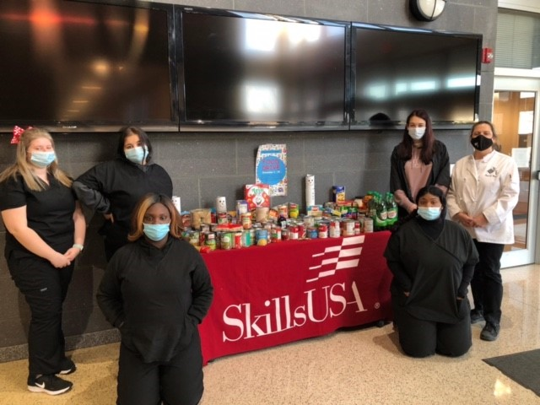
Other SkillsUSA Events
Pumpkin carving contest
Friendly competition for the members to get to know each other and show their skills (insert pictures)
Penny Wars
Total Raised $898.00 .
Competition for the class who raised the most money
Food drive
Total items raised 523 cans which was given to Koski Trucking who sent all donations

Slide 8
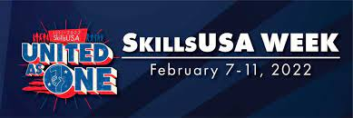
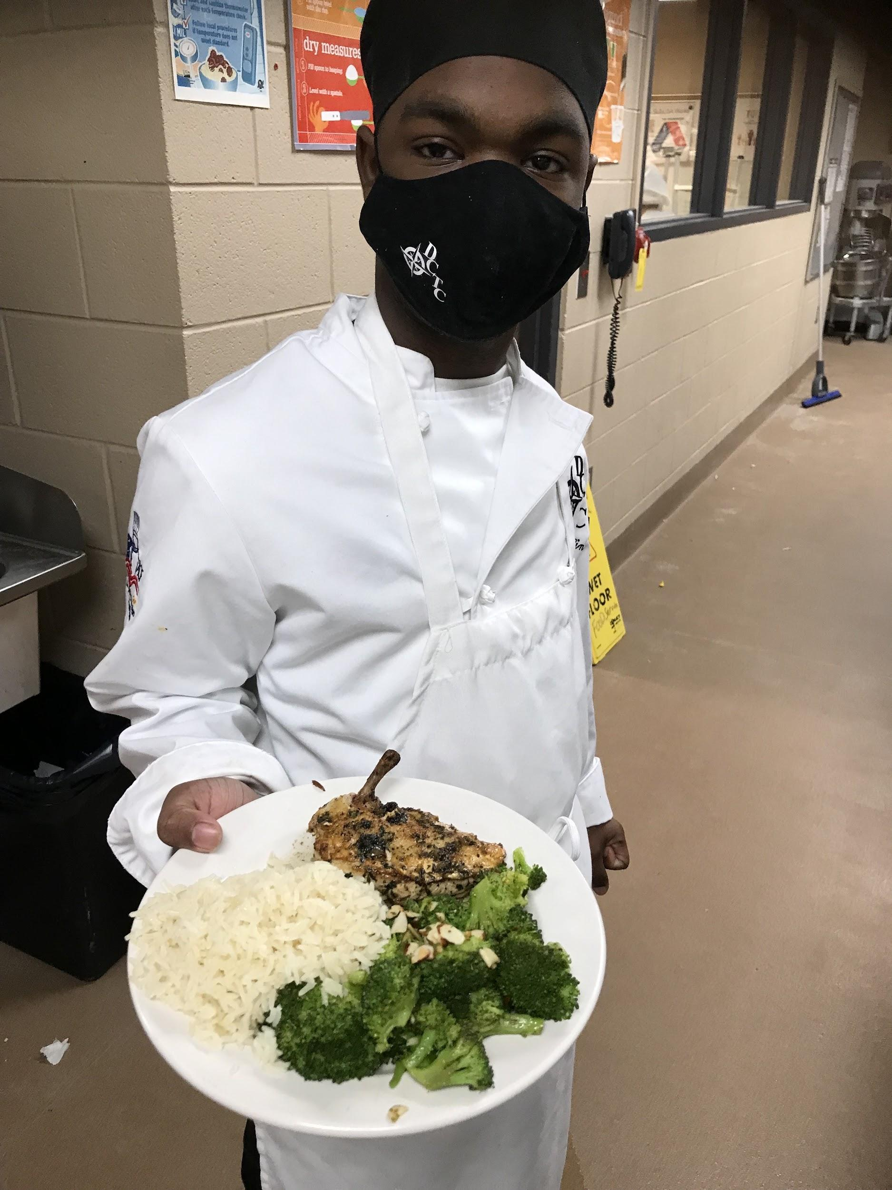
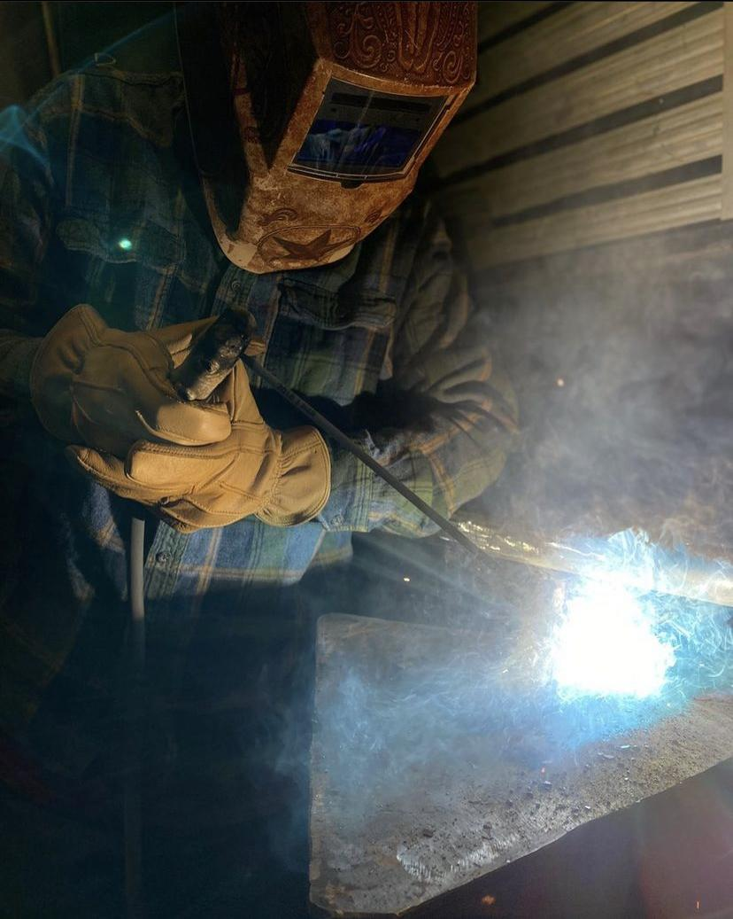
Monday - Recognize day: PowerPoint appreciating DCTC teachers
Tuesday - Give Back Day: Students wrote Thank You notes to teachers
Wednesday - Partner Day: Panel discussion
Thursday - Advocacy Day: Student favorite project showcase
Friday - SkillsUSA Day: Member celebration

Slide 9
What SkillsUSA Means to Us
“The student leaders and advisors are always there to help me”
“Enhanced my professional communication”
“Helped my with life skills”
“Meet new people”
“SkillsUSA accepted me”
“Through SkillsUSA I have learned new skills I never thought were possible”
“I learned to work better in teams, even with strangers”
“I have learned new skills that I can take into the workplace”
“SkillsUSA has given me great opportunities”
“I Learned how to write a resume and get an interview”
“Helping out the community became so much fun, I can’t wait to help more people”
“Improved my organization skills and flexibility.”
“I have grown in my leadership skills”
“Helped me open up”
“Got me thinking more seriously about my future and the careers ahead”
“Thank you SkillsUSA!”

