Slide 1
C-SD March Monthly Report
3/17/22

Slide 2
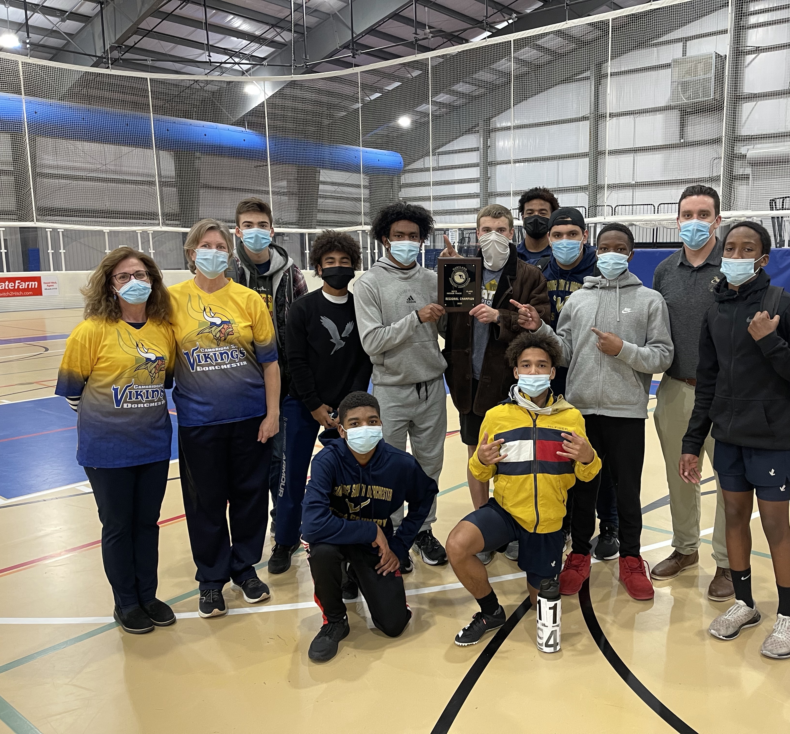
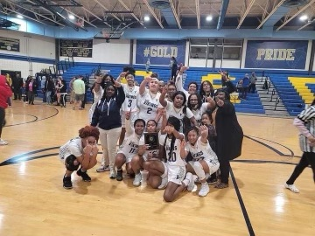
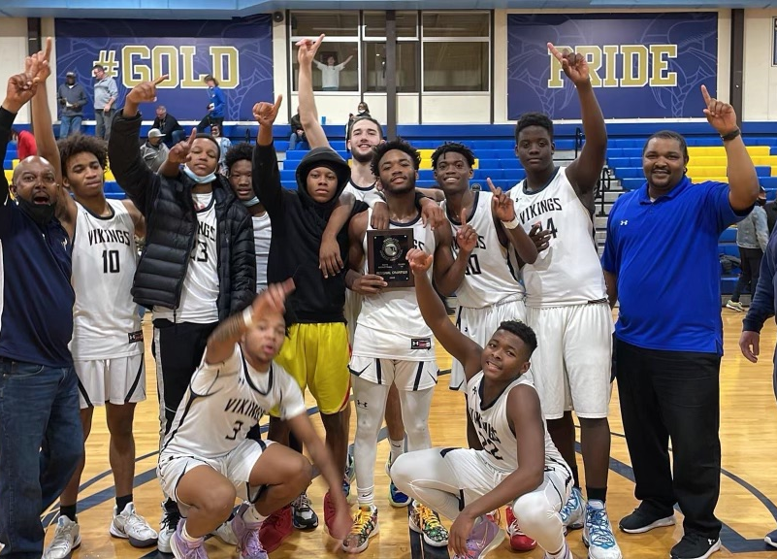
C-SD Regional Champions

Slide 3
Spring Sports has begun
The Men’s lacrosse team has gotten a large amount of interest, and they have a large team that is full of talent.
The Women’s lacrosse team has seen an equal showing, and they are excited for the season.
The baseball team is looking forward to the beginning of a new season.
The softball team has begun the season with a large number of students, which are additionally talented.
The outdoor track team is excited to see what it can accomplish after a very successful indoor campaign.

Slide 4
Upcoming AVID Events:
College Fair is scheduled for March 16th. There are 11 different schools lined up for the fair, and it will be a great opportunity for students to view the opportunities that different colleges can offer.
Career Day is scheduled for April 14th. This year, the event will be in-person and hosted in the gym.
Friday, April 8th, Avid College Trip to Stevenson University and Coppin State University. Approximately 80 students were invited to attend.

Slide 5
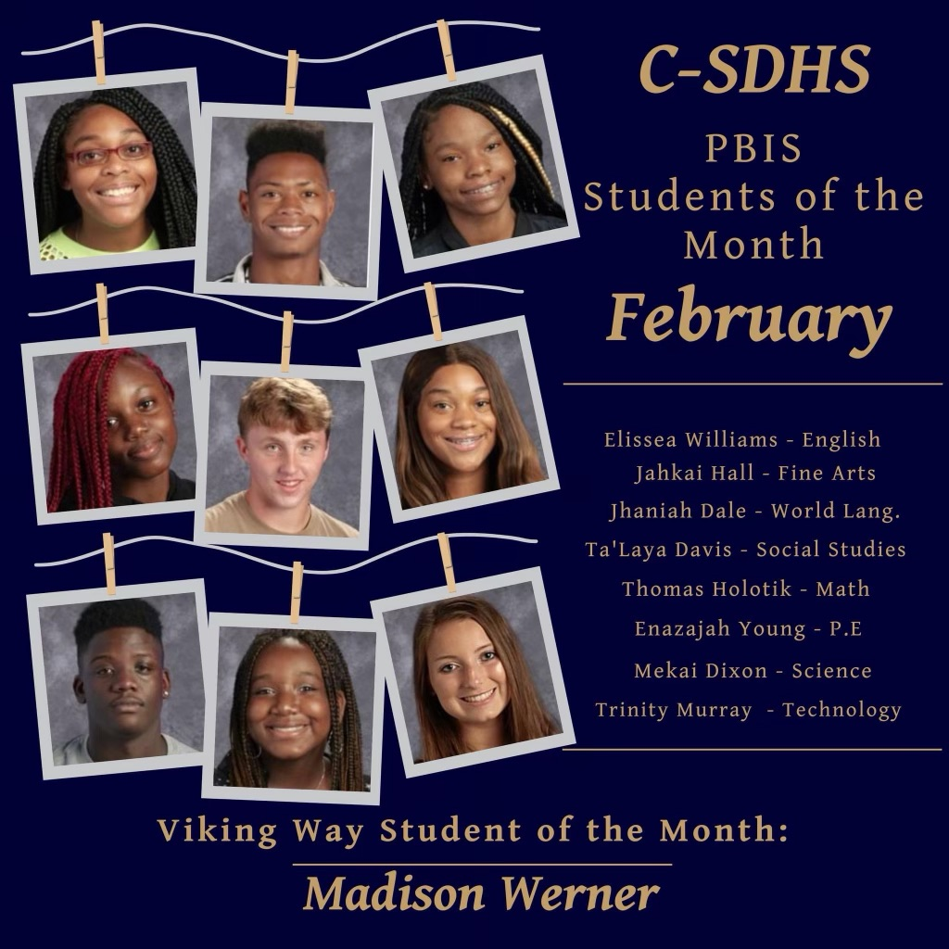
CSD Students of the Month

Slide 6
The Senior Class is excited to present the play Into The Woods

Slide 7
Student Success Conference

Slide 8
Closing Comments:
Congratulations to all the Winter Sports athletes for their hard work and success.
I am excited to see what our Spring sports teams will be capable of.
Make sure that you come see Into The Woods to support the Senior Class Play, and to have a good time.
A special thank you to the Theater teacher and director of the Senior Class Play Mr. Wilford. He has done a phenomenal job directing the play, and he has put numerous hours into preparing the cast for the show.

