Slide 1
DCTC March 2022
Sa’Mara Spriggs
DCTC Student Board Representative Alternate
March 17, 2022

Slide 2
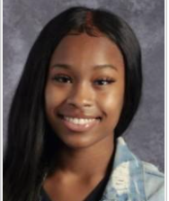
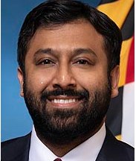
Visit from our State Superintendent
State Superintendent Choudhury will visit Dorchester County on March 30th and shadow our very own Sa’Mara Spriggs.
Notes:
State Superintendent Choudhury will have the opportunity to shadow Sa’Mara at DCTC in her Medical Services class and her English Honors class at Cambridge-South Dorchester High School.

Slide 3
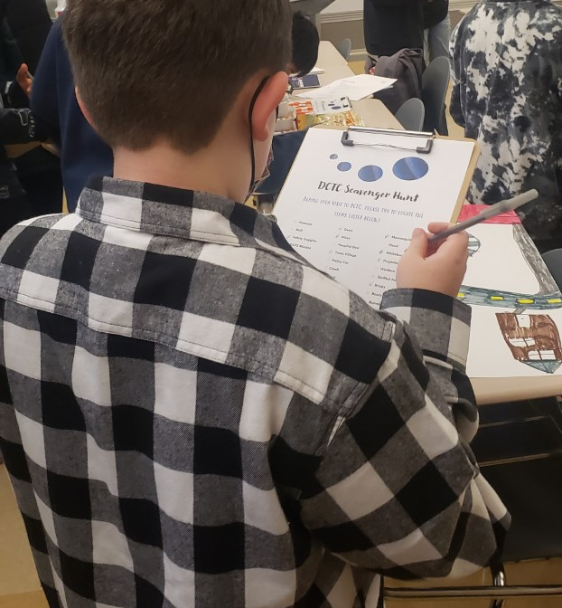
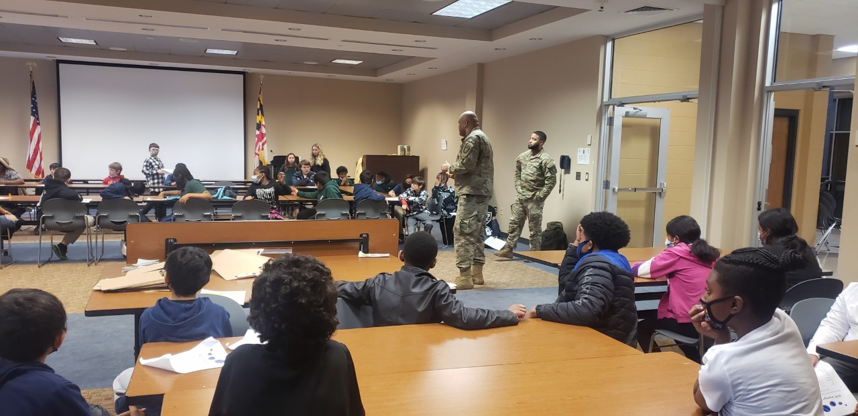
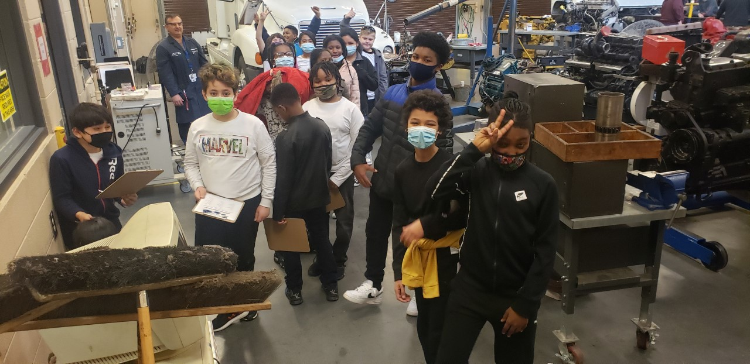
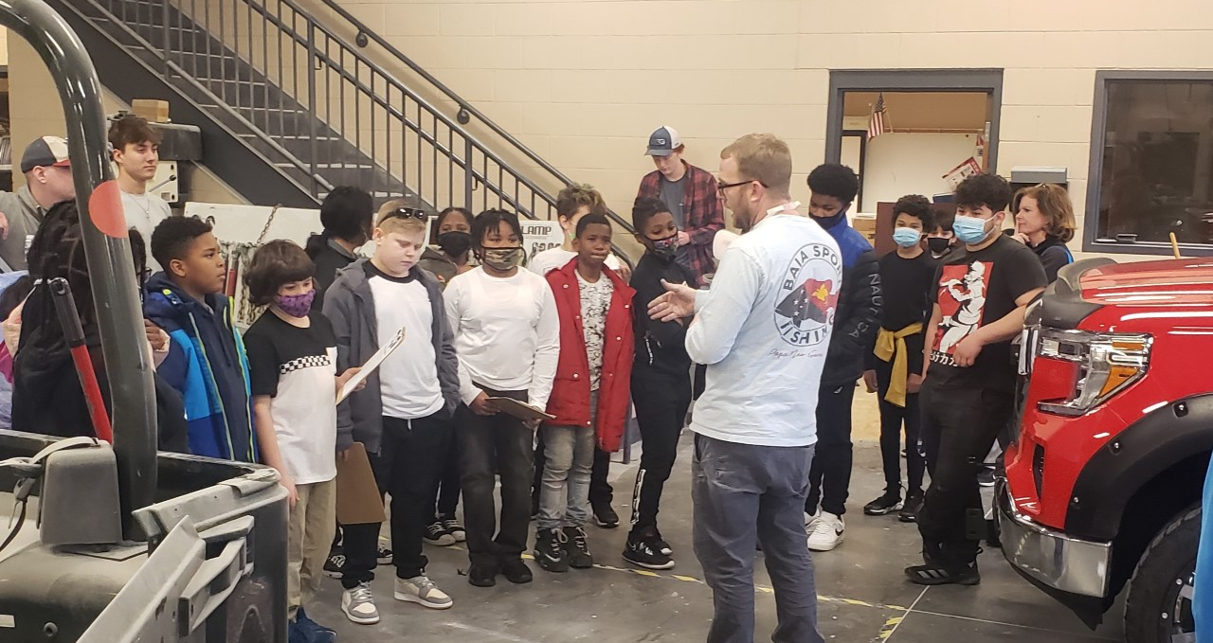
5th Graders Tour DCTC
Notes:
We were so excited to welcome our 5th graders from Maple Elementary, Choptank Elementary, Hurlock Elementary, Sandy Hill Elementary, and Vienna to DCTC to see all of our wonderful programs. Students enjoyed the tour and many have already decided which program they are going to take when they enter high school. We look forward to seeing the Warwick Huskies tomorrow and SDS Skipjacks next week.
Next week our Cambridge-South Dorchester Vikings in the 9th and 10th grade will be visiting us also.

Slide 4
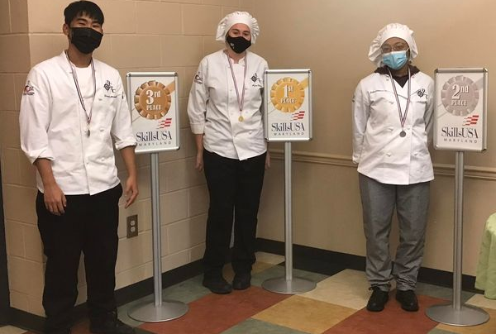
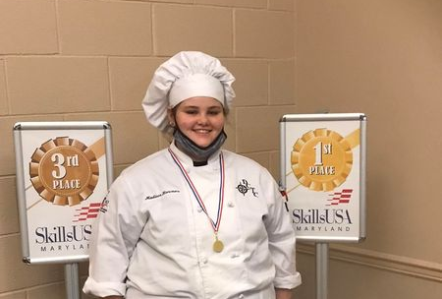
SkillsUSA – Career Competition Events
Notes:
The SkillsUSA Championships are career competition events showcasing the best career and technical education students in the nation. Contests begin locally and continue through the state and national levels.
Students in our local chapter of SkillsUSA will be competing in Linthicum, Maryland from March 31st to April 2nd. Students from DCTC will be competing in various events associated with our programs.

Slide 5
Upcoming Event at DCTC
Notes:
On April 10th, DCTC will be hosting Breakfast with the Easter Bunny. Our students in the Teacher Academy of Maryland program will be offering games and planned activities for children as well as an all you can eat breakfast from the Culinary Students.

Slide 6
Thank You

