Slide 1
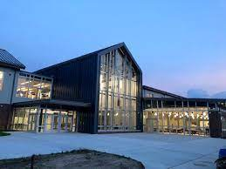
News From The Nest
By: The NDHS Representative Team

Slide 2
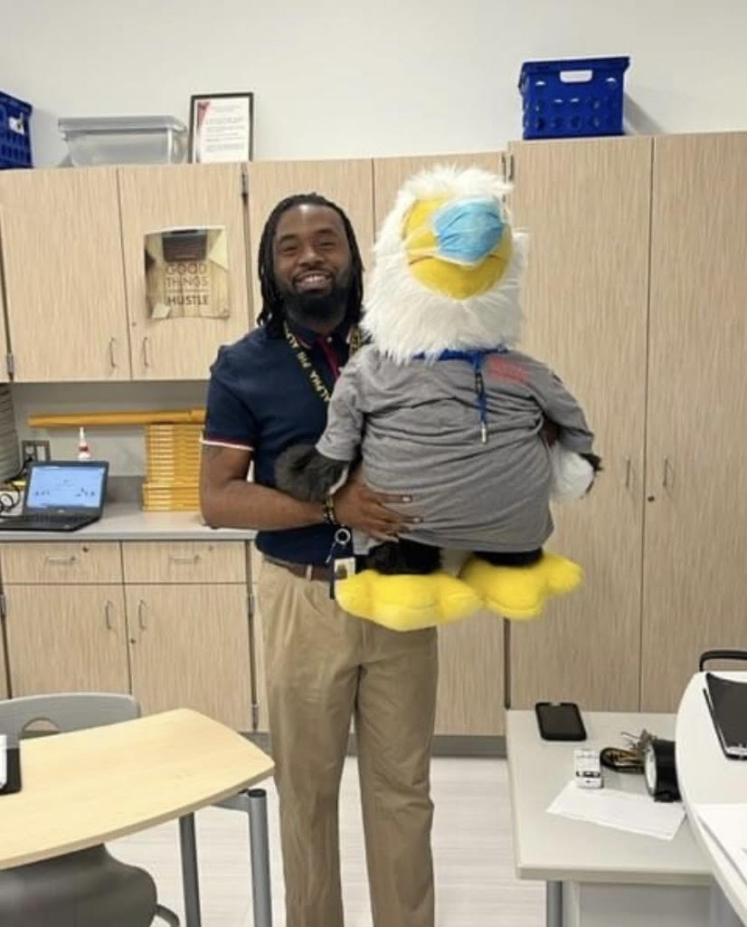
Introduction
Hello Everyone! Mr. Bromwell, President Layton, Board members, and families at home.
I'm very happy to see everybody for our Monthly Meeting.
In the month of March, NDHS has been doing great things and staying very active showing that Eagle Spirit!

Slide 3
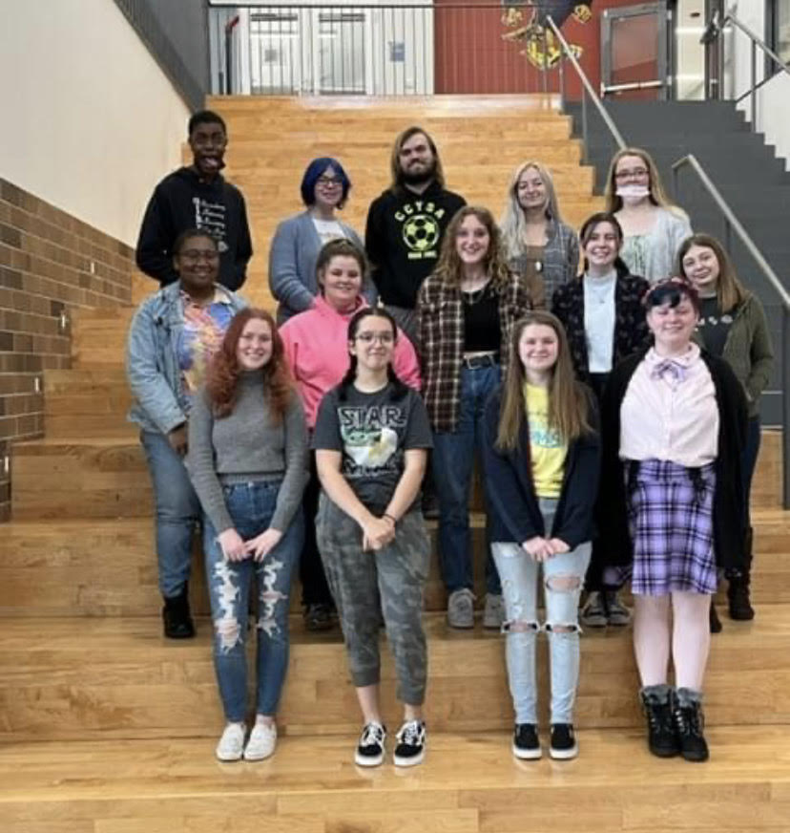
Student Shout-Outs
PBIS Weekly Winners: Ja’Mira Wayman and Jaylin Pinkett
PBIS Winners for February: Nickerline Joseph, T.J. Leonard, Fatima Kaleem, Donald Ruths, Amira Martin, Jaiden Brooks, Samantha Weir, Thomas Reincke
Avlynn Bennett, Dylan Ruppert, Kyle Fellon, and Karis Diggs attended RYLA. Avlynn Bennett won $1,000 to her chosen charity.
Julia Creighton, Regional Winner, finished 5th in State Wrestling Tournament
Kaden Handte and Leonardo Ramirez, finished 3rd in Wrestling Regionals

Slide 4
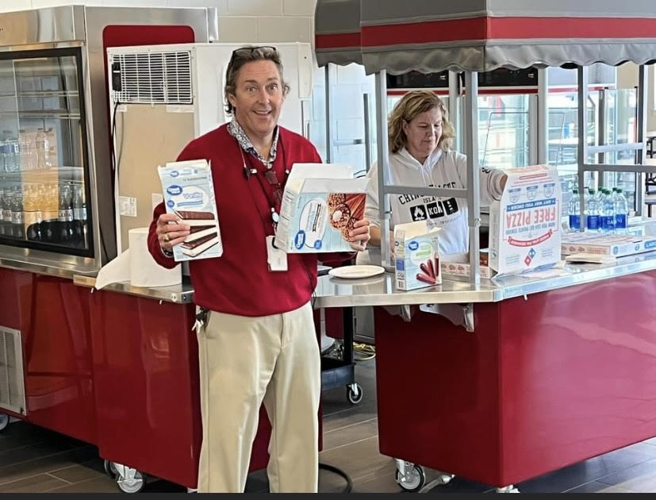
Staff Shout-Outs
PBIS Staff Winners for February: Mr. Greg Alsworth and Ms. Stephanie Fuchs,
Bubba Staff Winners of the Week: Karen Mercer, Todd Nock, Trey Mills
Deputy Robinson for helping Prom Commitee selling prom Tickets

Slide 5
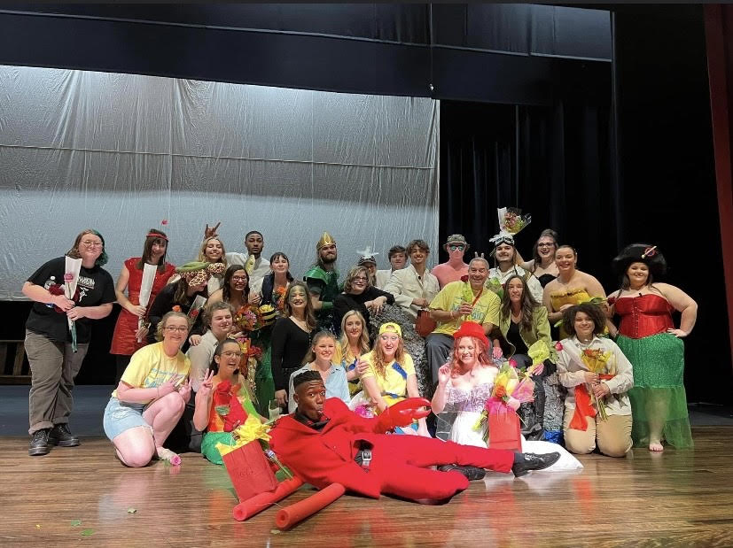
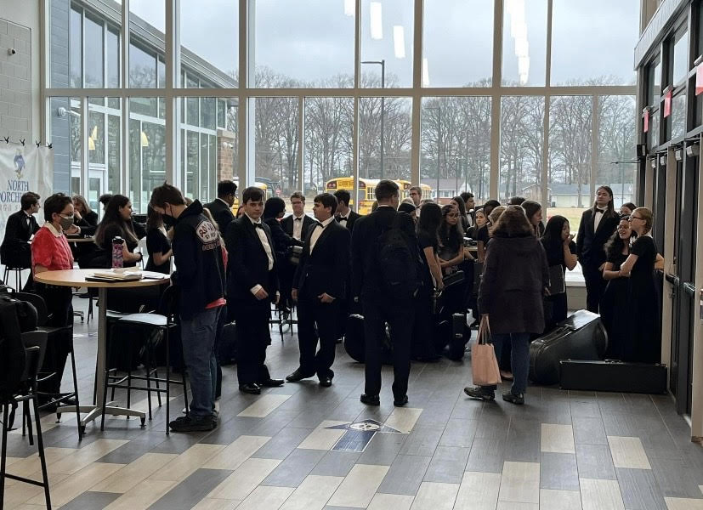
Current Events
February 28 - Interims were released.
March 1 and March 3 – 6, class play The Little Mermaid, and included performances for Warwick and Vienna Elementary Schools.
March 1 - Start of Spring Athletic Season
March 9 - District Band Festival held; 14 schools attended!
Student registration is continuing until March 25.
Black History Month (February)
Women’s History Month (March)

Slide 6
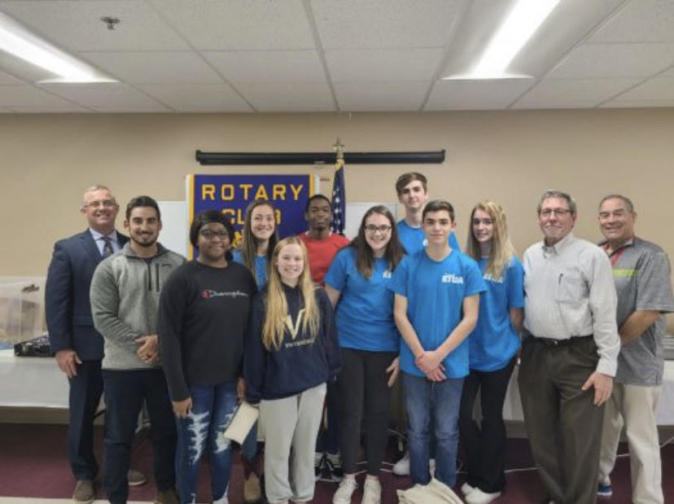
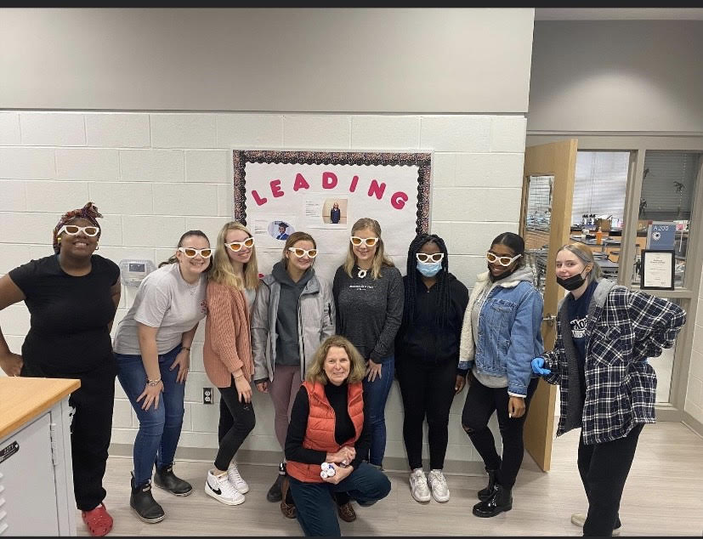
Current Events
March 7 - 11 - Social Worker Appreciation Month
March 7 - PLTW Recruitment visit to North Dorchester Middle School.
First Semester Honor Roll Ice Cream Social for 186 students!
Prom Committee started to sell tickets today!
The Eastern Allied Health Education came to visit the Anatomy classes to show them the anatomy and physiology of the eye.
Rotary Club Lunch in Cambridge on March 10

Slide 7
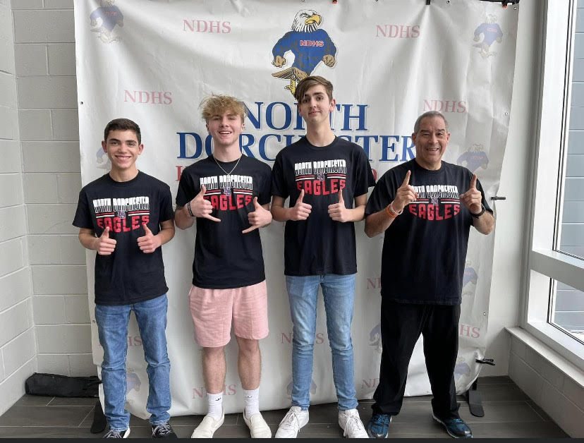
Athletics
February 22 - Winter Sports Awards Night
February 25 - Boys Basketball won their 1st Round of Play-offs
March 2 - Spring Athletic Director’s Meeting held
Winter Athletes Minds in Motion - 36 winners
Fundraising Winners Celebration - 24 winners
Julia Creighton, Regional Winner, finished 5th in State Wrestling Tournament
Kaden Handte and Leonardo Ramirez, 3rd in Regionals for wrestling
Zach Adam, Dylan Ruppert, Kyle Fellon were chosen to be Student Athletic Interns

Slide 8
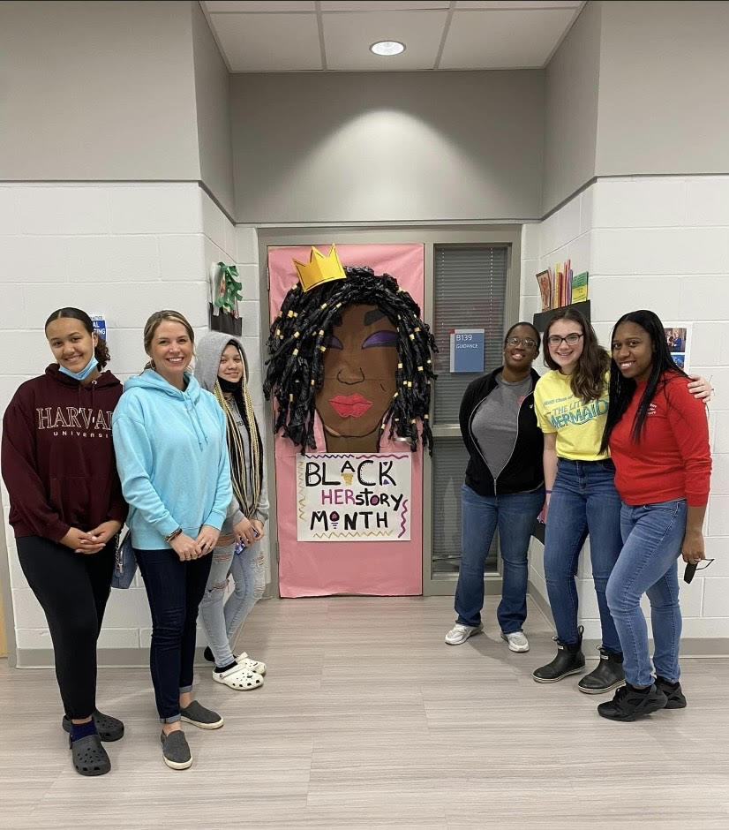
Clubs and Programs
Key Club and sophomore class are hosting a Hygiene Drive.
National Honor Society plans their next Blood Drive and Highway Cleanup.
Kindness Club did a Door Decorating Contest for Black History Month. The Counselors office won, with help from students Milan Jiggets, Madison Lewis, and Avlynn Bennett
New Kindness & Inclusivity Club Officers
President: Aurora Cantrell
Vice President: Apollo Rideout
Secretary: Sydney Weir
Treasurer: Avlynn Bennett

Slide 9
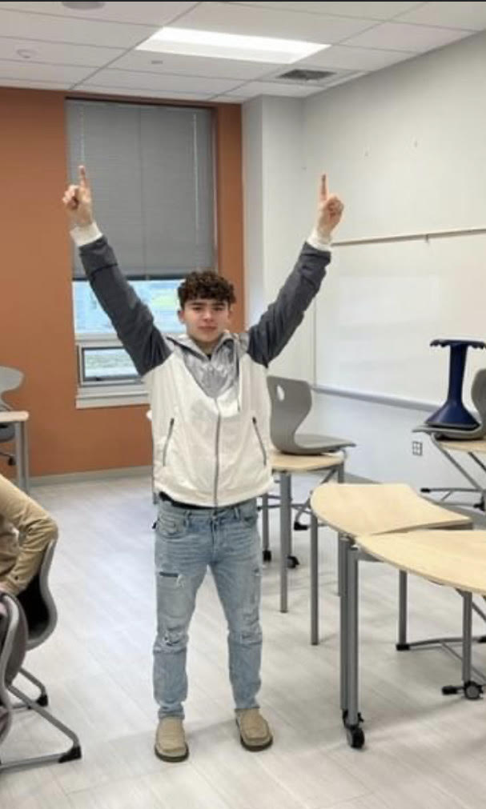
Future Events
March 15 - Maryland School Survey
March 22 - Senior Chorus Festival
March 23 - SAT School Day

Slide 10
Thank You All

