Slide 1
Educational Equity, Diversity, and Inclusivity
​ DCPS has worked to advance equity and embrace diversity and inclusion into every major undertaking.
DCPS is committed to eliminating disparities in access, opportunity and inclusion as the key to closing achievement and opportunity gaps and providing the nurturing and supportive school environment that every student deserves.

Slide 2
Current Perception is the reality
What is perceived is.
Perceptions are based on available information.
In the absence of information, we assume.
Behavior has a logical basis.

Slide 3
DCPS Diversity Policy 100.06
Dorchester County Public Schools welcomes, respects and values the diversity of its students, parents, staff and the broader community.
Dorchester County Public Schools is committed to promoting diversity awareness throughout the school system exemplifying the following beliefs:
All individuals will receive equitable treatment, opportunities, and education.
All individuals and their families have dignity and worth.
All individuals are unique and valuable.
Embracing diversity and inclusion, creates an environment where students, families, community members and employees will be welcomed, valued and supported.
Embracing diversity and inclusion will allow employees and students to perform at their personal best.
The District is committed to educating staff and students on the value the Diversity Awareness Policy and how it affects the opportunities and experiences of all stakeholders.
Staff and students, who willfully neglect to uphold the Diversity Awareness Policy of DCPS, may be subject to disciplinary proceedings.
The policy will be monitored and reviewed periodically.

Slide 4
DCPS Equity Policy 100.07
Equity
I. Philosophy
A. The Board of Education of Dorchester County (the Board) believes that every student in the school system should receive an education that maximizes their potential to become a globally competitive graduate. The Board is committed to the success of all students.
B. Raising achievement for all students and closing the racial achievement gaps among all students are top priorities of the Board.
C. Disparities on the basis of race, special education status, gender, ethnicity, sexual orientation, gender identity (including gender expression), English language learner (ELL) status, or socio-economic status are unacceptable and are directly at odds with the belief that all students can achieve. While complex societal and historical factors contribute to the inequities our students face, rather than perpetuating disparities, the school system must address and overcome inequity by providing all students with the opportunity to succeed.
II. Definitions
A. Equity - Providing each student with what is necessary to achieve high academic outcomes.
B. Inequity - Providing all students with the same support regardless of individual student needs to achieve high academic outcomes.

Slide 5
DCPS Equity Policy 100.07
III. Guidelines
In order to raise high academic achievement and close achievement gaps among all students, the Board directs the Superintendent to:
A. Report to the Board annually the progress made toward increasing student achievement.
B. Include in any and all facilities plans for new construction and in the renovation of existing facilities, considerations of equity in access to twenty-first century learning environments.
C. Include cultural responsiveness in reviews of curriculum and assessment design.
D. Identify annually whether the discipline process has any disproportionate impact on minority, English language learner status students, or a negative impact on special education students.
E. Recruit and increase participation of persons from underrepresented groups on school programs; and
F. Report annually on the employment, retention, recruiting, and placement of persons from underrepresented groups.
IV. Implementation
The Board directs the Superintendent to implement this policy.

Slide 6
DCPS Equal Employment Opportunity Policy 502.01 and 502.02
It is the policy of the Board to provide equal opportunity in employment to all employees and applicants for employment. No person is to be discriminated against in employment because of race, color, sex (including pregnancy, gender identity, and sexual orientation), age, national origin, religion, disability, genetic information, reprisal, or any other basis prohibited by law. This policy applies to all terms, conditions, and privileges of employment including, but not limited to hiring, introductory period, training, placement and employee development, promotion, transfer, compensation, benefits, educational assistance, layoff and recall, social and recreational programs, employee facilities, termination, and retirement.
It is the policy of the Board to be an equal opportunity employer and to hire individuals solely upon the basis of their qualifications and ability to do the job to be filled.
Notes:
Code of Maryland Regulations (COMAR) 13A.07.05.01

Slide 7
Hiring Practices per Maryland Legislature HB 1372 Kirwin Provision
On or before July 1, 2022, each county board of education shall evaluate its hiring practices to determine if those practices are contributing to a lack of diversity in Maryland’s teaching staff, make changes as appropriate, and report its findings and proposed changes to the Governor and, in accordance with § 2–1257 of the State Government Article, the General Assembly, and the Accountability and Implementation Board established under Section 3 of this Act.
https://mgaleg.maryland.gov/2021RS/bills/hb/hb1372E.pdf

Slide 8
Educational Equity Task Force Stated Goal
Review and promote equitable hiring practices; and the development of programs to support and retain teachers of color.

Slide 9
DCPS Staff Demographics
Certificated & Support Staff (2022)
Certificated-
A& S ( AA-15, W-46)
DE (AA-52, Asian-1, Pac. Is. -1, W-386)
Support Staff-
ESP (AA-97, Asian-3, Other-1, W-174)
Dorchester County Public Schools Leadership Demographics are as follows (2022)
Executive team- 5 White
Principals- 4 African American, 8 White
Supervisors- 7 African American, 4 White
Assistant Principals- 12 White, 5 African American
Notes:
Comparison-
Talbot- 0 Principals of Color
Caroline-1
QAC-1

Slide 10
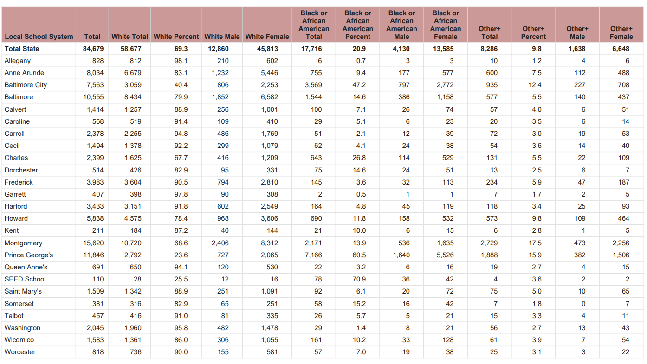
State Analysis of Professional Staff by Assignment, Race/Ethnicity and Gender 2021
Dorchester County professional staff is 82.9 % White, 14.6 % African American, 13% Other
https://www.marylandpublicschools.org/about/Documents/DCAA/SSP/20212022Staff/2022ProfStaffbyRace.pdf
Notes:
* Includes all positions reported in the following tables, as well as staff developers/teacher trainers, other instructional professionals, and health professionals + Other includes Asian, Hispanic, American Indian or Alaska Native, Native Hawaiian or Other Pacific Islander, Two or More Races
Caroline County-5.1 %
Talbot-5.7%
QAC- 3.2%
Somerset-15.2 %
Worchester 7%

Slide 11
Dorchester County Demographics
Community (2021) & School (2022)
Population-32,489 | Total Student Population PK-12-4,456
White-62.3% | White-1859, 41.71%
African American- 29% | African American-1871, 41.98%
Asian- 1.2% | Asian-45, 1.00%
Native American/Pacific Islander-0.1% | Native American or Alaskan Native-19, 0.42%
Hispanic/Latino-6.1% | Pacific Islander-10, 0.22%
Two or more Races-2.4% | Two or more Races-287, 6.44%
Under 18 years of age- 21.0% Over 65 years of age-22.1% | Hispanic/Latino-364, 8.17%
https://www.census.gov/quickfacts/dorchestercountymaryland | 2,596 or 58.25% students of color
Notes:
Comparison-
Talbot- 0 Principals of Color
Caroline-1
QAC-1

Slide 12
Staff Diversity
Higher levels of staff diversity lead to diverse viewpoints and perspectives, which add value to all school communities. When students see their identities reflected in their teachers and other school staff, they are more engaged in learning and improve academically, social-emotionally and behaviorally. DCPS continues to work toward bringing staff diversity into line with the diversity of our student body, and to enhance efforts towards ensuring a wider pool of highly qualified prospective candidates amidst a severe shortage of teachers regionally and nationally.
Superintendent Bromwell will meet quarterly with school administrators of color and the Educational Equity Task Force (biannually), which meet regularly to provide feedback and recommendations regarding DCPS programs and processes and identify opportunities for improvement.
Requesting focused efforts toward diversifying the workforce.

Slide 13
How to Recruit & Retain
Amend recruitment focus south & specifically HBCU's
Increase teacher mentor support in each school building
Develop support specifically for teachers of color
Continue UMES High School Teacher University
Continue to increase students of color enrollment in TAM program
Initiate the DCPS Grow your own Scholarship
Continue the staff development to teacher approach
Develop connection with local social supports and business entities

Slide 14
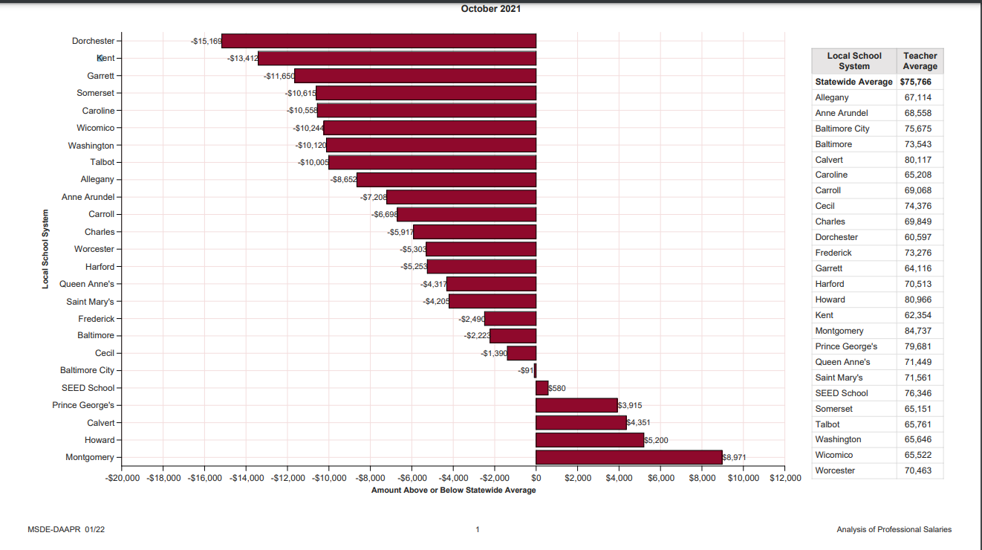
Salary Impact 2021
Dorchester County has the lowest average teacher salary at $ 60, 597, and is $15, 169 below the state average. Our surrounding counties average between $5 –10,000 higher. 8.2 % lower
Notes:
The tables in this report were prepared from the data submitted by the 24 Maryland local school systems in the fall of 2021. Salaries include annual pay for 10, 11, and 12 month full-time and part-time employees in the positions shown. All data reported reflect the conversion of part-time employees to full-time equivalents. Calculations The average (mean) salaries are computed by dividing the sum of the individuals’ salaries by the sum of the full-time equivalent positions. The value of the means may be distorted by extremely high or low salaries in the distribution and so may not provide an accurate estimate of population averages. Therefore, medians (middle values) are also provided as estimates of typical salaries. The median represents the salary that divides the group in half. The first and third quartiles are provided as an estimation of the distribution of salaries across groups. Quartiles represent a division point similar to the median. The first quartile indicates the salary below which twenty-five percent of salaries fall while the third quartile represents the point above which twenty-five percent of salaries fall.

Slide 15
Specific Support Commitments
Embedding diversity and inclusion throughout the curriculum and school culture
Equitable discipline practices
Employing a staff that reflects the diversity of its community
Providing staff with professional development on cultural proficiency
Leveraging partners such as county government and community organizations.

Slide 16
Definitions
DIVERSITY is recognizing, accepting and respecting that individuals come from many different life experiences with various frames of reference and perspectives. While diversity values unique perspectives and individual differences, it also values the commonalities we all share. Diversity includes, but is not limited to, race/ethnicity, gender, gender identity, socioeconomic status, sexual orientation, language, culture, religion/ beliefs, mental and physical ability, age and national origin.
EQUITY is providing the access, opportunities and supports needed to help students, families and staff reach their full potential by removing barriers to success that individuals face. It does not mean equal or giving everyone the same thing.
INCLUSION is making sure all individuals are engaged participants in the learning environment and community. All students, families and staff members feel valued, respected, appreciated and involved. Individuals see their unique identities reflected in all facets of education including staffing, curriculum, instruction and activities.

Slide 17
Organizational Culture and Climate
Built upon principles of inclusion and equity, the DCPS Equity and Diversity policies and recommendations of the Educational Equity Task Force to guide all system actions and decisions toward ensuring the academic success and social-emotional well-being for each student in an inclusive and nurturing environment. Our system’s commitment to eliminating disparities in access, opportunity and inclusion will be the key to closing achievement and opportunity gaps and providing the nurturing and supportive school environment that every student deserves.
The Superintendent and Board of Education members are personally committed to ensuring that no member of the DCPS school or system community will be the victim of disrespectful treatment or intolerance. Following all major national, international or local episodes of intolerance or hatred, Superintendent Bromwell has issued statements to emphasize the importance of community inclusion and mutual respect.
The Board annually issues proclamations underscoring the important contributions and heritage of diverse groups in the DCPS community.

Slide 18
Professional Development and School Improvement
Professional learning is essential to organizational development, and high-quality professional learning experiences are essential to instilling the tenets of diversity, equity, and inclusion. Staff who are well trained in diversity, equity and inclusion are more effective in their roles, and support the establishment of school and office cultures that provide more inclusive, engaging and supportive learning environments where the dignity of all is valued. Quality instruction is improved by supporting the development of culturally responsive teachers who have access to a strong set of diverse, district-provided instructional resources.
DCPS utilizes an MTSS framework embedded in school improvement to determine professional development needs.
A focus on equity is incorporated into every administrator’s full year evaluation. At the onset of a full evaluation year, school-based leaders identify key actions that will be taken to foster an equitable learning environment for all students. In addition, school-based leaders have engaged in regular professional learning focused on diversity, equity, and inclusion as well as effective discipline practices.
Newly added or updated DEI-related staff training sessions could include:
Restorative Justice
Mindfulness
Cultural Proficiency
Trauma Informed Care
Student Voice
Culturally Responsive classrooms
Microaggressions workshop
Conscious discipline

Slide 19
Curriculum & Assessment
Beginning in 2022 DCPS is committed to several actions to remove structural barriers to access and ensure a rigorous classroom experience that reflects the rich diversity of our community:
Eliminated all unnecessary prerequisites for courses that had historically proven to exclude underrepresented student populations
Provide pre-exposure and support during and after if prerequisites are eliminated
Continue to promote AVID from middle to high school
Eliminated low-level courses that had delayed high school graduation for some students, and sent others to college needing remediation in English and/or math
Established more inclusive access to gifted and talented and advanced placement programming
Developed accessible and affordable dual enrollment course pathways
Adopted a consistent, districtwide early reading program and interventions, which include phonemic awareness development
Significantly Increased the diversity of texts appearing in media centers, classrooms and the curriculum
Incorporated research-affirmed, universal design principles into curriculum instructional strategies and specially designed instruction
Trained teachers and school administrators in delivering research-based first instruction and teaching controversial issues
Added electives, including an African American history course offered at both high schools
EETF planning Saturday Math Academies offer instruction and enrichment to a diverse student population, and Parent Academies
DCPS Parent University Saturday Academies & Early childhood experiences

Slide 20
Equitable Discipline Practices
Equitable and restorative discipline practices support students’ access to a well-rounded curriculum and opportunities, which ultimately lead to graduation and long-term success. DCPS is committed to reducing disproportionality in implementing discipline, including reducing the need for disciplinary actions, ensuring consistency in suspension usage, and to meet school quality targets for discipline proportionality that are included in all in School Improvement Plans (SIPs). Additions to staffing and resources to support student mental health are giving more students full access to the supports they need and helping to reduce the stressors that can lead to discipline issues.
All DCPS schools will develop and implement a school improvement plan that target disproportionate suspensions. A central component of each school’s plan is identifying root causes and developing specific strategies to address the causes. DCPS has established a monthly protocol that requires school teams to unpack discipline data and conduct in-depth analysis which includes identifying trends and patterns. After analyzing the data, school teams develop strategies to address areas of concern. Professional learning in restorative practices and alternatives to suspensions has been provided for all school administrators.

Slide 21
Restorative Practices
DCPS has accelerated the application of restorative justice practices as a primary, long-term strategy for achieving higher levels of student engagement and achievement, narrowing achievement gaps among student groups, and ensuring nurturing, inclusive and safe learning environments for all students. These practices build healthy relationships based on empathy between students and staff, and among adults in the school community, which are fundamental to learning engagement.
All schools are implementing restorative work, and many have made significant progress in establishing restorative school cultures. Examples of the wide variety of restorative processes in place include staff training sessions; restorative discipline practices; community-building circles based on focus areas such as peace, instruction, and other topics of mutual importance to staff, students and community stakeholders; restorative gatherings such as morning meditations and restorative conversations; assigning a teacher-on-call to assist students needing extra support; regular check-in circles for students having challenges; and restorative parent-teacher-student conferences.
The elevation of student voice is a fundamental strategy for schools to establish a restorative climate. Student voice circles and other initiatives deepen staff members’ understanding of student perspectives, increase students’ role in school leadership, and inform teaching and learning experiences that are engaging and inspiring.

Slide 22
Community Collaboration
DCPS recognizes that advancing system goals for diversity, equity and inclusion will require the ongoing support and collaboration among all members of the community. We value the partnership of local organizations, volunteers and supporters in providing input to system decisions, supporting students and staff, and advocating for policies and funding in support of our mutual goals.
The Superintendent’s Educational Equity task Force, comprising staff, students, and community members, represents a wide range of perspectives and advises on systemic efforts as they relate to diversity, equity, and inclusion, will meet each semester with the Superintendent.
All committees and advisory groups or task forces will include diverse representation.
Community workshops will be offered in collaboration with Educational Equity Task Force(EETF) to educate parents about topics such as healthy relationships, social media, student well-being, home/school communication, and anti-bullying supports.
Town halls hosted by DCPS Student Services, Midshore Mediation, and in partnership with other Dorchester County Community Organizations will continue to provide information to parents and the community regarding issues of concern and importance.
Title I office and COP Steering Committees will continue community partnerships to drive planning and supports for identified school communities.
Many community organizations contribute their expertise and initiatives to help DCPS advance and embrace diversity, equity and inclusion among students, teachers and staff.

Slide 23
Supports for Students and Staff
DCPS strives for “equity,” rather than “equality” in providing supports, because each student and staff member has unique challenges and requires individualized services and supports to achieve their goals.
Every school has at least one staff member who serves as a member of the Educational Equity task Force to lead efforts that support diversity, equity, and inclusion. The EETF supports school leadership with attaining equity efforts, strengthening the diversity, and increasing belonging among students, staff and community. They will report out at each faculty meeting.
The Student Services health and wellness committee supports staff in responding appropriately to student and staff mental health issues, including secondary trauma, collective trauma, and racial trauma, amidst the ongoing pandemic and social unrest.
Involve training for staff from approved vendors to meet Title IX regulations and establish a culture of inclusion and support.
Bullying prevention public service announcement and training provided annually through the office of Student Services and provides for 24 online reporting as well as traditional in-person interaction.

Slide 24
Initiatives and Practices
Midshore Mediation: introduction to DCPS restorative practices.
Increasing Student Voice: a forum for student voice through diverse first-person narratives.
Freshman Academy at Cambridge-South Dorchester and North Dorchester High Schools: a restorative school program to accelerate student achievement.
AP/Dual Enrollment summer Academies for 1st time course taking student to support and prepare for expectations and rigors.
DCPS partnership with UMES to develop the High School Teacher University Program.
DCPS Future Educator Recognition program.
GT enrichment and extension afterschool and summer programs.
Social emotional learning afterschool and summer programs.
District commitment to coordinated Social emotional learning implementation.

Slide 25
DCPS Educational Equity Task Force
Members/Organization:
Kirk Howie-Director of Student Services/Chair, howiek@dcpsmd.org
Monique Giddens-Supervisor of Social Studies/Co-chair, giddensm@dcpsmd.org
Dr. Paula Turner | LaSina Branch | Marion Fisher
Anna Howie | Chan'Tay Nelson | Greg Meekins
Dr. Theresa Stafford | Charlene Jones | Michelle Nichols
Rev. Joan Brooks | Dannie Morris | Omeaka Jackson
Bill Christopher | Rev. George Ames | Portia Wheatley
Dr. Barbara Woolford | Dr. Gwen Handy | Rev. Lawrence Purnell
AC Alray | James Pinkett | Susan Banks
Jermaine Anderson | Magdalene Molock | Stacy Brooks

Slide 26
DCPS Educational Equity Task Force
Members/Organization:
Kirk Howie-Director of Student Services/Chair, howiek@dcpsmd.org
Monique Giddens-Supervisor of Social Studies/Co-chair, giddens@mdcpsmd.org
Shayna Church | Lynn Sorrells
Theresa Connors | Stacey Stanley
Sonja Dashiell | Lashawn Tucker
Lori Janda | Kim Waller
Julia Howard | Tunisia Waller
Shanna Hubbard | Cynitha Woolford
Bonnie Johnson | Kawana Webb
Lisa Kahl | Oliver McKinney

