Slide 1
C-SD OCTOBER MONTHLY REPORT

Slide 2
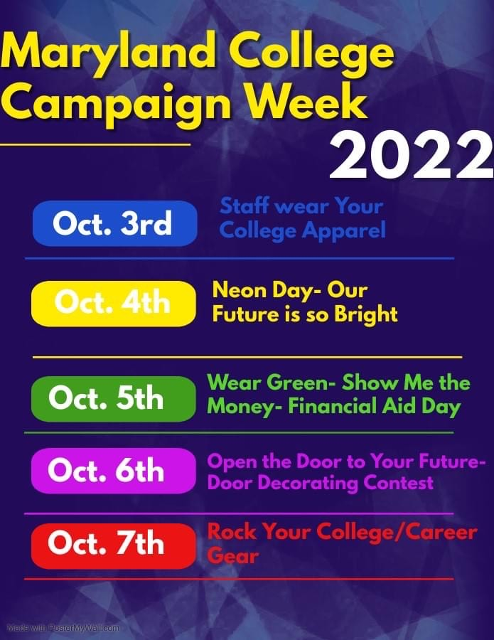
Maryland Application Spirit Week

Slide 3
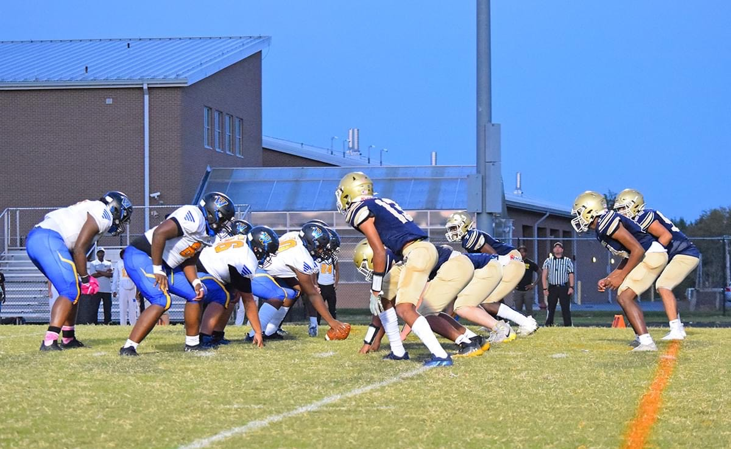
Varsity Football vs. WiHi

Slide 4
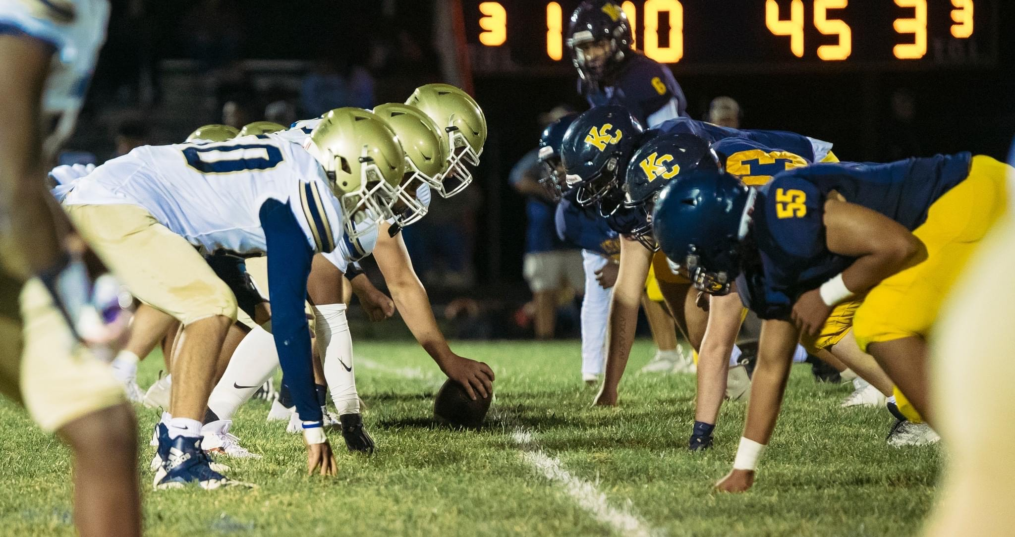
Varsity Football vs. Kent County

Slide 5
Varsity Soccer Boys
VS.
Easton & Queen Annes
OTHER GAMES

Slide 6
JV Football Vs. WiHi

Slide 7
Varsity Soccer Girls Vs. Kent County

Slide 8
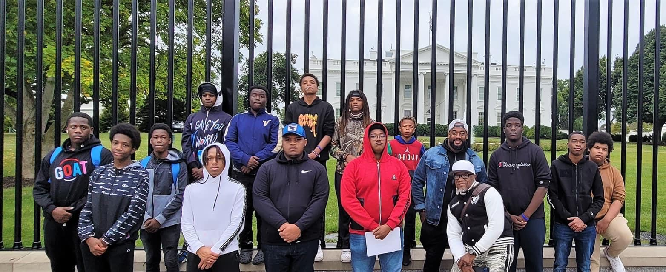
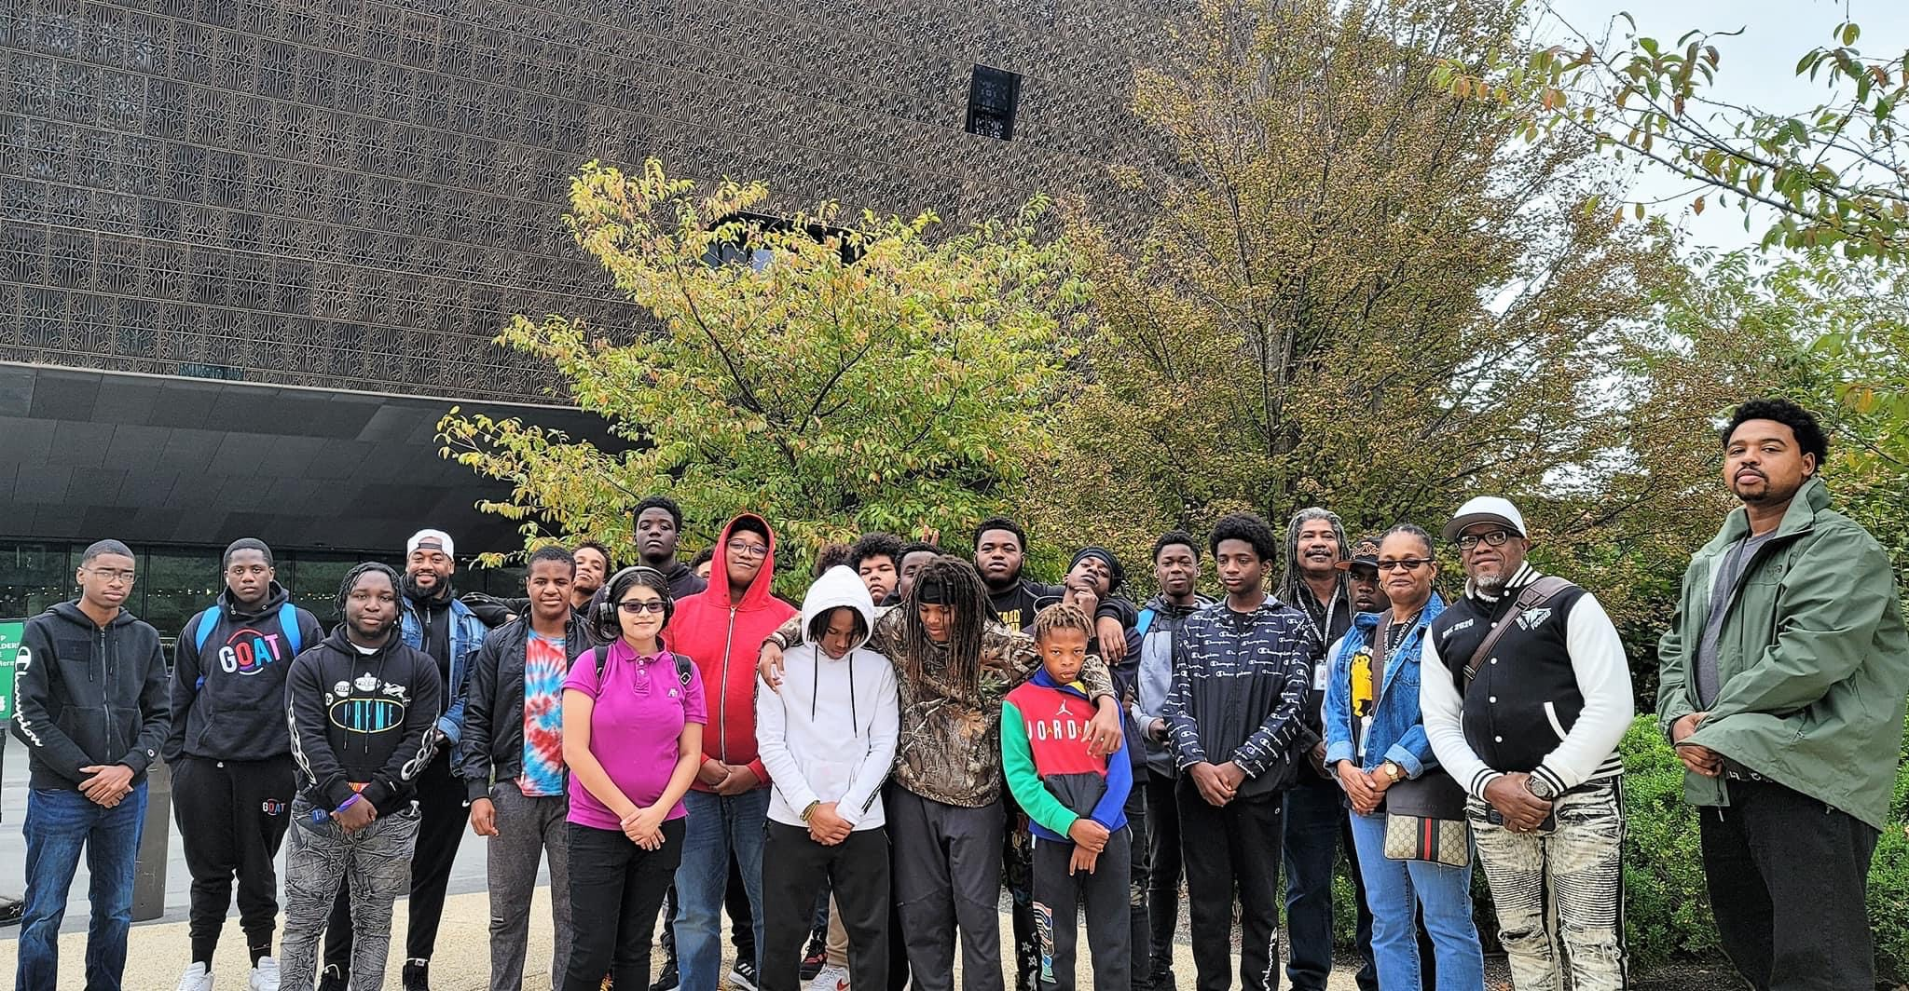
Gentlemen’s Club Goes To
National African American Museum

Slide 9
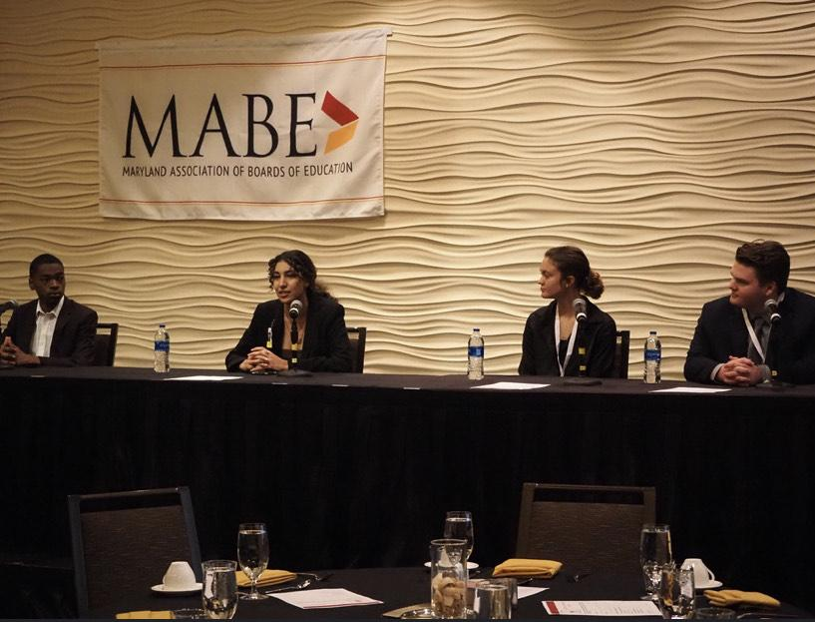
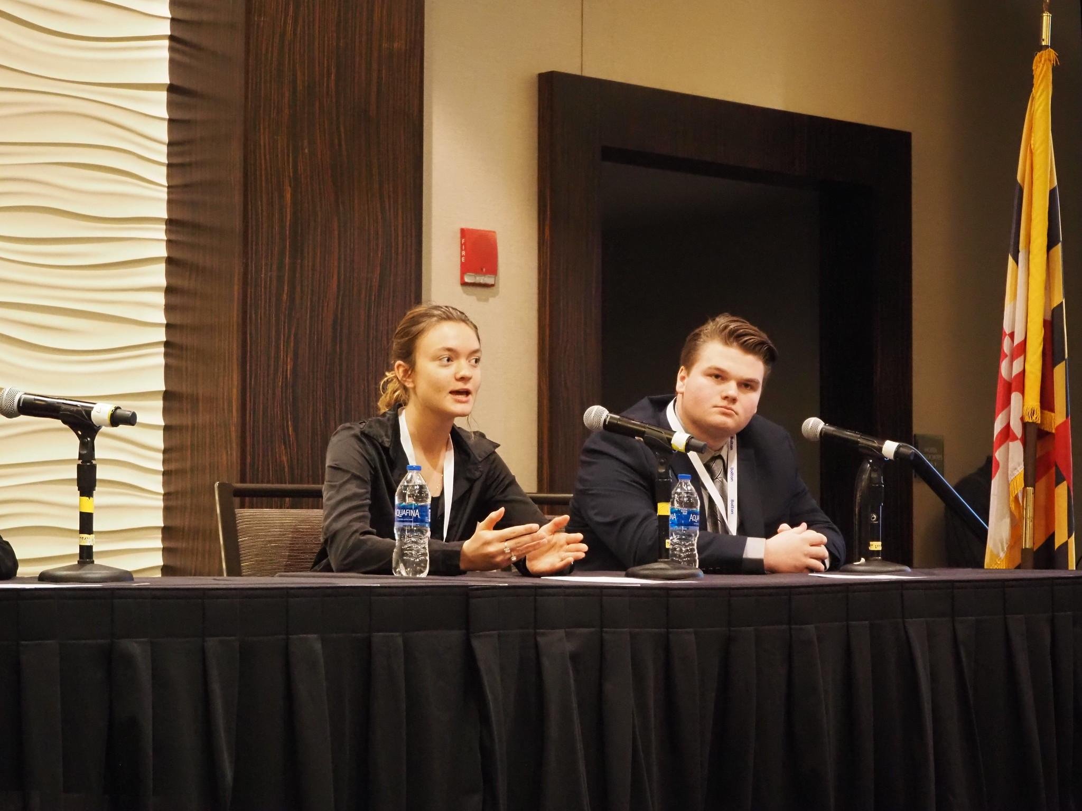
Student Board Representatives Attend The Annual MABE Conference 2022

Slide 10
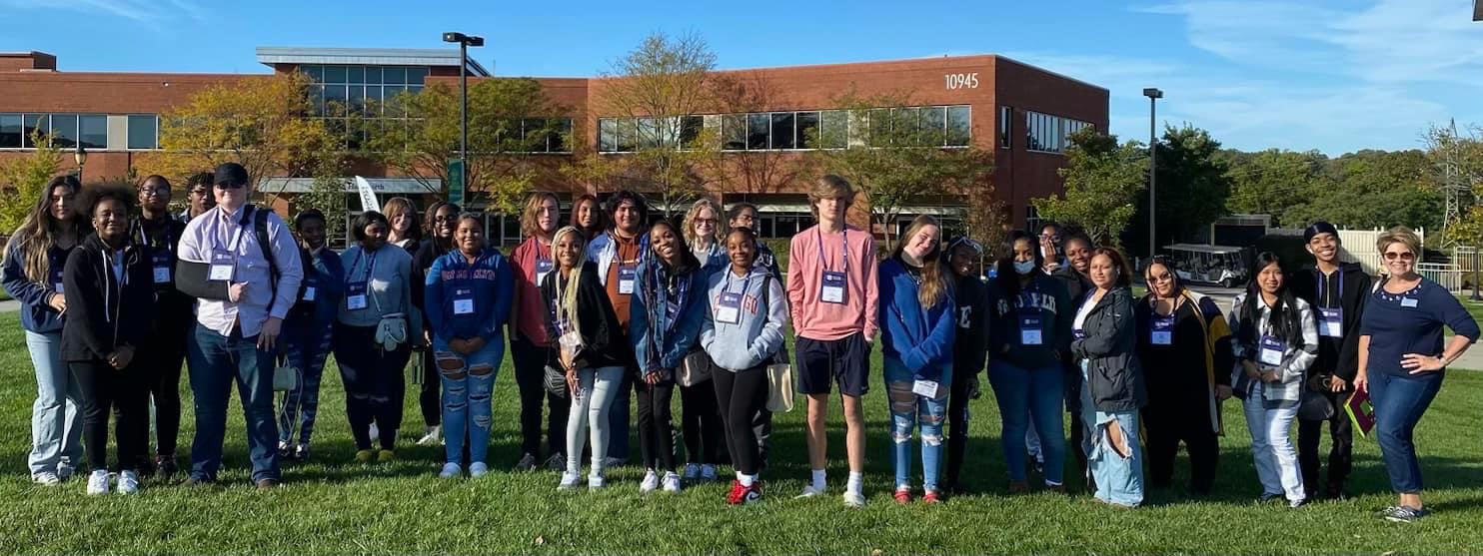
Stevenson University Trip

Slide 11
