Slide 1
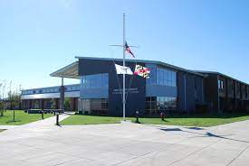
DCTC
October 2022
Katelyn Masden, DCTC student Board of Education Representative

Slide 2
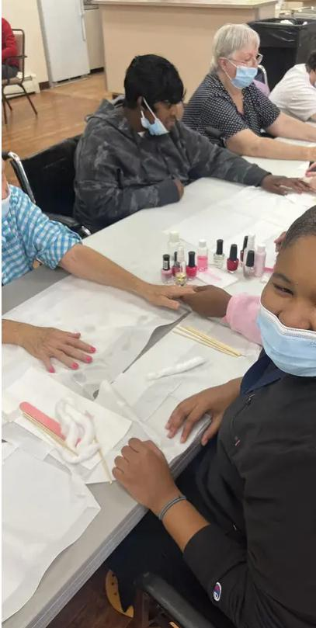
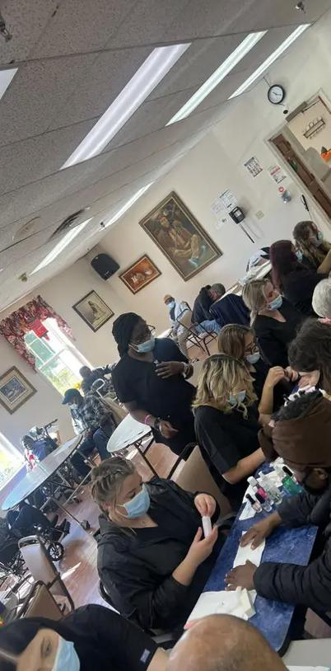
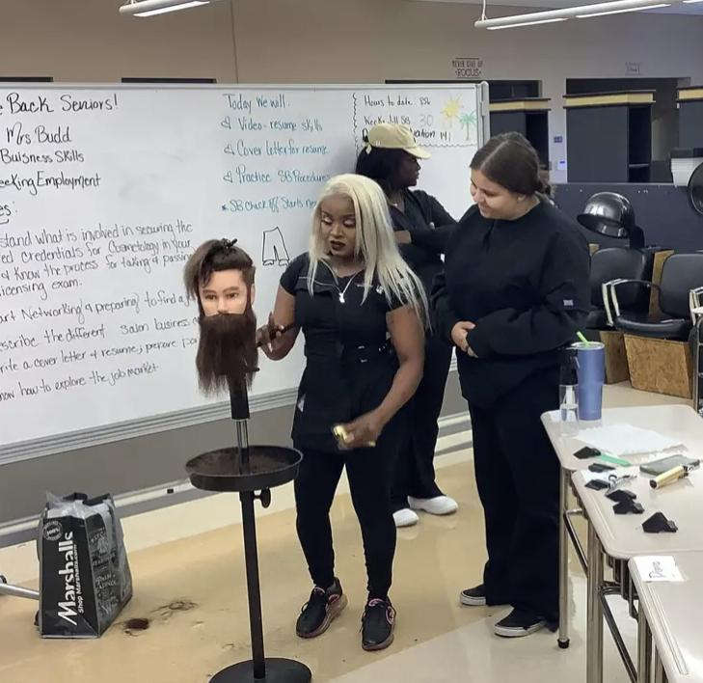
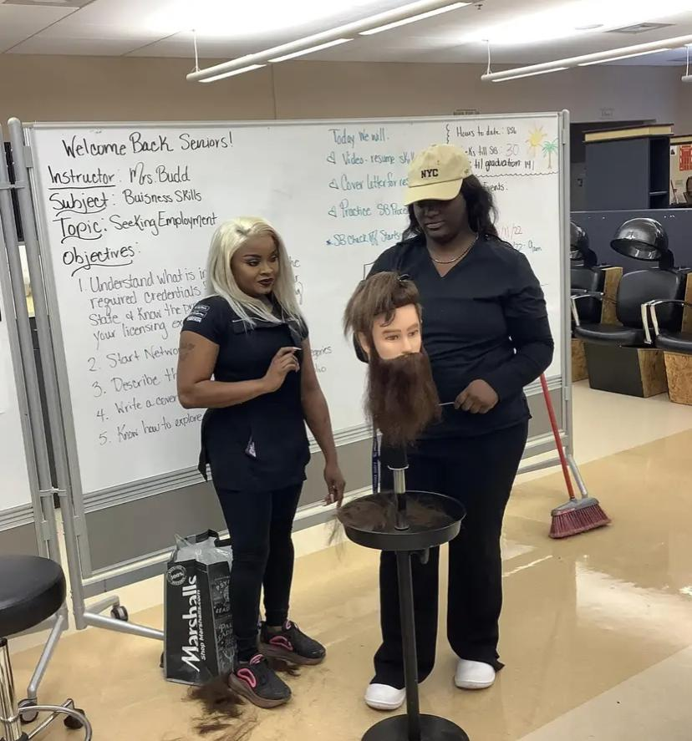
Cosmetology
Ms. Budd and Ms. Ewing's classes had the opportunity to hear from Sports Clips professionals from both Cambridge and Easton locations when they paid a visit to their classrooms. Students learned about income potential, the application process and the educational opportunities provided by the franchise.
Cosmetology students in Ms. Ewing's class visited Pleasant Day and performed mini-manicures for clients. It was a great opportunity for students to serve their
community and get practice in their field.

Slide 3
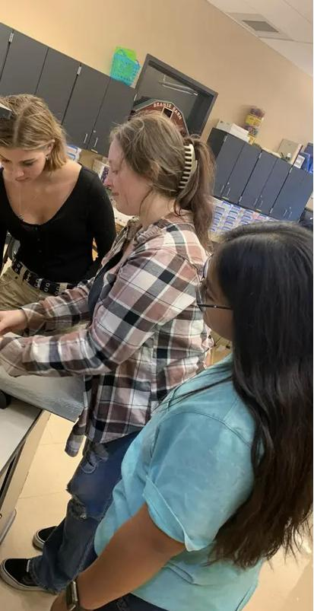
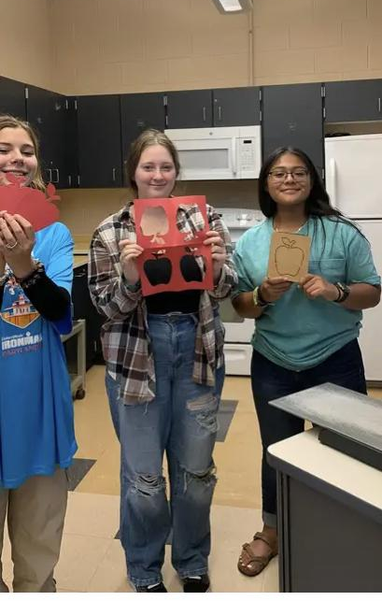
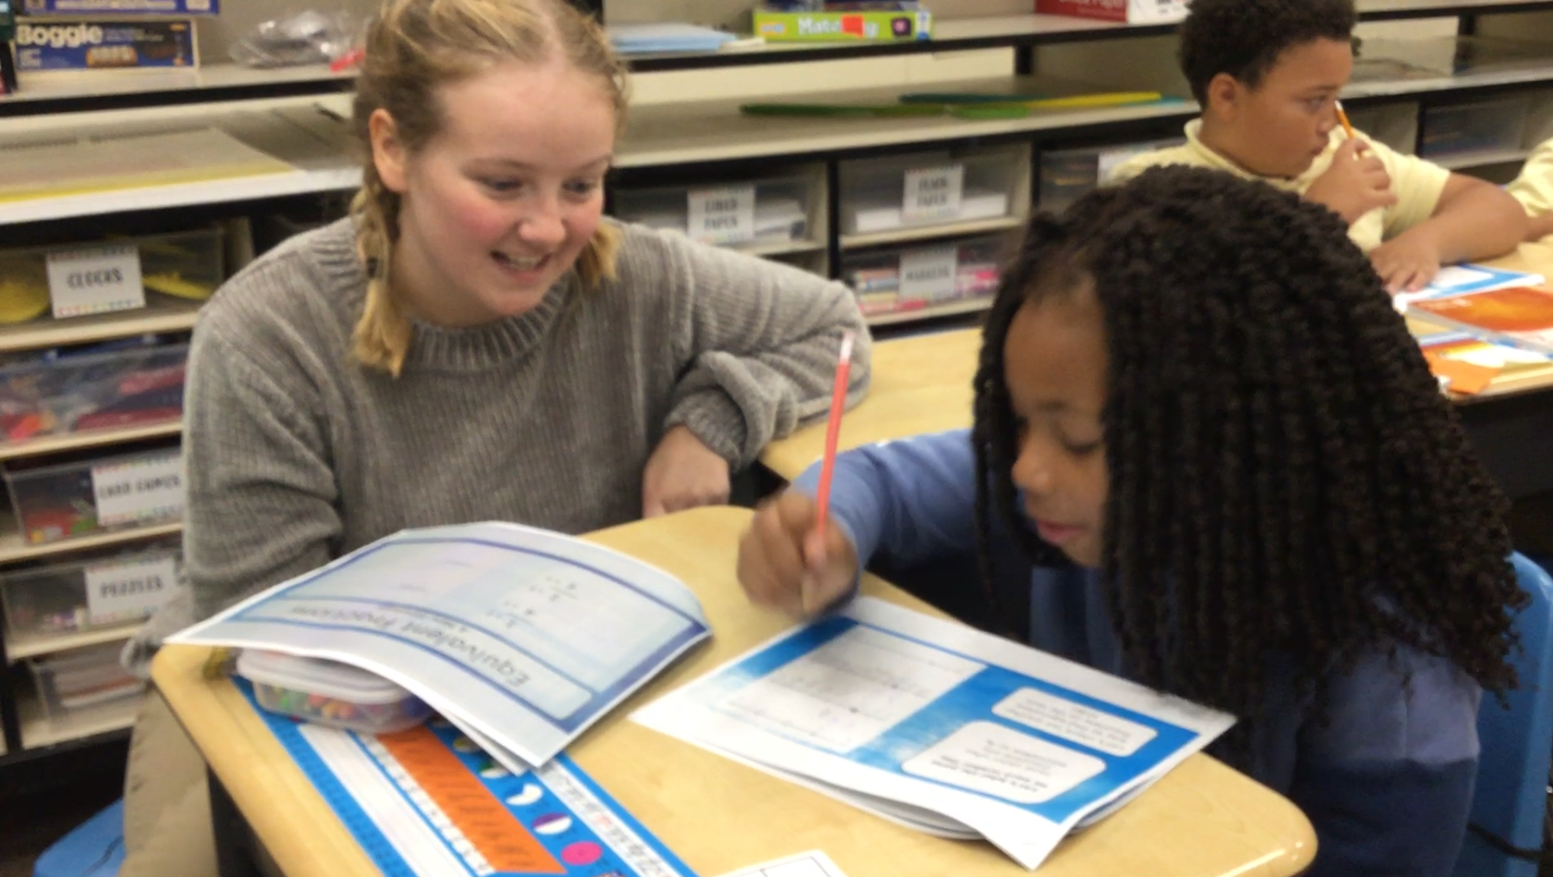
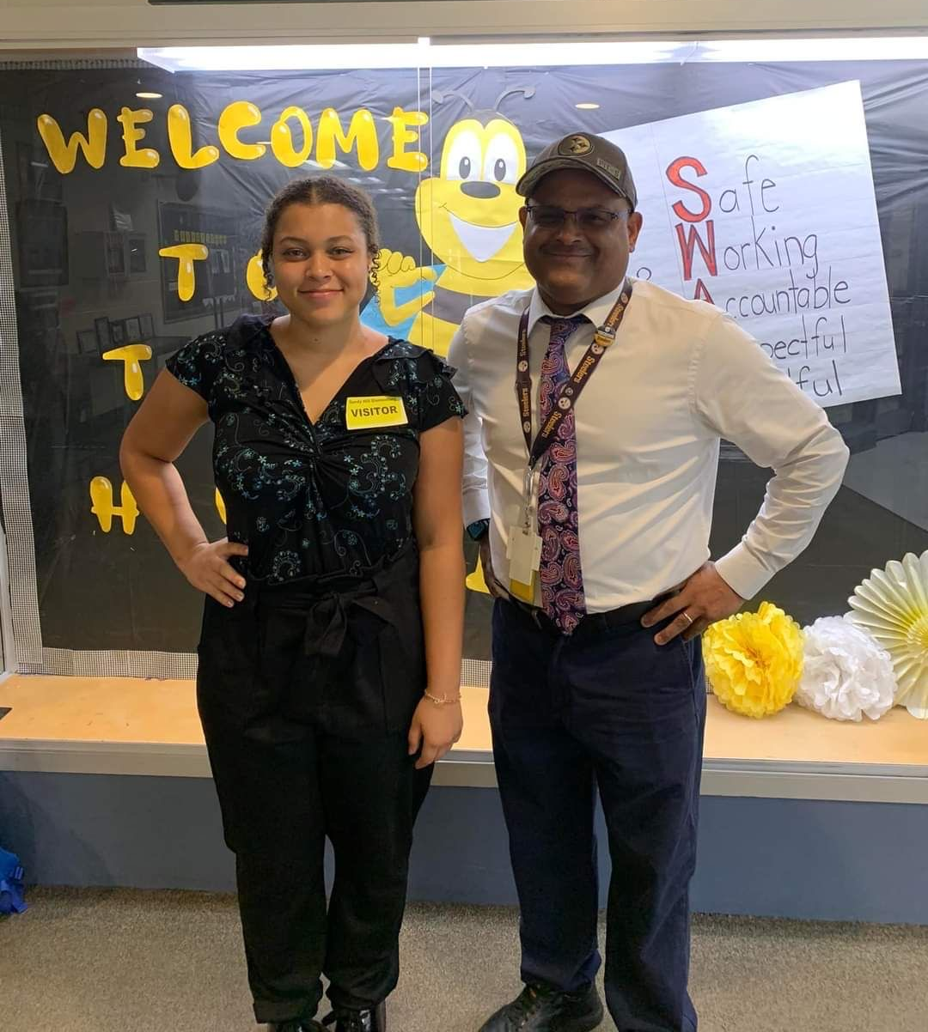
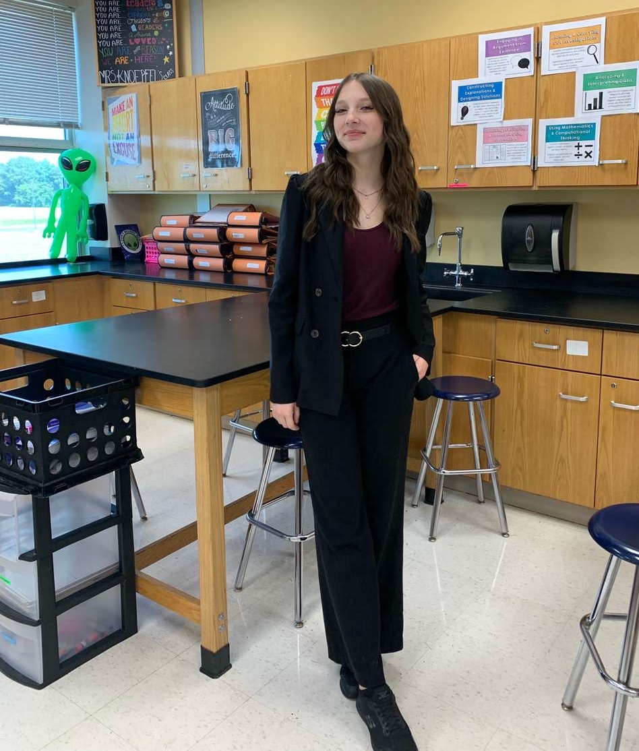
Teacher Academy
Junior students in Teacher Academy of Maryland learned how to use the Ellison machine.
Seniors first day in their internships

Slide 4
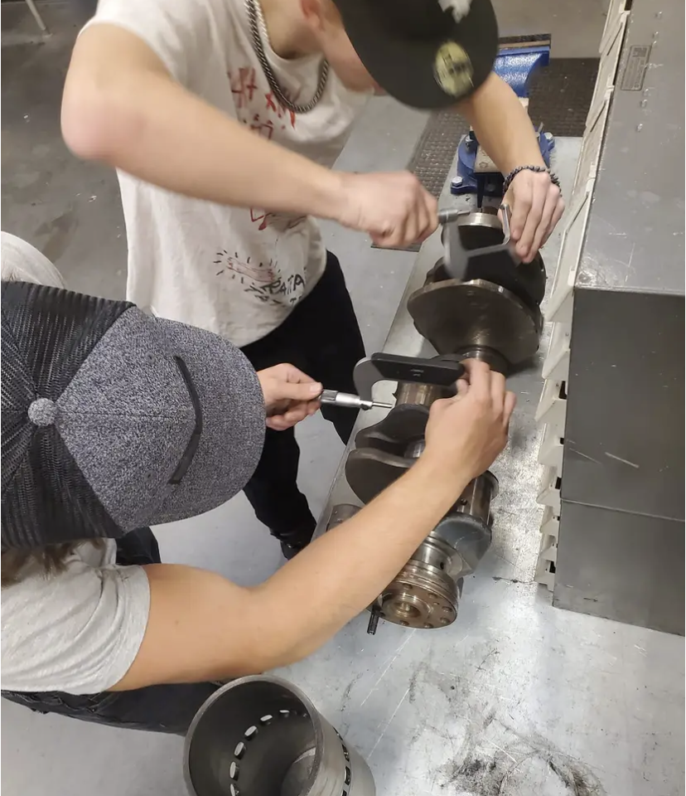
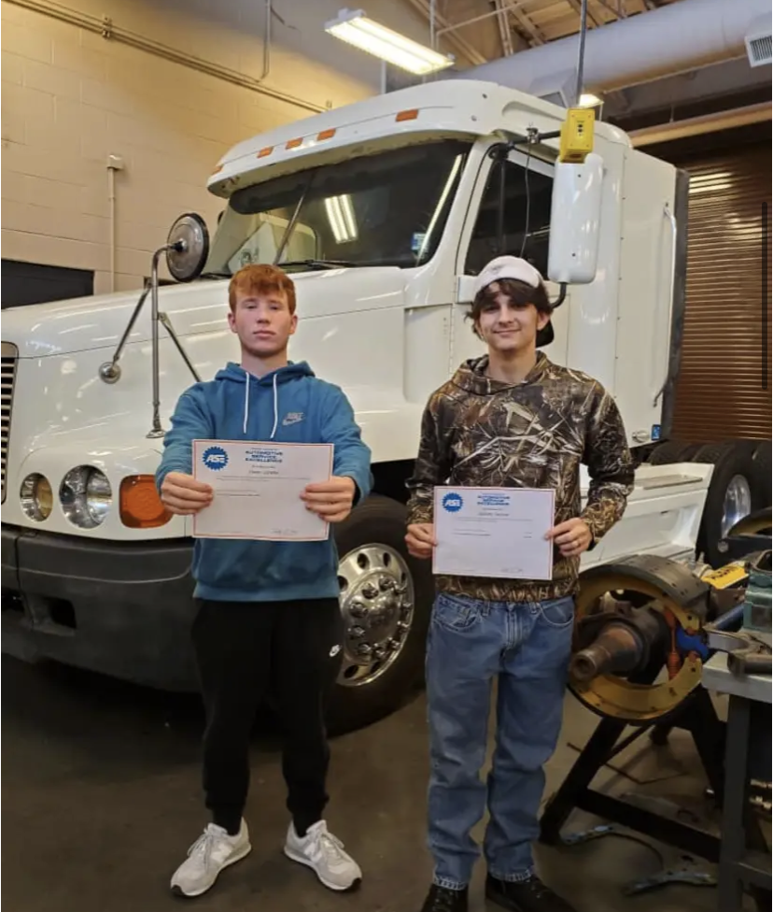
Medium / Heavy Trucks
Owen Jorette and Landon Abey are now ASE Certified in inspection Maintenance and Minor Repair.
Students seen using outside micrometers to measure a crankshaft
Owen Jorette and Zach Sacona passed the ASE certification test for Diesel Engines

Slide 5
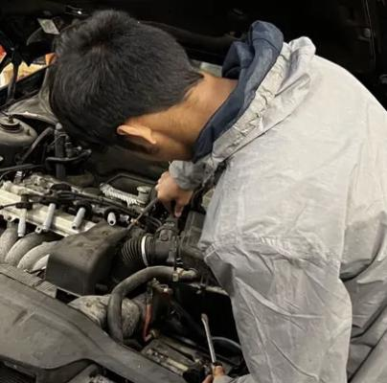
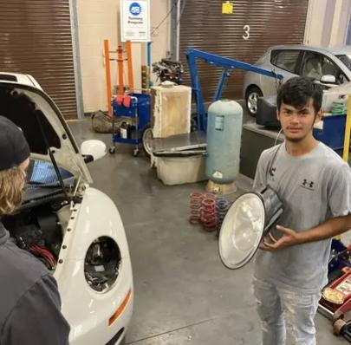
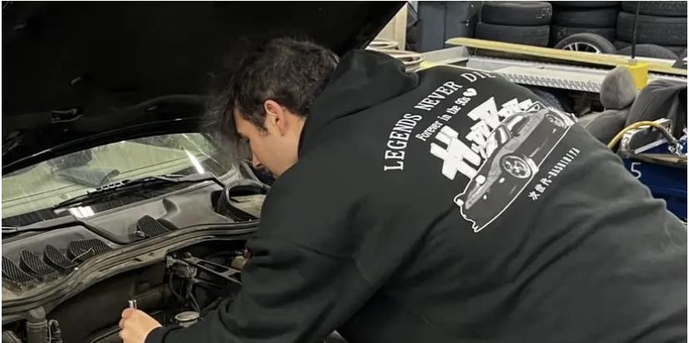
Auto tech
Three automotive students passed 2 of their ASE Certification exams under the tutelage of Mr. Perry.
Left to right are Brooks McDuffie (CSD, NHS President),Gavin Whitman (ND), and Tyler Tyson (CSD).

Slide 6
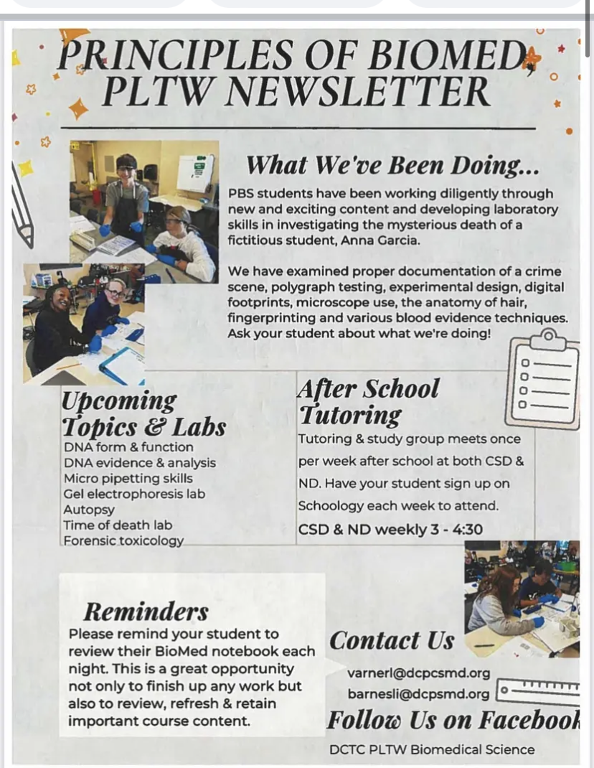
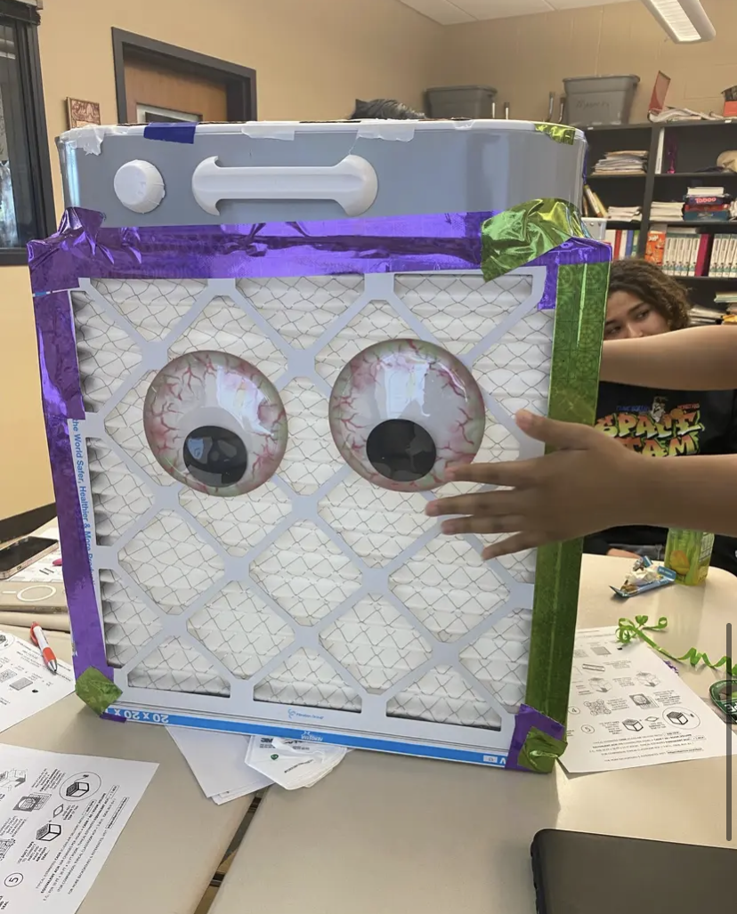
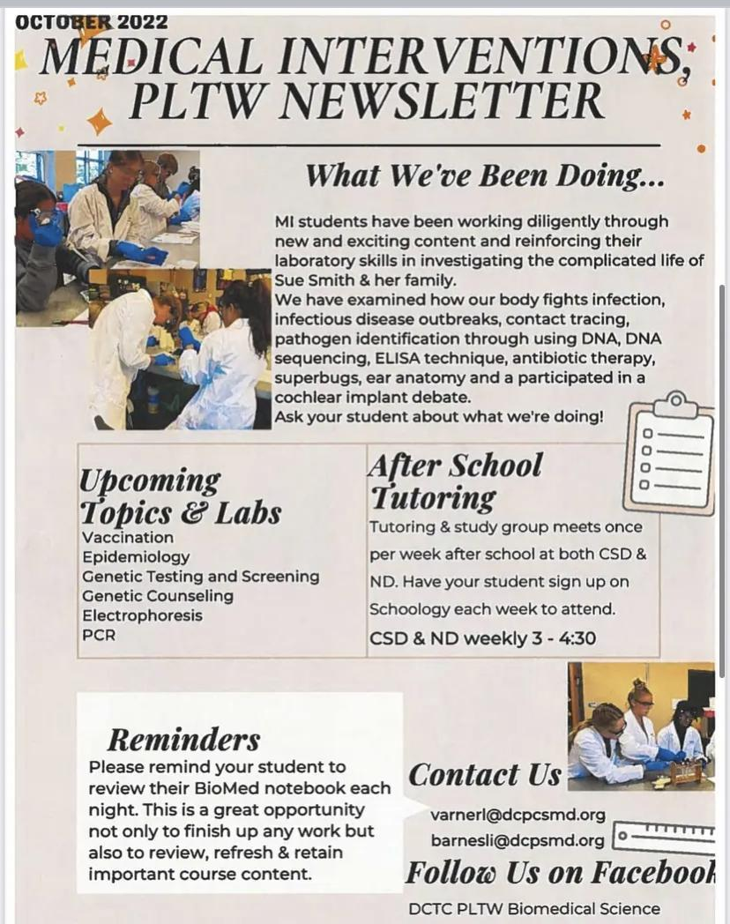
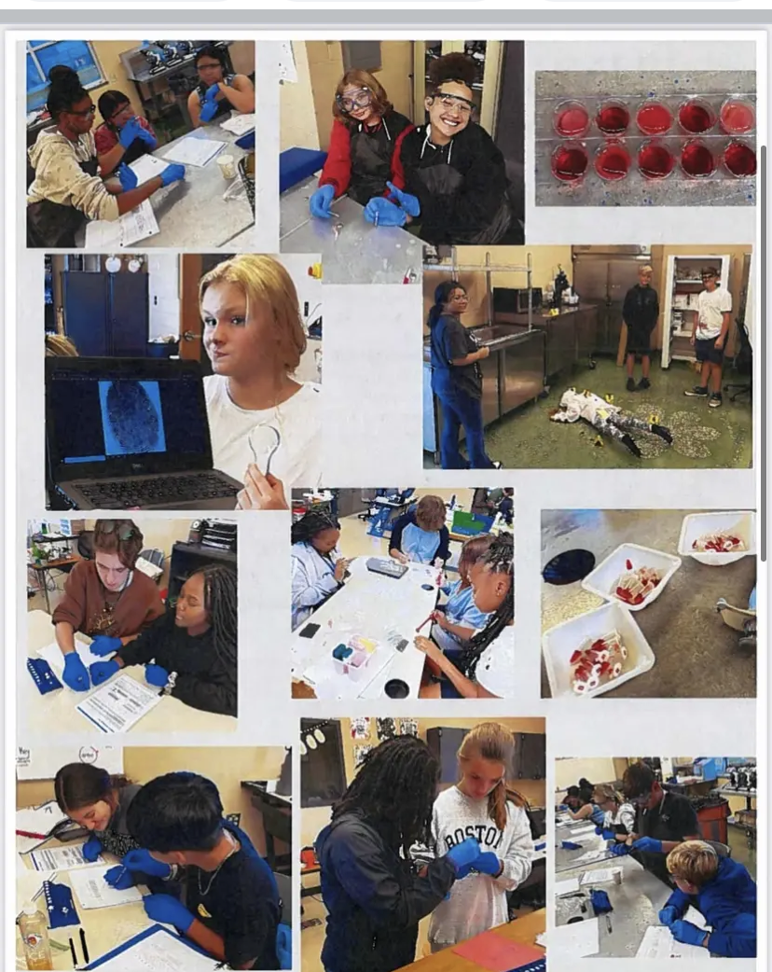
PLTW - Biomed
Check out the October DCTC PLTW Biomedical Science
Newsletters.
Medical Services and Homeland Security students designed their own Corsi Cubes, a do-it-yourself air purifier that can aid in reducing airborne viral particles like COVID-19 and Flu in homes, schools, and offices.

Slide 7
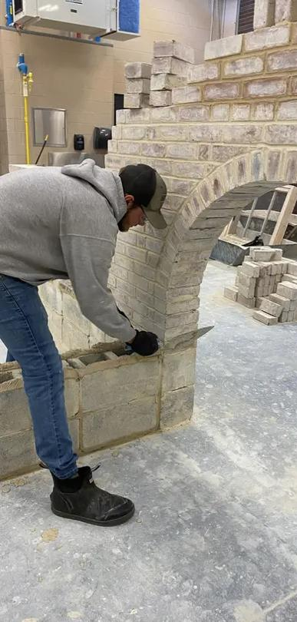
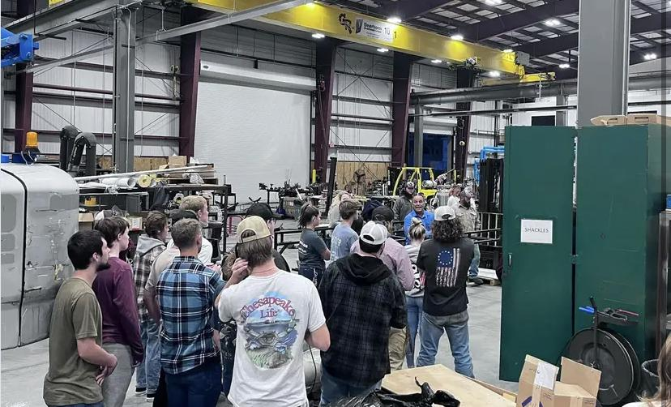
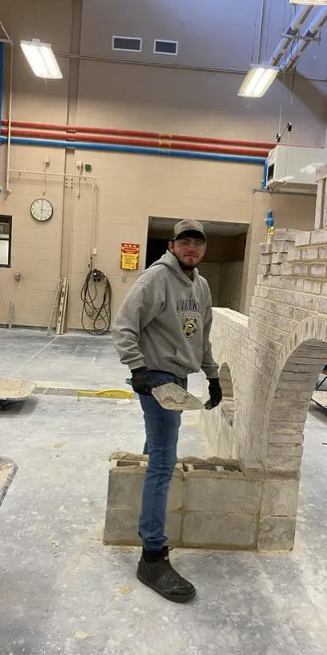
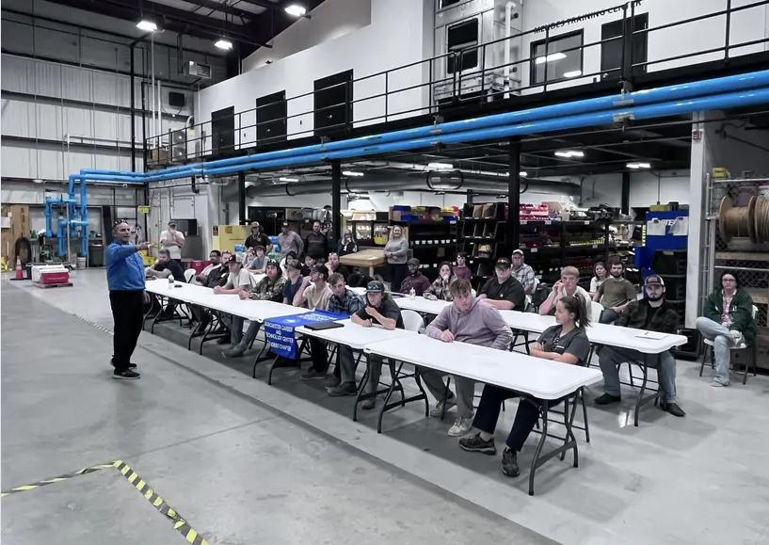
Welding and Masonry
The American Welding Society Student Chapter of the Dorchester Career & Technology Center ventured over to Delmar, Delaware this evening to the General Refrigeration Company for a tour, meeting, and dinner.
Check out Colby Phillips working on a masonry arch. Thanks so much Mr. Bailey!

Slide 8
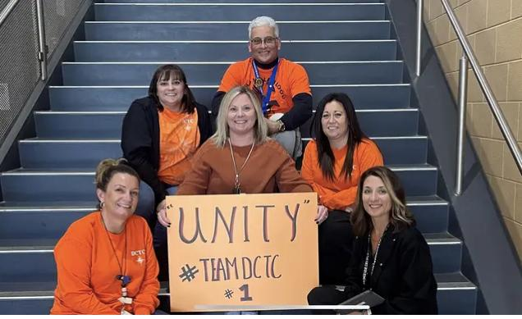
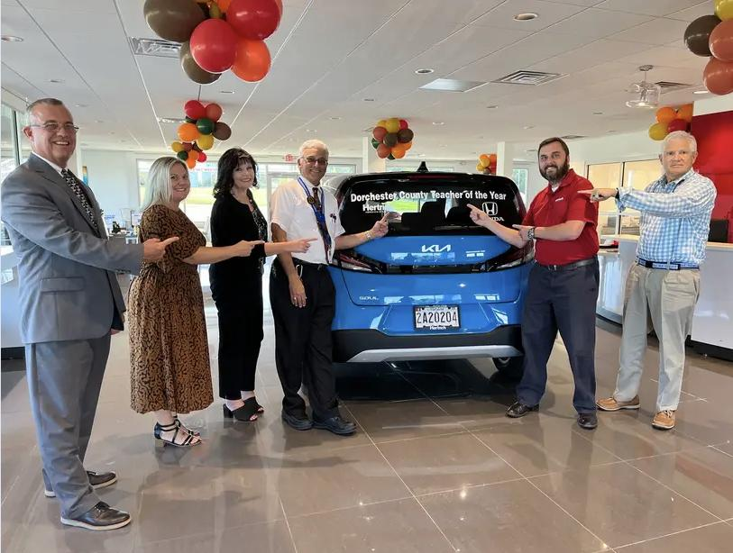
Staff Shout Outs
DCTC Staff is against Bullying!!!
Celebrating our Dorchester County Public Schools Teacher of the Year Phil Albert! He picked up his new vehicle, accompanied by Superintendent of Schools Dave Bromwell.

Slide 9
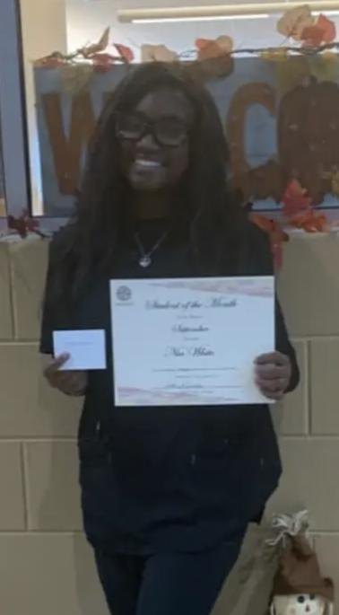
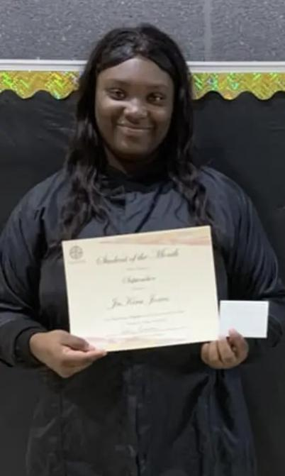
Students of the month
Nia White for being selected as DCTC's Students of the Month for
September.
Ja'Kira Jones selected as DCTC's Students of the Month for September.
Thank you for demonstrating integrity this month!

Slide 10
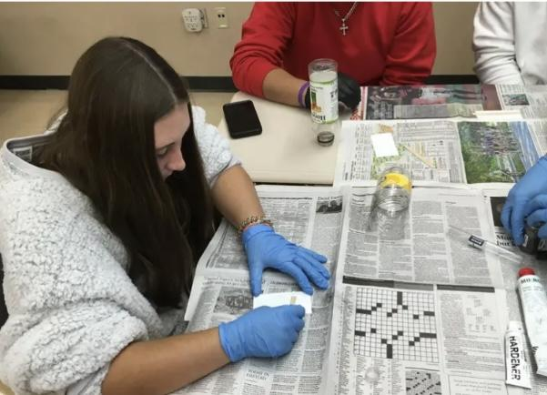
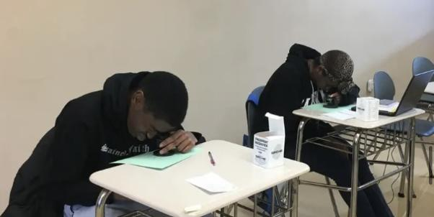
Homeland Security
In Homeland Security and Emergency Preparedness, students worked this week to analyze fingerprints to identify them as an arch, loop or whorl. They then identified minutiae points, which are what makes each print unique to a person.
Students are seen removing prints from objects. They began by applying Mikrosil to a bottle with an uneven surface

