Slide 1
North
Dorchester
High School

Slide 2
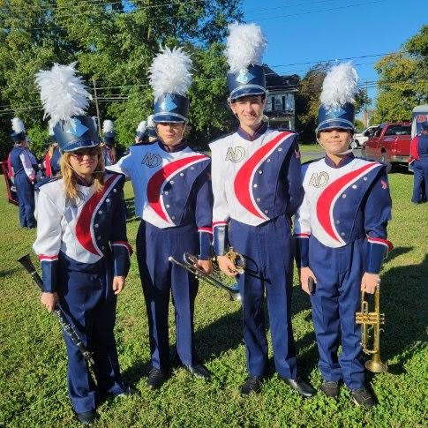
Current Events 1
(9/17)
NDHS students and staff volunteered with the IRONMAN
Triathlon.
(9/17)
NDHS Band marched in the Sharptown Parade.
(9/19 and 9/21)
Christopher Newport University and McDaniel College visit NDHS.
(9/28)
NDHS 1st quarter interim Parent-Teacher Conferences.
(10/3)
First issue of “Bubba’s Bulletin”,
our NDHS newspaper.

Slide 3
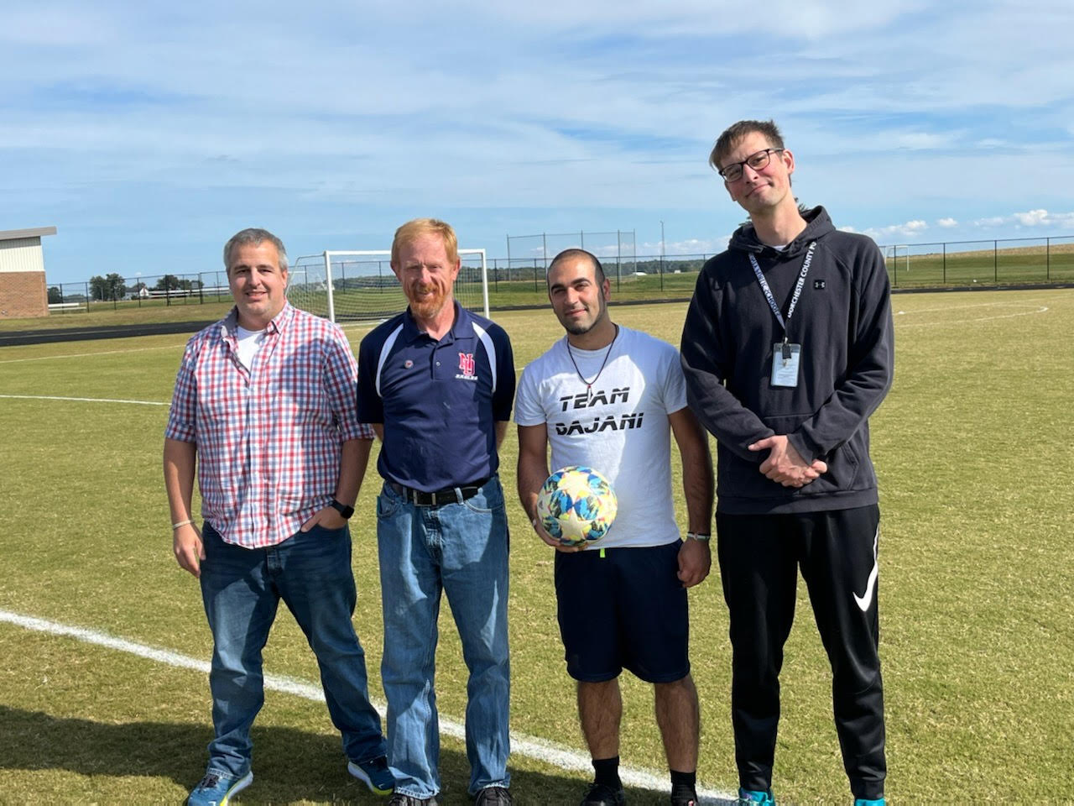
Current Events 2
(10/8)
NDHS Cheer and Band participated in the Hurlock Fallfest parade.
(10/10)
NDHS class of 62’ visit and donate a plaque.
(10/10 – 10/14)
NDHS Fall spirit week.
M- Neon Day
T- Country vs Country Club
W- Class Colors
Th- Senior Citizen
F- Decades Day
(10/12)
Fall Pep Rally honoring NDHS Fall Sports.
(10/14)
NDHS Homecoming Dance, with Nasir Polk and Milan Jiggetts crowned king and queen

Slide 4
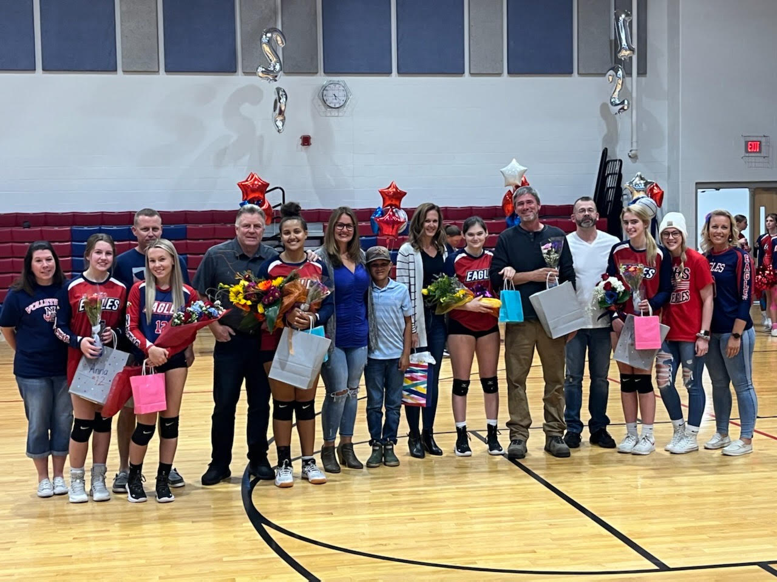
Golf
Bayside Championships held at the Hyatt Regency on 10/10.
Athletics
Volleyball
Still undefeated, 12-0 and ranked number 1 in the region!
Playoffs
All sports begin playoffs/regionals
Boys Soccer
Ranked number 2 in the region going into playoffs.
Cross Country
Team ranked number 2 in the region.

Slide 5
Shoutouts
Staff
9/21- Staff Professional Development Day
9/28, Some staff attended Special Education Law Seminar
Dr. Sabedra, selected for NFHS Athletic National Book Study Workshop
John Prekrel, New Envirothon Sponsor
Tabita Enciu, New Mu Alpha Theta Sponsor

Slide 6
Shoutouts
Students
9/29, students begin auditioning for Fall Play Artifice!
10/14, the whole school participated in the Evacuation Drill to Shiloh Camp
10/19- Student Make-Up picture Day
Avlynn Bennet, New Yearbook Editor

Slide 7
PBIS
(10/7)
FallFest event in which 427 students were eligible!
(9/28)
PBIS Staff and Coaches Met

Slide 8
AVID
AVID 10th grade students recently prepared for and took the PSAT during school.
NDHS AVID is preparing for a tour of University of Maryland College Park on Nov 10
All AVID students are using physical 3-inch binders this year for organization.

Slide 9
Senior Officer’s are meeting weekly to plan for Senior Year events (Ms. Benner)
9/29 - Money for College Night Seminar!
10/7- Senior Make-Up Portrait
10/17 - 10/21- College Application Week (Salisbury, Swarthmore, Chesapeake College, Stevenson)
10/17- College Spirit Week celebration!
Seniors

Slide 10
Upcoming Events
Quarter 1 ends and Quarter 2 begins on 11/1
NDHS Cheer has their Navy Game performance on 10/22
Nov 17th and 18th NDHS Fall play

Slide 11
Thank you
From
North Dorchester

