Slide 1
Differences between Y-Survey and CAN Survey (related to relocation of YMCA to Cambridge Harbor) *Note that full data sets of result details are available upon request.
References:
Advantages and Disadvantages of Open-Ended and Close-Ended Questions (monkeylearn.com)
https://measuringu.com/three-points/
https://drive.google.com/file/d/1hHzK_WwGmx0TFiiNMRRPd_qfaEAfG6Xv/view

Slide 2
Survey Comparison - High Level Take Aways
Both surveys were done by experienced professionals
The purpose of each survey was very different.
The sample sizes were statistically similar in both surveys.
Both surveys sampled from Dorchester County area.
Y-survey did not include Y members.
CAN survey did include Y members.
3-point Likert Scale in Y-Survey can:
• lead respondents
• result in less differentiation between groups
• provide less meaningful information
Open-ended responses in CAN Survey
• do not steer or bias responses
• provide more thorough opinions
• provide deeper more meaningful information

Slide 3
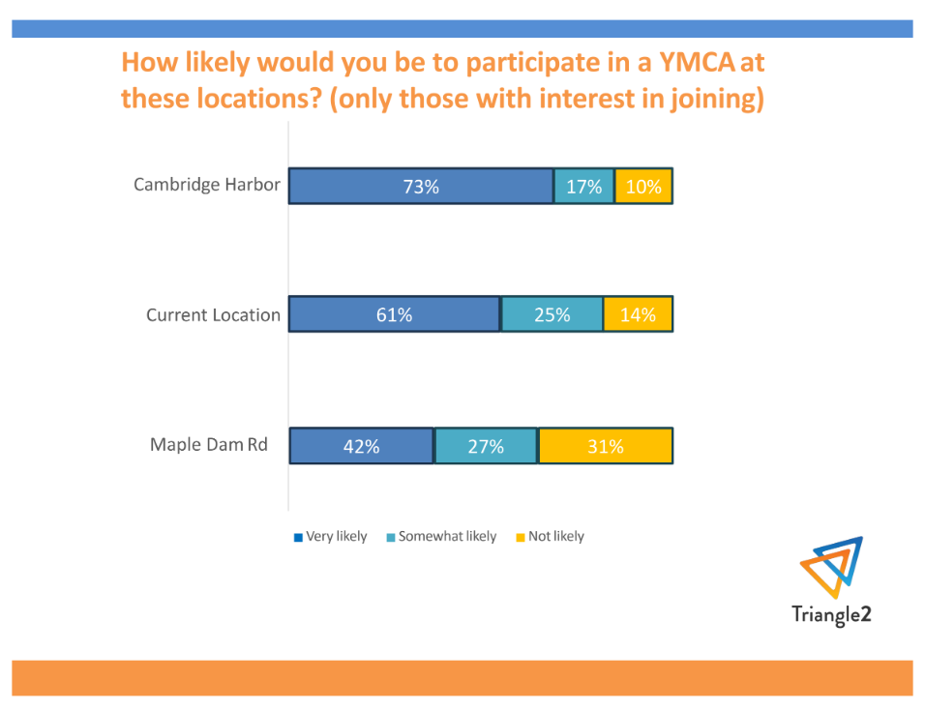
Y-Survey Relevant Question & Result
90% of potential new members would likely participate in a YMCA at Cambridge Harbor
86% (just 4% less) of potential new members would likely participate in a YMCA at the Current Location.
https://drive.google.com/file/d/1hHzK_WwGmx0TFiiNMRRPd_qfaEAfG6Xv/view

Slide 4
Survey High Level Take Aways
84% feel current Y location serves the community well (Q1)
71% of respondents perceived there is no benefit in moving the Y (Q2)
97% of respondents perceived drawbacks, i.e., lost tax revenue, opportunity cost, unfavorable location, other drawbacks. (Q3)
85% of respondents thought moving the Y is a bad idea overall (Q4)
15% of respondents were excited about the possibility of a new facility (Q2)
12% of respondents were excited about the new location (Q2)

Slide 5
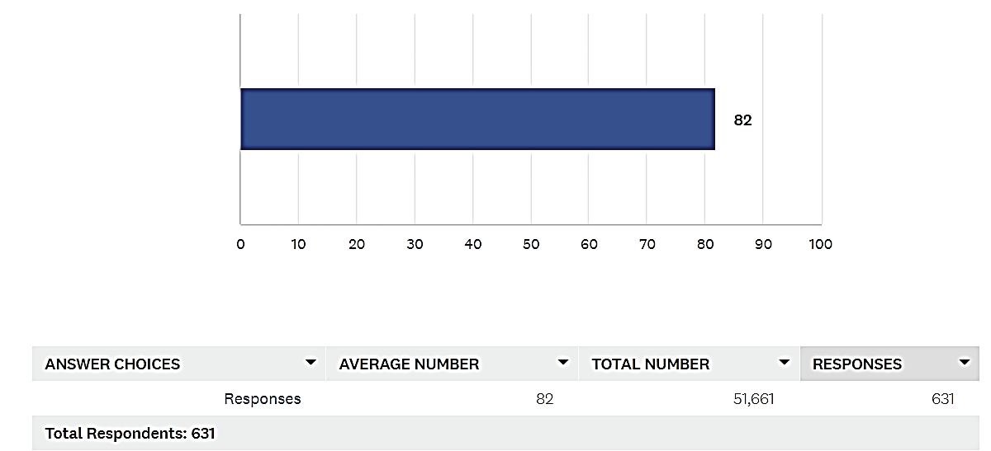
CAN Community Survey: Q1- I think the present location of the Y (201 Talbot Ave) serves the community well.
84% moved slider between 51-100 (well to very well range)
average

Slide 6
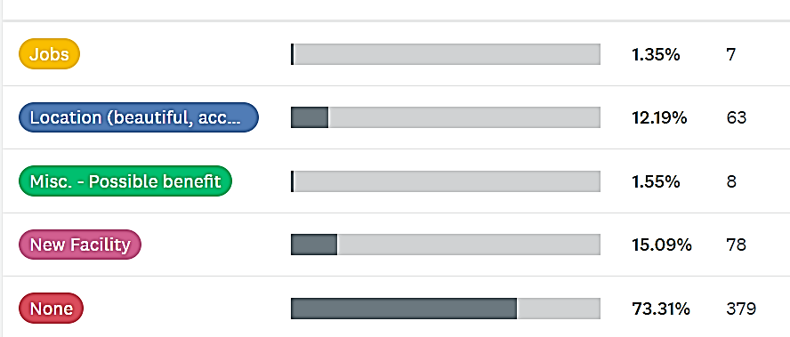
CAN Community Survey: Q2 - Please specify any perceived benefits in moving the Y to the CWDI Waterfront property.
1.3%
11.7%
1.5%
14.5%
71%
Display by Single Category

Slide 7
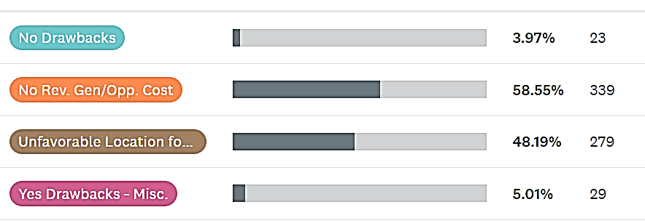
CAN Community Survey: Q3 - Please specify any perceived drawbacks in moving the Y to the CWDI Waterfront property.
3.4%
50.6%
41.7%
4.3%
Display by Single Category

Slide 8
Differences in Survey Purpose
Y Survey | Market Survey to potential new members The survey was sent to random non-Y members to see if they would be interested in joining a Y that had new programs not currently offered at the Dorchester Y.
CAN Survey | Community Feedback on potential Y Relocation The survey asked about the benefits & drawbacks of relocating the Y to Cambridge Harbor.

Slide 9
Sample Size, Reach and Sampling Method
Y Survey¹ | Sample Size: 814 phone interviews from Dorchester County Reach: unknown Sampling Method: Random Sample (excluded Y members)
CAN Survey | Sample Size: 636 self survey responses from Dorchester County Reach: ≈ 5000 (conservative estimate accounting for overlap) Facebook ≈ 3,500 members Next Door ≈ 5,000 CAN Website ≈ 1,000 WMDT website (https://www.wmdt.com/2024/05/can-launches-cambridge-waterfront-development-survey/) Sampling Method: All inclusive (included Y members & non-Y members)
¹https://drive.google.com/file/d/1hHzK_WwGmx0TFiiNMRRPd_qfaEAfG6Xv/view

Slide 10
Multiple Survey Responses by Individual Allowed?
Y Survey | Assuming No since phone interviews were done by professionals.
CAN Survey | No. Respondents' IP addresses are tracked to ensure that each person can only fill out the survey once. There were no duplicate IP addresses.

Slide 11
Differences in Survey Methods
Y Survey | One question regarding three Y-location sites was asked using a Closed-Ended question Survey Method called a Three-point Likert Scale. Other questions pertaining to member demand & activities of interest are not discussed here as these topics are irrelevant to relocation topic.
CAN Survey | One (1) Numerical Slider Scale Question Three (3) Open-Ended Questions

Slide 12
Survey Creation and Analysis
Y Survey | Paid professional group
CAN Survey | Unpaid expert in surveys, data management & analysis

Slide 13
Survey Method Advantages
Y Survey | Three-point Likert Scale Question gathers quantitative data for quick high-level view provides standard range of response
CAN Survey | Numerical Slider Scale (Q1) ability to gather more precise answers provides a quantifiable measure, ranging from 0 to 100, allowing respondents to rate their opinion numerically captures distinct qualitative information in a numerical way

Slide 14
Survey Method Advantages (Continued)
CAN Survey | Open Ended Questions (Q2- Q4) Expands range of data gathering w/ more thorough opinions & inputs from respondents, Compared to use of limited ‘yes/ no,’ multiple choice or Likert scale items only, there is no limit to what can be learned. New & unexpected insights can be gained allowing respondents to go into as much detail as needed to express their point of view. Offer deeper, qualitative data. While close-ended questions can yield quantifiable data expressed as numbers, percentages, etc., they do not go deeper. Open-ended questions offer deeper data that not only show trends but also provide meaningful information to inform decisions. Do not steer or bias responses: A limited & controlled number of response topics in Likert scale surveys denies the opportunity to express important preferences held by respondents, therefore restricting and biasing results. Give you sentiment & opinions. Open-ended questions allow one to understand ideas, feelings, emotions, and opinions of respondents. To understand the sentiment of survey responses, artificial intelligence tools, such as integrated text analysis, are used to search for similar words within all responses allowing for categorization for a final quantitative analysis.

Slide 15
Survey Method Disadvantages
Y Survey | One 3 Point Likert Scale Question Use of predefined topics may preclude acquisition of important information. Response options can ‘lead’ respondents. The reader can only respond in a predefined way. Respondents may misinterpret questions with no option to correctly provide desired input. Three-point scale: lacks nuance. unreliable, forces respondents to choose & introduces rounding error results in less differentiation between groups; cannot identify extreme attitudes 3-point scales contain less information. Communicate 2 pieces of information (neutrality & direction). 4-point scales communicate intensity of direction, but no neutral opinion. 5-point scales are better because they provide three pieces of information: direction (positive/negative), intensity of opinion, and a neutral point.
CAN Survey | One Numerical Slider Scale Question (Q#1 = 99% response rate, 631/636 respondents) If used as single question, can limit response & reduce clarity (not true in CAN survey as other questions were used) Three Open Ended Questions May take longer to answer, causing less responses. (Q1 81% response Q2 91% response Q4 50% response) Analysis takes longer to categorize responses for comparisons, conclusions and quantitative data presentation.

